Slide 1
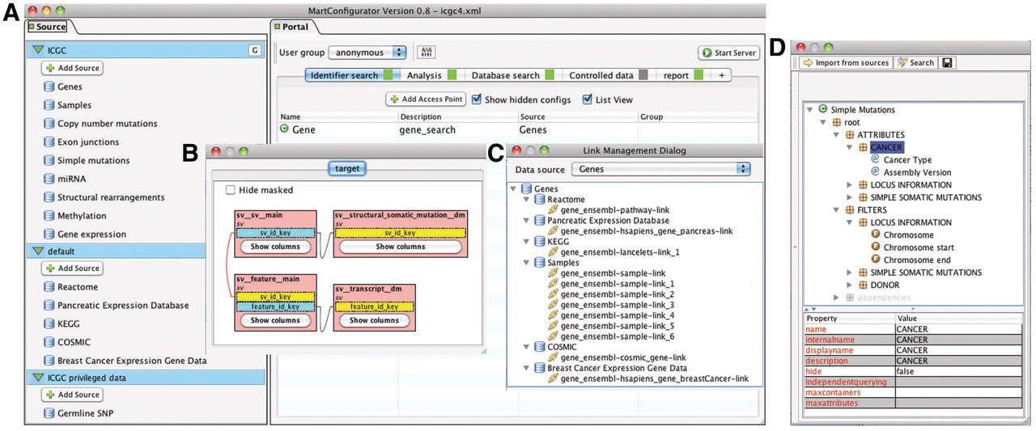
Figure 6. MartConfigurator. (A) The main MartConfigurator window is divided into two panels. Data sources are listed on ...
Notes:
Figure 6. MartConfigurator. (A) The main MartConfigurator window is divided into two panels. Data sources are listed on the left. Data portal access points are listed on the right and are organized by types. (B) The Schema Editor window, showing the reverse star schema of a data set. (C) The Link Management window, showing the data links between data sources. (D) The Access Point Editor window, showing attributes and filters organized in containers.
Unless provided in the caption above, the following copyright applies to the content of this slide: © The Author(s) 2011. Published by Oxford University Press.This is Open Access article distributed under the terms of the Creative Commons Attribution Non-Commercial License (http://creativecommons.org/licenses/by-nc/2.5), which permits unrestricted non-commercial use, distribution, and reproduction in any medium, provided the original work is properly cited.

