Slide 1
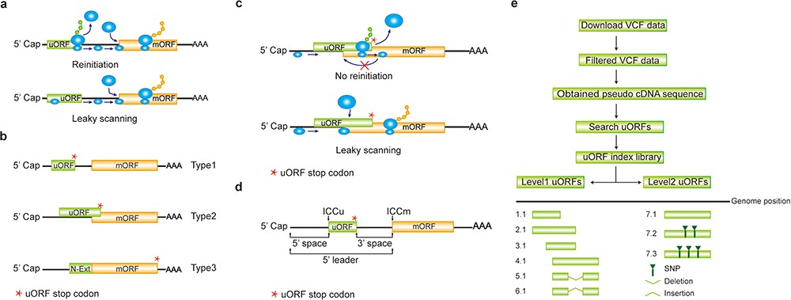
Figure 1 Computation of uORF variation. (a) Reinitiation and leaky scanning models. In the reinitiation model, the 80S ...
Notes:
Figure 1 Computation of uORF variation. (a) Reinitiation and leaky scanning models. In the reinitiation model, the 80S ribosomal subunit will separate after translating the uORF and the 40S subunit remains associated with mRNA, regaining fresh eIF2 ternary complex and other unknown reinitiation factors to translate the mORF. In the leaky scanning model, the uORF initiation codon is bypassed by the scanning complex, which will ignore the uORF and translate the mORF. (b) uORF types. uORFs are divided into Types1–3 with respect to the position of uORF stop codon relative to the mORF. N-Ext, N extension. (c) Type2 uORF-controlled mORF translation is only favored by leaky scanning. Overlap between the Type2 uORF and mORF makes reinitiation of the mORF impossible after translation of uORF. (d) uORF positional information on cDNA. The mORF is flanked by the 5′ leader and 3’ UTR (3′ untranslated region). 5′ and 3′ space are used to describe the distance from Cap to uORF AUG and from uORF stop codon to mORF AUG, respectively. The sequence from −3 to +4 relative to the AUG initiation codon (A as +1) corresponding to the Kozak consensus (A/GCCAUGG) position is termed as initiation codon context (ICC) with ICCu and ICCm for uORF and mORF, respectively. (e) Workflow to identify uORF variants. VCF files are downloaded from public databases and filtered as described in the Method. Pseudo cDNA sequences are generated by replacing all the splicing models with filtered variants. After uORFs identification, their relative positions on the pseudo cDNAs are transferred into absolute positions in the reference genome to create an index library. uORFs are pairwise compared and those uORFs with the same genomic positions and sequences are assigned the same index number to indicate no uORF changes. Otherwise, two leveled uORF identifiers (Level1.Level2) are used to describe the variation. Level1 indicates major differences that cause uORF creation, loss or length changes due to SNPs or INDELs (insertion and deletion). Level2 indicates minor differences that lead to nucleotide and/or amino acid substitution due to SNPs. Continuous index numbers starting with number 1.1 are assigned in the prioritized orders of uORF ATG occurrence in the reference genome, uORF length (shorter), deletion and insertion at Level1, and of SNP number (fewer) at Level2.
Unless provided in the caption above, the following copyright applies to the content of this slide: © The Author(s) 2020. Published by Oxford University Press.This is an Open Access article distributed under the terms of the Creative Commons Attribution License (http://creativecommons.org/licenses/by/4.0/), which permits unrestricted reuse, distribution, and reproduction in any medium, provided the original work is properly cited.

