Slide 1
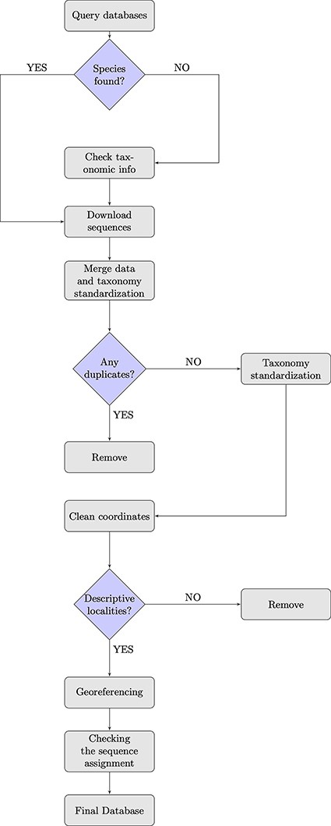
Figure 1. Flowchart showing the database building process.
Notes:
Figure 1. Flowchart showing the database building process.
Unless provided in the caption above, the following copyright applies to the content of this slide: © The Author(s) 2024. Published by Oxford University Press.This is an Open Access article distributed under the terms of the Creative Commons Attribution License (https://creativecommons.org/licenses/by/4.0/), which permits unrestricted reuse, distribution, and reproduction in any medium, provided the original work is properly cited.

Slide 2
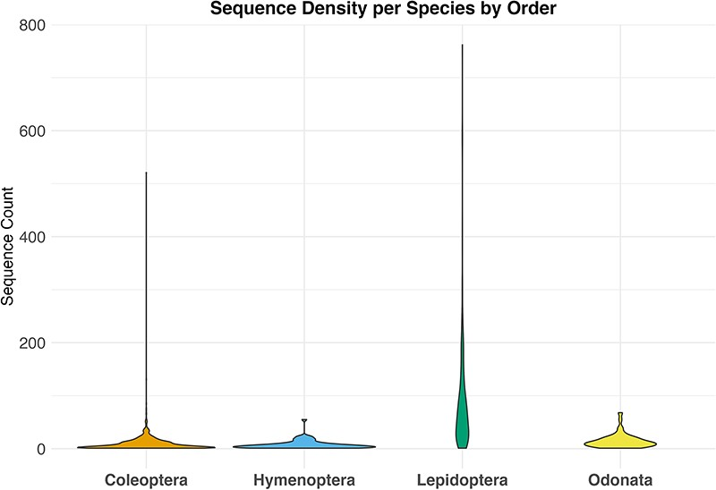
Figure 2. Violin plot showing the distribution of sequence counts per species across different orders, Where the y-axis ...
Notes:
Figure 2. Violin plot showing the distribution of sequence counts per species across different orders, Where the y-axis indicates the number of sequences for each species in the dataset and the x-axis the examined taxa.
Unless provided in the caption above, the following copyright applies to the content of this slide: © The Author(s) 2024. Published by Oxford University Press.This is an Open Access article distributed under the terms of the Creative Commons Attribution License (https://creativecommons.org/licenses/by/4.0/), which permits unrestricted reuse, distribution, and reproduction in any medium, provided the original work is properly cited.

Slide 3
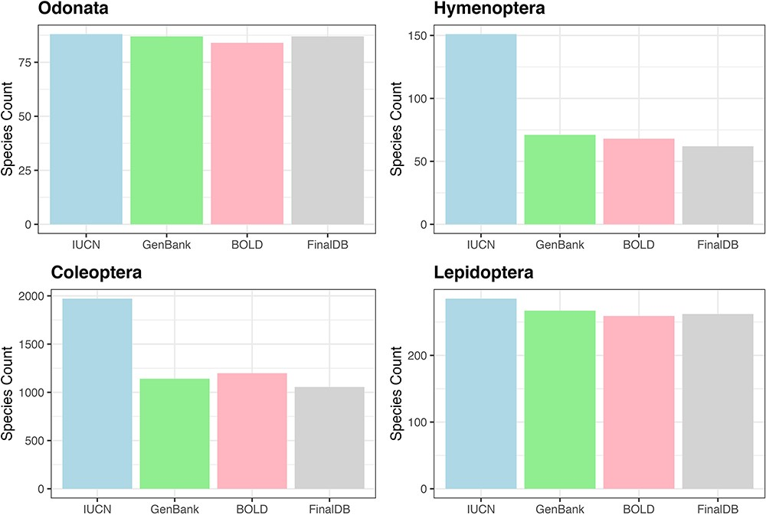
Figure 3. Bar plot showing retrieved species numbers from online databases compared with IUCN Red Lists for the ...
Notes:
Figure 3. Bar plot showing retrieved species numbers from online databases compared with IUCN Red Lists for the examined taxa.
Unless provided in the caption above, the following copyright applies to the content of this slide: © The Author(s) 2024. Published by Oxford University Press.This is an Open Access article distributed under the terms of the Creative Commons Attribution License (https://creativecommons.org/licenses/by/4.0/), which permits unrestricted reuse, distribution, and reproduction in any medium, provided the original work is properly cited.

Slide 4
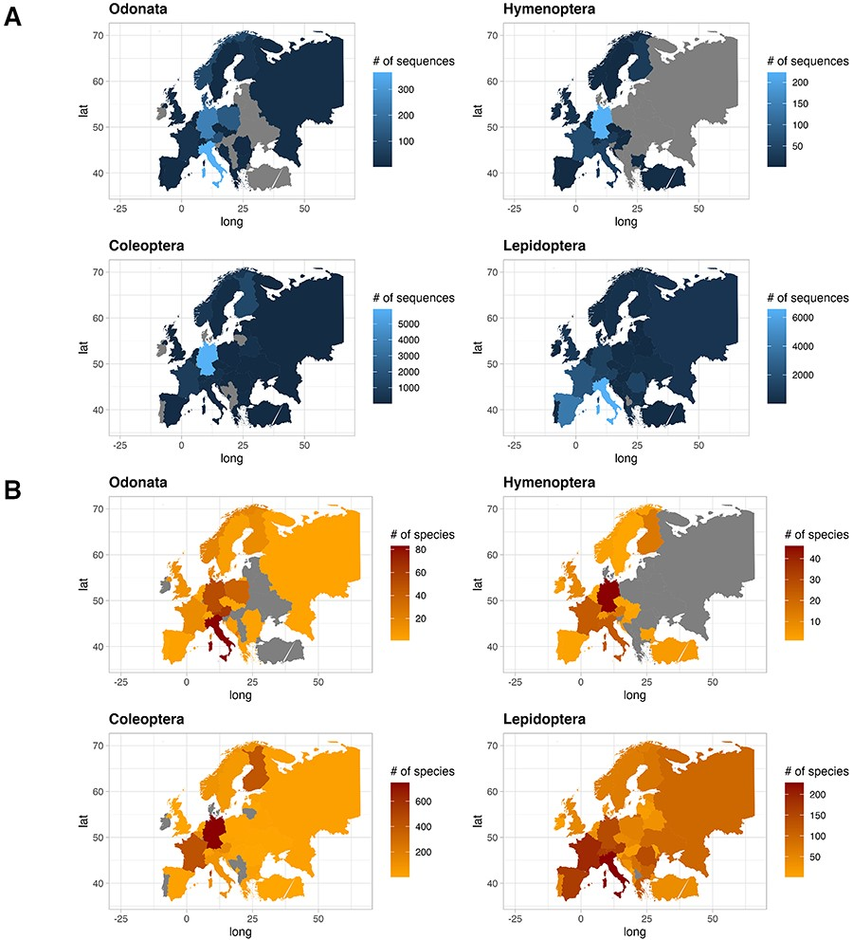
Figure 4. Plot showing the number of sequences for each country for the four IUCN Red Listed insect orders in the final ...
Notes:
Figure 4. Plot showing the number of sequences for each country for the four IUCN Red Listed insect orders in the final database (A), and plot showing the number of species for each country for the four IUCN Red Listed insect orders in the final database (B), where grey color refers to the absence of information.
Unless provided in the caption above, the following copyright applies to the content of this slide: © The Author(s) 2024. Published by Oxford University Press.This is an Open Access article distributed under the terms of the Creative Commons Attribution License (https://creativecommons.org/licenses/by/4.0/), which permits unrestricted reuse, distribution, and reproduction in any medium, provided the original work is properly cited.

Slide 5
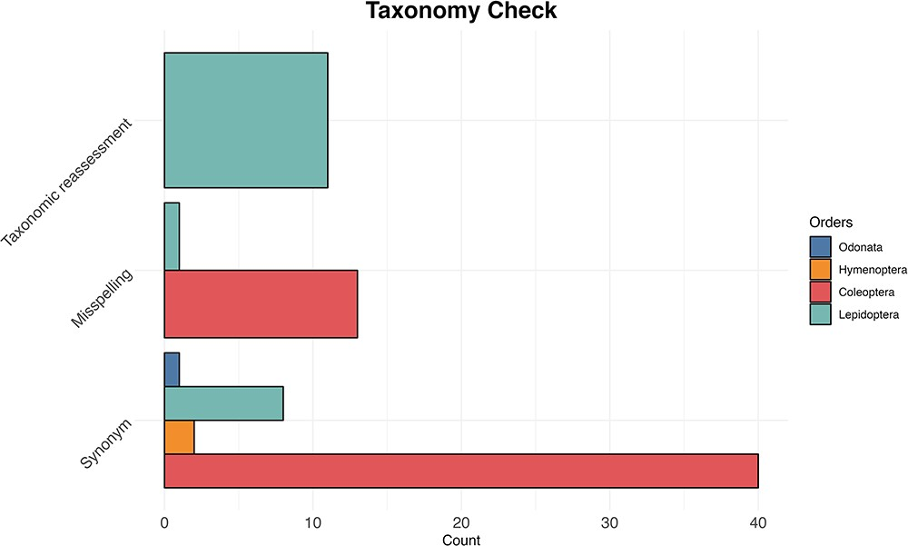
Figure 5. The bar plot shows for each examined taxon the count of the three most common reasons (synonyms, misspelling ...
Notes:
Figure 5. The bar plot shows for each examined taxon the count of the three most common reasons (synonyms, misspelling and taxonomic reassessment) for taxonomic discrepancy between the IUCN Red Lists and the reference taxonomy of GenBank and BOLD databases.
Unless provided in the caption above, the following copyright applies to the content of this slide: © The Author(s) 2024. Published by Oxford University Press.This is an Open Access article distributed under the terms of the Creative Commons Attribution License (https://creativecommons.org/licenses/by/4.0/), which permits unrestricted reuse, distribution, and reproduction in any medium, provided the original work is properly cited.

Slide 6
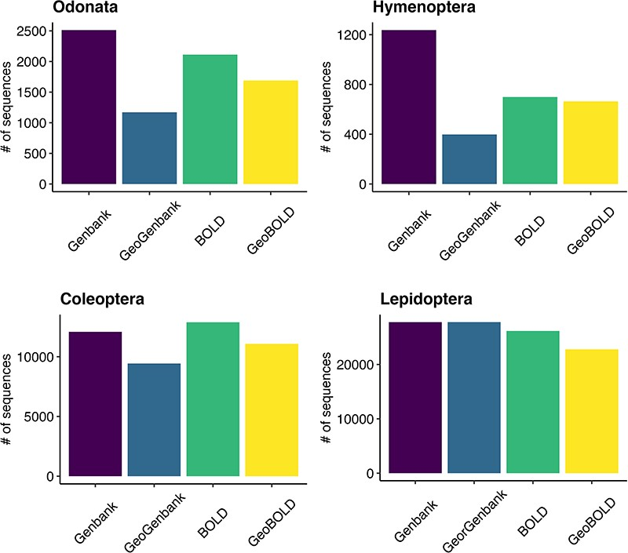
Figure 6. Grouped bar plot showing differences between BOLD and GenBank retrieved data on the left and georeferenced ...
Notes:
Figure 6. Grouped bar plot showing differences between BOLD and GenBank retrieved data on the left and georeferenced records on the right for the examined taxa.
Unless provided in the caption above, the following copyright applies to the content of this slide: © The Author(s) 2024. Published by Oxford University Press.This is an Open Access article distributed under the terms of the Creative Commons Attribution License (https://creativecommons.org/licenses/by/4.0/), which permits unrestricted reuse, distribution, and reproduction in any medium, provided the original work is properly cited.

