Slide 1
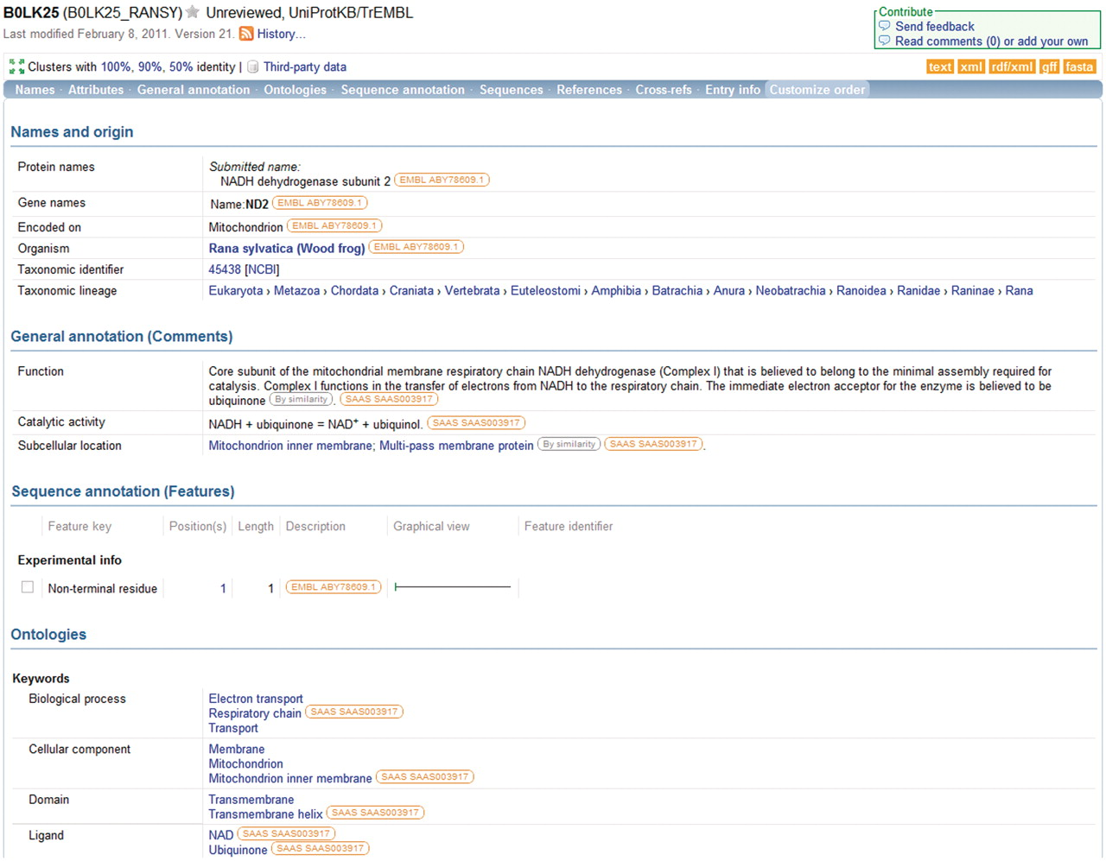
Figure 4. Information in a UniProtKB entry is linked to underlying data sources. The source of each data item is ...
Notes:
Figure 4. Information in a UniProtKB entry is linked to underlying data sources. The source of each data item is indicated and the source information is hyperlinked to allow users to access the original data source directly.
Unless provided in the caption above, the following copyright applies to the content of this slide: © The Author(s) 2011. Published by Oxford University Press.This is Open Access article distributed under the terms of the Creative Commons Attribution Non-Commercial License (http://creativecommons.org/licenses/by-nc/2.5), which permits unrestricted non-commercial use, distribution, and reproduction in any medium, provided the original work is properly cited.

