Slide 1
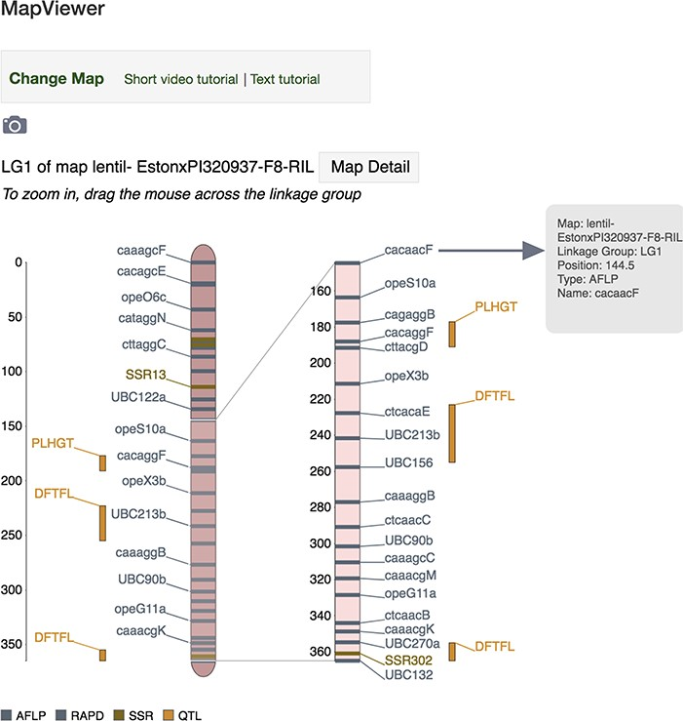
Figure 2 MapViewer main page displaying interactive linkage group interface. Hover above a locus (genetic marker, MTL ...
Notes:
Figure 2 MapViewer main page displaying interactive linkage group interface. Hover above a locus (genetic marker, MTL or QTL) or its label on the zoomed view and a tooltip dialog will appear showing more detailed information about the locus such as map, linkage group, position, type and name. Click on a locus or its label to launch the associated corresponding genetic marker, MTL or QTL Tripal page.
Unless provided in the caption above, the following copyright applies to the content of this slide: © The Author(s) 2019. Published by Oxford University Press.This work is written by US Government employees and is in the public domain in the US.

