Slide 1
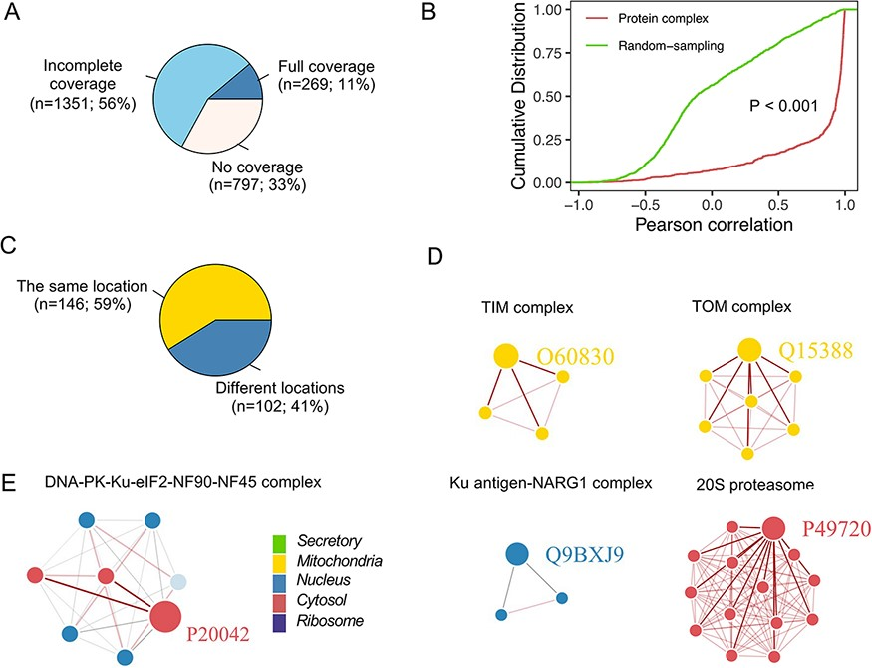
Figure 7. Subcellular localization for the protein complex. (A) The coverage of CORUM complexes in PSL-LCCL. CORUM: the ...
Notes:
Figure 7. Subcellular localization for the protein complex. (A) The coverage of CORUM complexes in PSL-LCCL. CORUM: the comprehensive resource of mammalian protein complexes; full: all the protein complex members were present in our data; no coverage: members in the protein complex were not identified in our study. (B) A cumulative plot of the correlation for the protein complex members in CORUM. Random sampling was from a random sampling of correlations for nonprotein complex members. (C) The consistency of the localization of the protein complex members. (D) Examples of members of protein complexes located in the same neighborhood. (E) Examples of members of protein complexes located in different neighborhoods.
Unless provided in the caption above, the following copyright applies to the content of this slide: © The Author(s) 2022. Published by Oxford University Press.This is an Open Access article distributed under the terms of the Creative Commons Attribution License (https://creativecommons.org/licenses/by/4.0/), which permits unrestricted reuse, distribution, and reproduction in any medium, provided the original work is properly cited.

