Slide 1
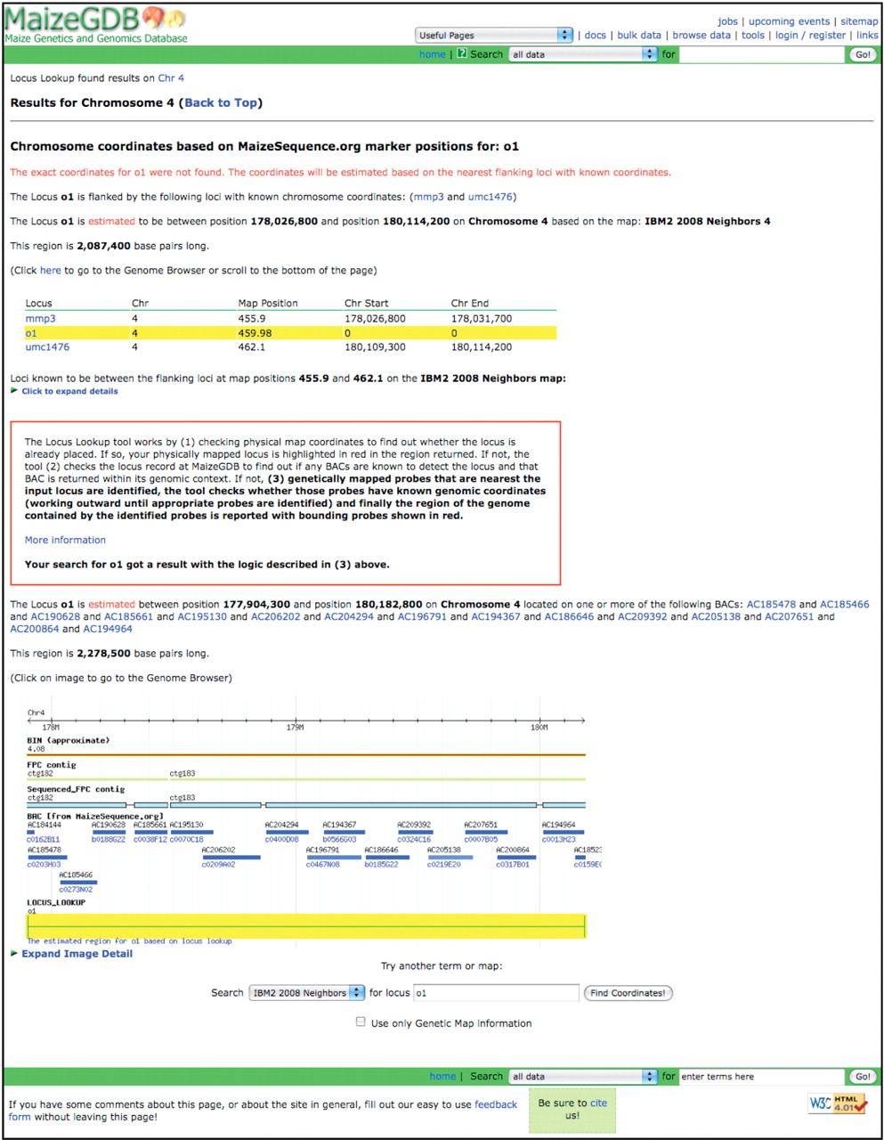
Figure 3. The result page for the approximate genomic coordinates for the opaque endosperm1 (o1) locus when the Locus ...
Notes:
Figure 3. The result page for the approximate genomic coordinates for the opaque endosperm1 (o1) locus when the Locus Lookup tool is used.
Unless provided in the caption above, the following copyright applies to the content of this slide: Published by Oxford University Press 2009.This is Open Access article distributed under the terms of the Creative Commons Attribution Non-Commercial License (http://creativecommons.org/licenses/by-nc/2.5/uk/) which permits unrestricted non-commercial use, distribution, and reproduction in any medium, provided the original work is properly cited.

Slide 2
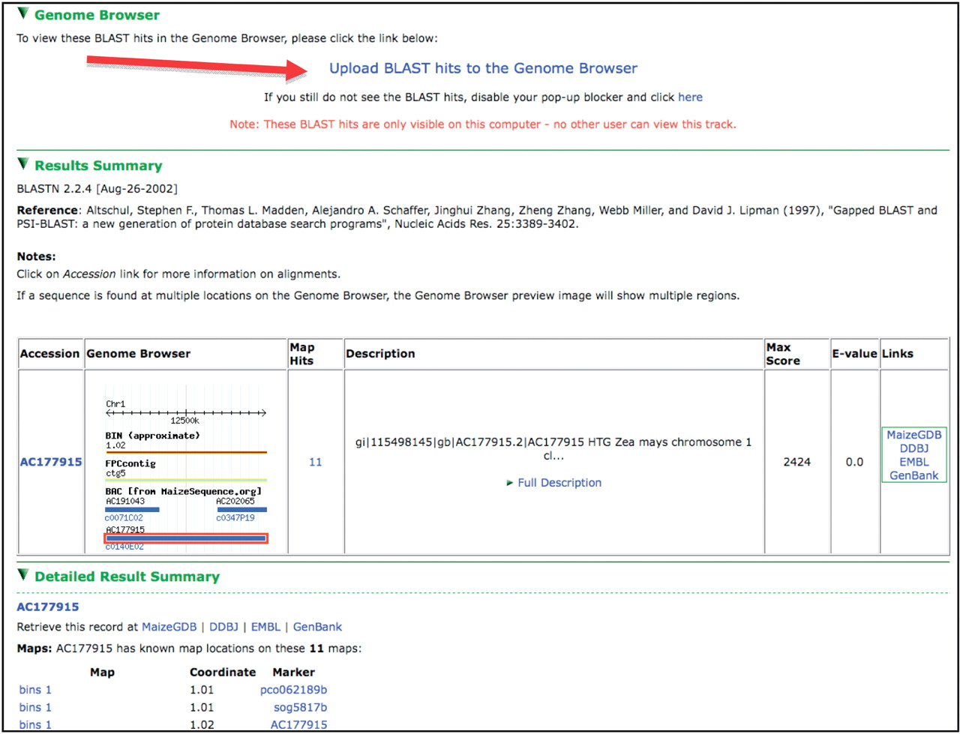
Figure 2. A view from the BLAST results interface. Note the link toward the top of the page allowing BLAST hits to be ...
Notes:
Figure 2. A view from the BLAST results interface. Note the link toward the top of the page allowing BLAST hits to be uploaded as a track in the Genome Browser, results table showing a thumbnail of the hit’s genomic context and hit assignment to BACs via the molecular markers associated with the hit sequence.
Unless provided in the caption above, the following copyright applies to the content of this slide: Published by Oxford University Press 2009.This is Open Access article distributed under the terms of the Creative Commons Attribution Non-Commercial License (http://creativecommons.org/licenses/by-nc/2.5/uk/) which permits unrestricted non-commercial use, distribution, and reproduction in any medium, provided the original work is properly cited.

Slide 3
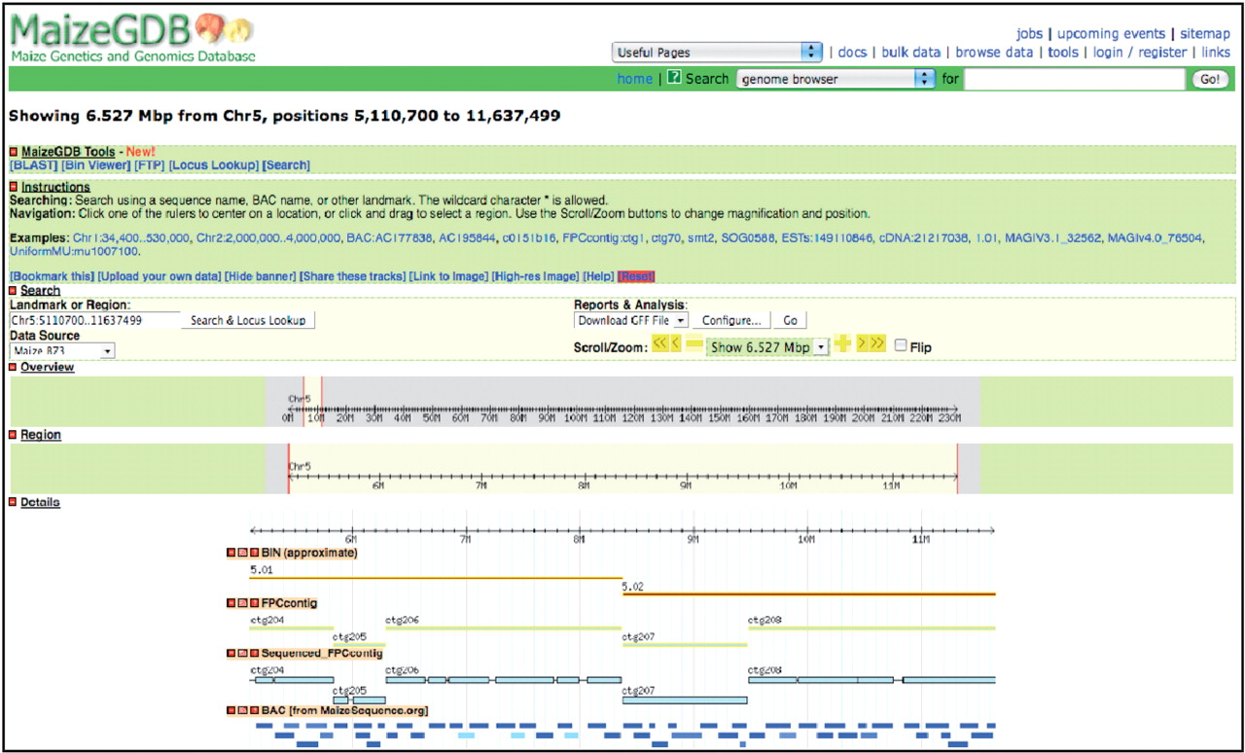
Figure 1. The MaizeGDB Genome Browser showing chromosome 5 from nucleotide position 5 110 700 to 11 637 499. The ‘BIN’ ...
Notes:
Figure 1. The MaizeGDB Genome Browser showing chromosome 5 from nucleotide position 5 110 700 to 11 637 499. The ‘BIN’ track shows bins 5.01 and 5.02, and the ‘Sequenced FPC contig’ track clearly displays regions within the FPC contigs that are not currently sequenced.
Unless provided in the caption above, the following copyright applies to the content of this slide: Published by Oxford University Press 2009.This is Open Access article distributed under the terms of the Creative Commons Attribution Non-Commercial License (http://creativecommons.org/licenses/by-nc/2.5/uk/) which permits unrestricted non-commercial use, distribution, and reproduction in any medium, provided the original work is properly cited.

