Slide 1
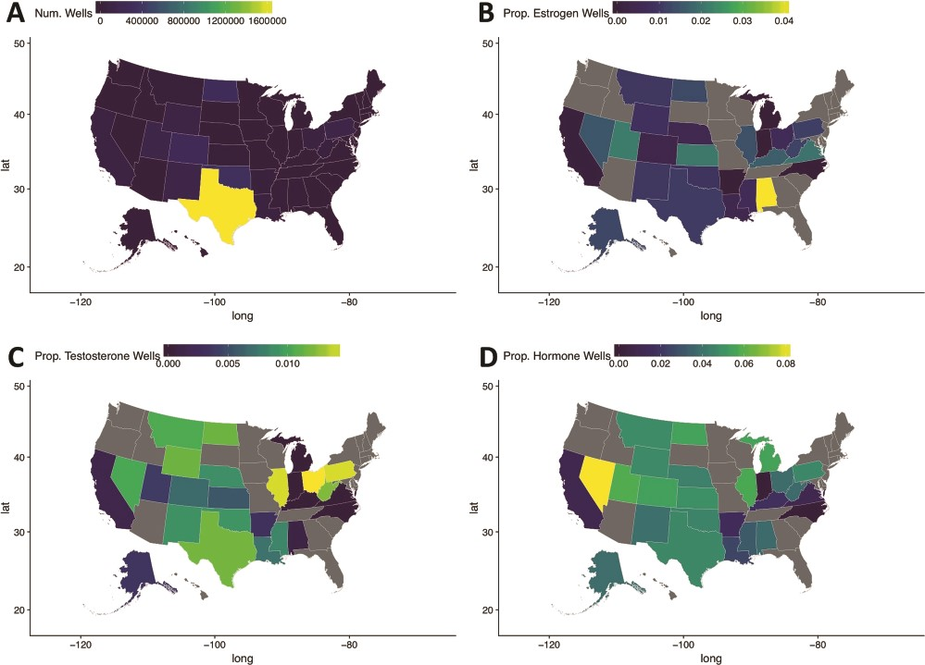
Figure 3 Maps of the United States of America detailing hydraulic fracturing well locations (A), the proportion of ...
Notes:
Figure 3 Maps of the United States of America detailing hydraulic fracturing well locations (A), the proportion of wells with estrogen pathway-targeting Ingredients (B), the proportion of wells with testosterone pathway-targeting Ingredients (C) and the proportion of wells with hormonal pathway-targeting ingredients (D). Notice that states with elevated proportions of certain estrogen, testosterone or hormonal pathway ingredients relative to other hydraulic fracturing wells can be easily identified using these visual maps.
Unless provided in the caption above, the following copyright applies to the content of this slide: © The Author(s) 2020. Published by Oxford University Press.This is an Open Access article distributed under the terms of the Creative Commons Attribution License (http://creativecommons.org/licenses/by/4.0/), which permits unrestricted reuse, distribution, and reproduction in any medium, provided the original work is properly cited.

