Slide 1
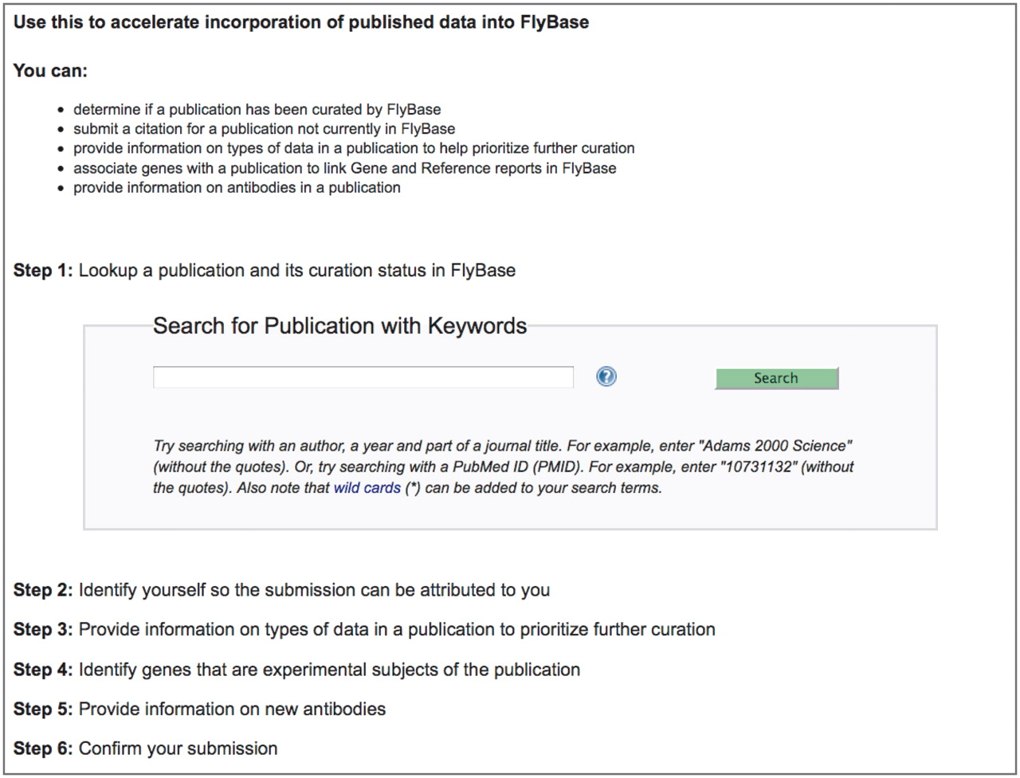
Figure 2. The Fast-Track Your Paper tool. The first page of the FTYP tool, listing the six steps that guide the user ...
Notes:
Figure 2. The Fast-Track Your Paper tool. The first page of the FTYP tool, listing the six steps that guide the user through the complete community curation process.
Unless provided in the caption above, the following copyright applies to the content of this slide: © The Author(s) 2012. Published by Oxford University Press.This is an Open Access article distributed under the terms of the Creative Commons Attribution Non-Commercial License (http://creativecommons.org/licenses/by-nc/3.0), which permits unrestricted non-commercial use, distribution, and reproduction in any medium, provided the original work is properly cited.

