Slide 1
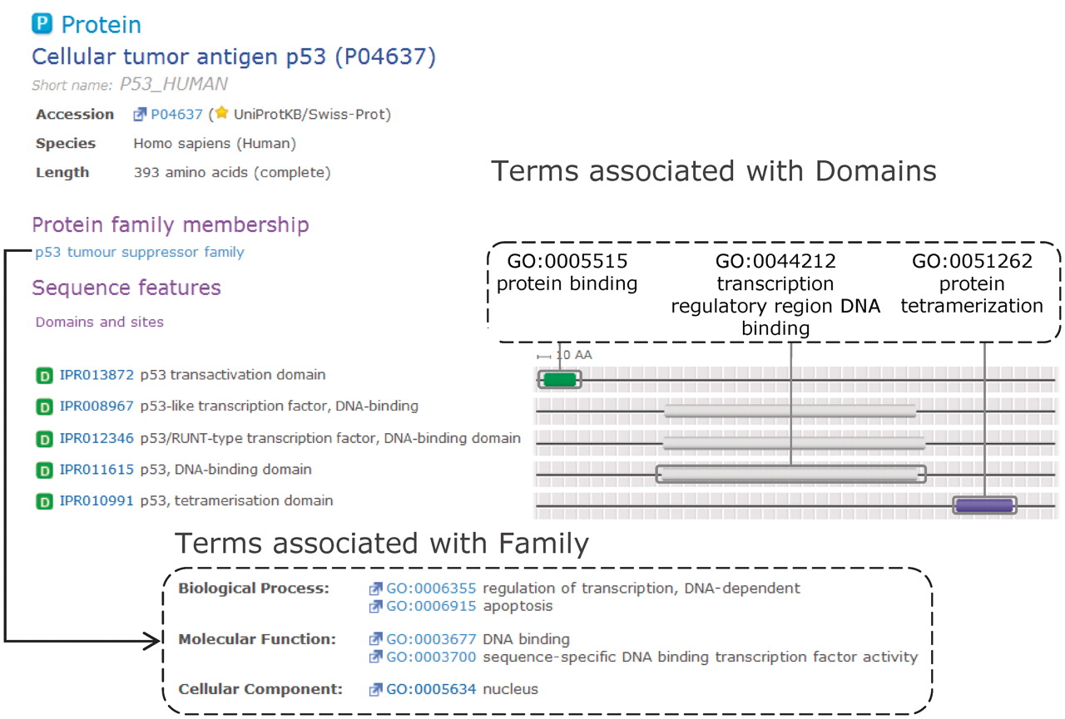
Figure 3. Complementary domain and family GO mapping for InterPro entries that match the human cellular tumour antigen ...
Notes:
Figure 3. Complementary domain and family GO mapping for InterPro entries that match the human cellular tumour antigen p53. Domain GO annotation enables the function(s) of the family to be attributed to individual domains within the protein.
Unless provided in the caption above, the following copyright applies to the content of this slide: © The Author(s) 2012. Published by Oxford University Press.This is an Open Access article distributed under the terms of the Creative Commons Attribution Non-Commercial License (http://creativecommons.org/licenses/by-nc/3.0), which permits unrestricted non-commercial use, distribution, and reproduction in any medium, provided the original work is properly cited.

