Slide 1
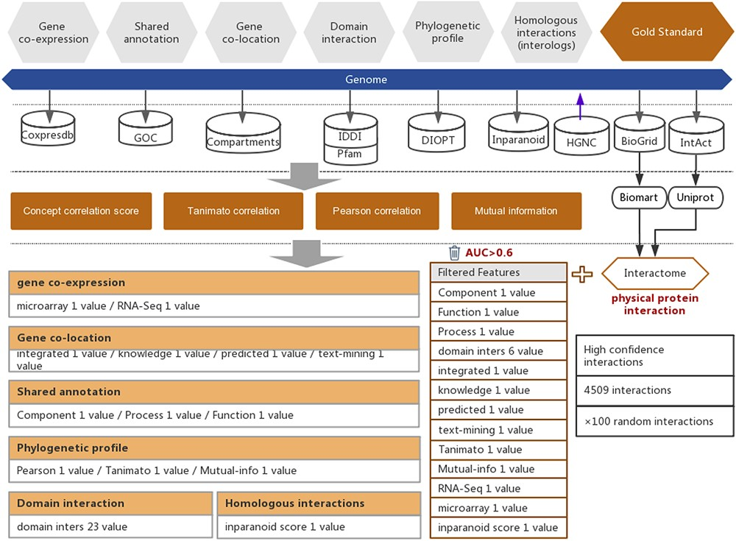
Figure 1. Workflow of the functional interaction prediction between human genes. High-quality experimentally reported ...
Notes:
Figure 1. Workflow of the functional interaction prediction between human genes. High-quality experimentally reported protein interactions were integrated from two databases and were used as positive examples. Six types of functional association evidence from seven databases were collected to infer putative functional interactions. A total of 18 high-quality feature values were selected from 36 feature values that characterize this evidence with different mathematical representations. Random gene pairs with all positive examples removed were used as negative examples. The number of negative examples was 100 times the number of positive examples.
Unless provided in the caption above, the following copyright applies to the content of this slide: © The Author(s) 2021. Published by Oxford University Press.This is an Open Access article distributed under the terms of the Creative Commons Attribution License (http://creativecommons.org/licenses/by/4.0/), which permits unrestricted reuse, distribution, and reproduction in any medium, provided the original work is properly cited.

