Slide 1
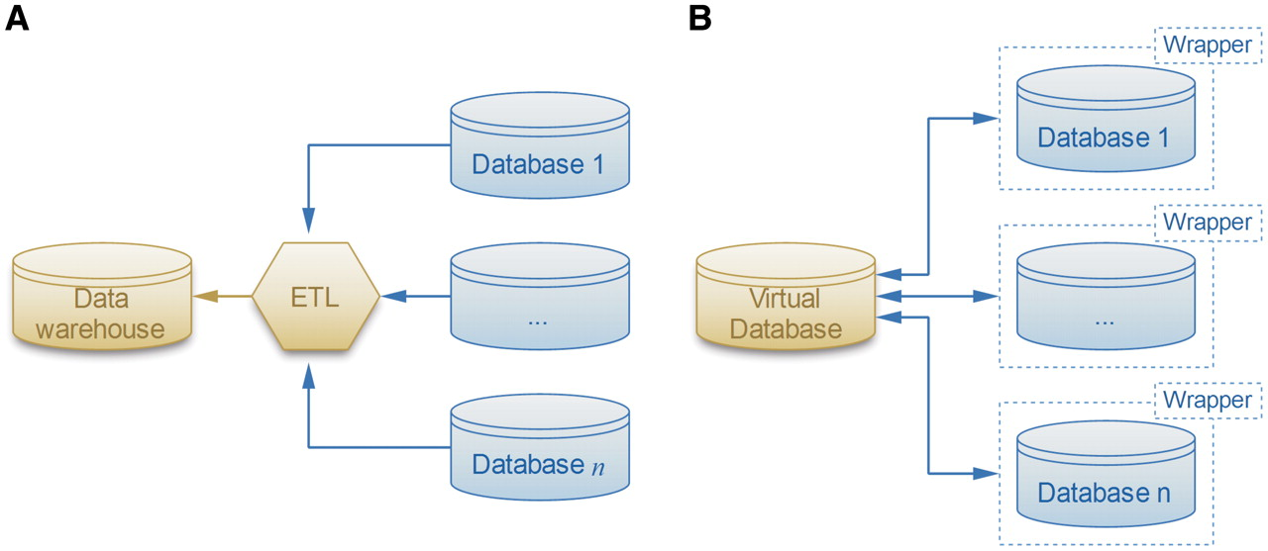
Figure 1. Two solutions for the data integration problem. (A) The ETL software extracts, transforms and loads the data ...
Notes:
Figure 1. Two solutions for the data integration problem. (A) The ETL software extracts, transforms and loads the data sources into the warehouse. (B) The more flexible local-as-view method defines a virtual database that interacts with data sources through wrappers, which provide simplified views of the original databases.
Unless provided in the caption above, the following copyright applies to the content of this slide: © The Author(s) 2010. Published by Oxford University Press.This is Open Access article distributed under the terms of the Creative Commons Attribution Non-Commercial License (http://creativecommons.org/licenses/by-nc/2.5), which permits unrestricted non-commercial use, distribution, and reproduction in any medium, provided the original work is properly cited.

Slide 2
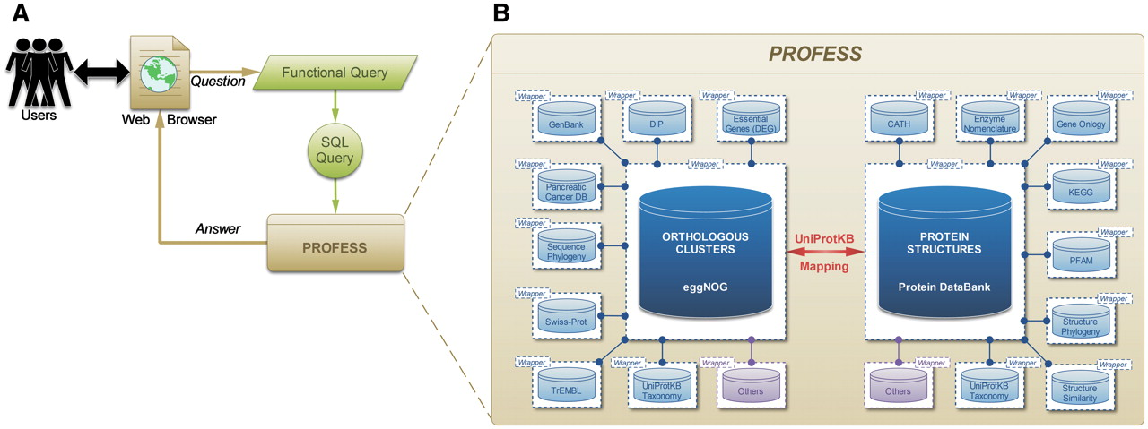
Figure 2. Outline of the PROFESS database. (A) The relationship of the user interface to the functional query system ...
Notes:
Figure 2. Outline of the PROFESS database. (A) The relationship of the user interface to the functional query system (green) to the PROFESS databases; and (B) the core databases integrated in PROFESS. The central eggNOG-PDB linkage is shown in red, double arrows indicate intensive interactions, blue boxes represent databases available on the internet, and purple boxes denote other databases to be integrated in the future. Each additional data set interacts with the PROFESS core through the use of wrapper programs to make query language uniform.
Unless provided in the caption above, the following copyright applies to the content of this slide: © The Author(s) 2010. Published by Oxford University Press.This is Open Access article distributed under the terms of the Creative Commons Attribution Non-Commercial License (http://creativecommons.org/licenses/by-nc/2.5), which permits unrestricted non-commercial use, distribution, and reproduction in any medium, provided the original work is properly cited.

Slide 3
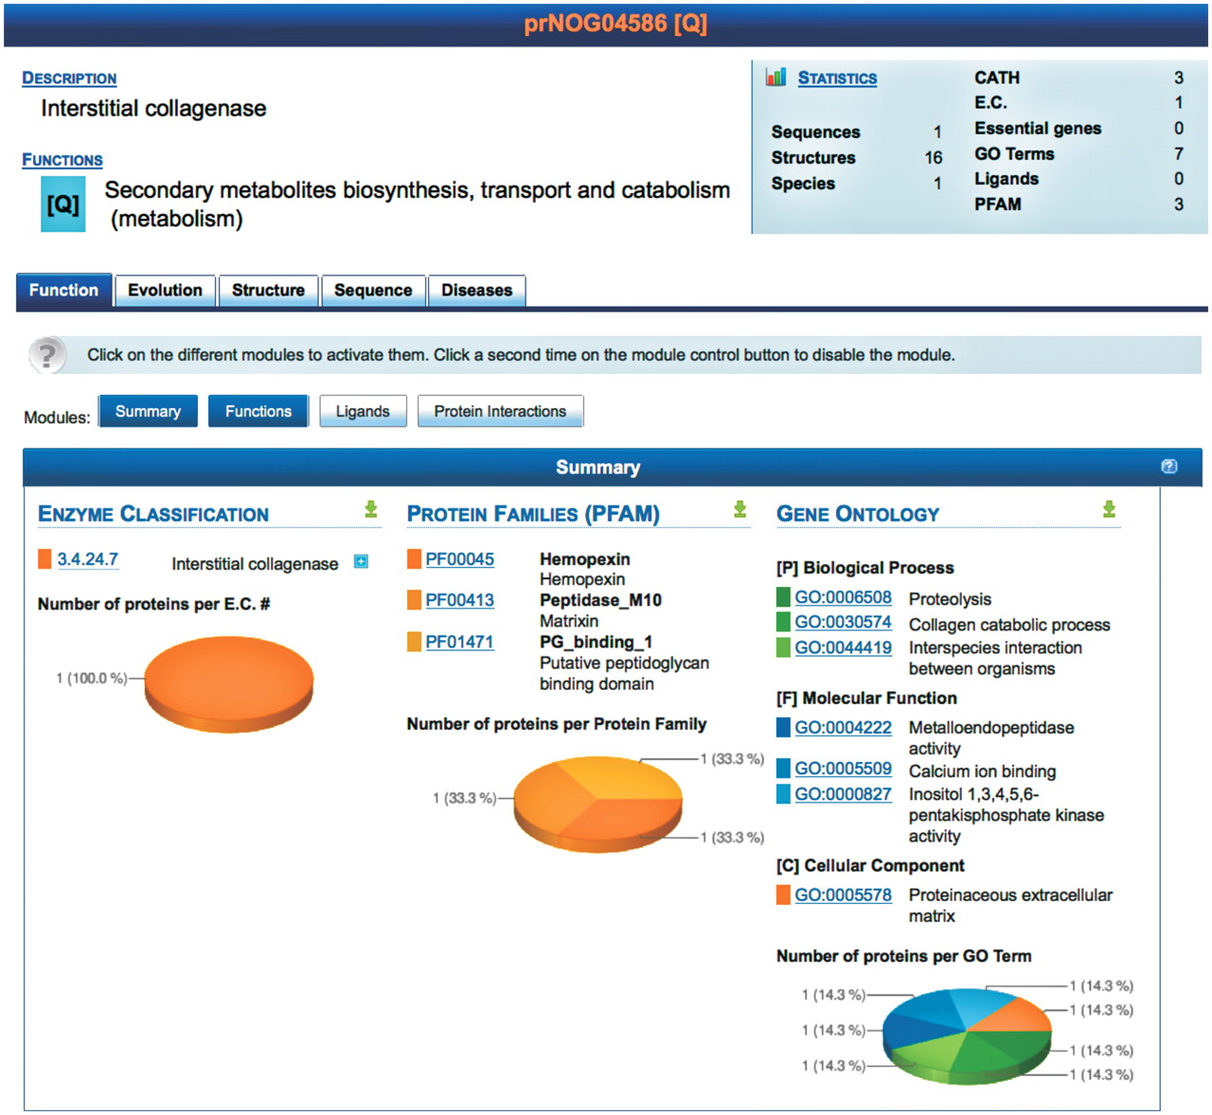
Figure 3. Screenshot of the result page for prNOG04586. A brief description of the cluster is displayed (top) along ...
Notes:
Figure 3. Screenshot of the result page for prNOG04586. A brief description of the cluster is displayed (top) along with statistics. Detailed data is shown for each level (function, evolution, structure, sequence and disease). At each level, data is further clustered into different modules, each module providing a unique view of the data. Each module may be activated or deactivated depending on the needs of the user. The screenshot shows the module summarizing functional annotations of proteins in prNOG04586. Data is mined from the enzyme classification, the protein families database and the gene ontology. For each database, PROFESS shows entries related to proteins within cluster prNOG04586. The pie charts represent the relative frequency of each database entry within the orthologous cluster.
Unless provided in the caption above, the following copyright applies to the content of this slide: © The Author(s) 2010. Published by Oxford University Press.This is Open Access article distributed under the terms of the Creative Commons Attribution Non-Commercial License (http://creativecommons.org/licenses/by-nc/2.5), which permits unrestricted non-commercial use, distribution, and reproduction in any medium, provided the original work is properly cited.

Slide 4
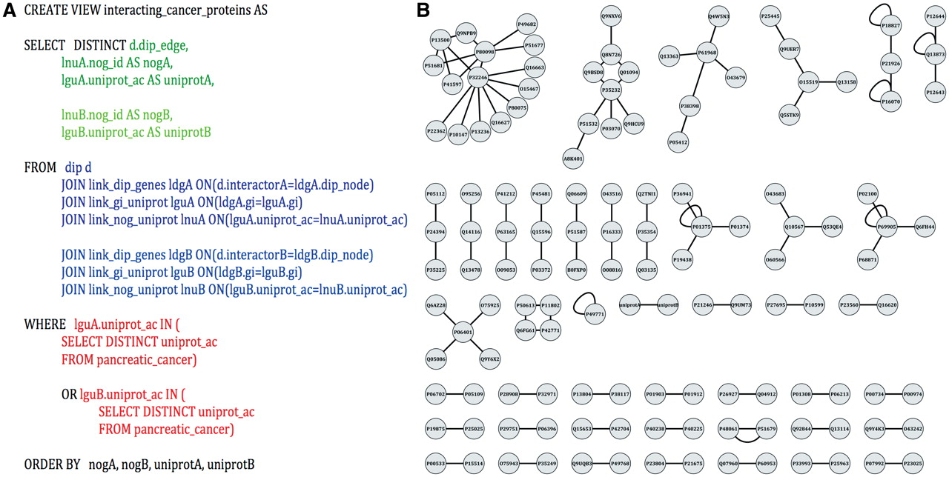
Figure 5. Identification of potential pancreatic cancer drug targets. (A) An example SQL query used to parse PROFESS to ...
Notes:
Figure 5. Identification of potential pancreatic cancer drug targets. (A) An example SQL query used to parse PROFESS to generate protein–protein interaction networks between pancreatic cancer-related proteins. Select (green) only the information relevant to solve the stipulated question from the dynamic join of relevant views from PROFESS (blue). The results are then filtered to mine only interactions involving proteins of interest (red). Parts of the query related to the first interactor are shown in darker colors, whereas sections of the query related to the second interactor are shown in lighter colors. (B) The SQL query on PROFESS resulted in a list of protein-protein interactions among the set of pancreatic cancer-related proteins. The interaction networks were displayed using Cytoscape (55). Identifying proteins that are part of a larger network provides one method to prioritize potential therapeutic targets among the set of pancreatic cancer-related proteins.
Unless provided in the caption above, the following copyright applies to the content of this slide: © The Author(s) 2010. Published by Oxford University Press.This is Open Access article distributed under the terms of the Creative Commons Attribution Non-Commercial License (http://creativecommons.org/licenses/by-nc/2.5), which permits unrestricted non-commercial use, distribution, and reproduction in any medium, provided the original work is properly cited.

Slide 5
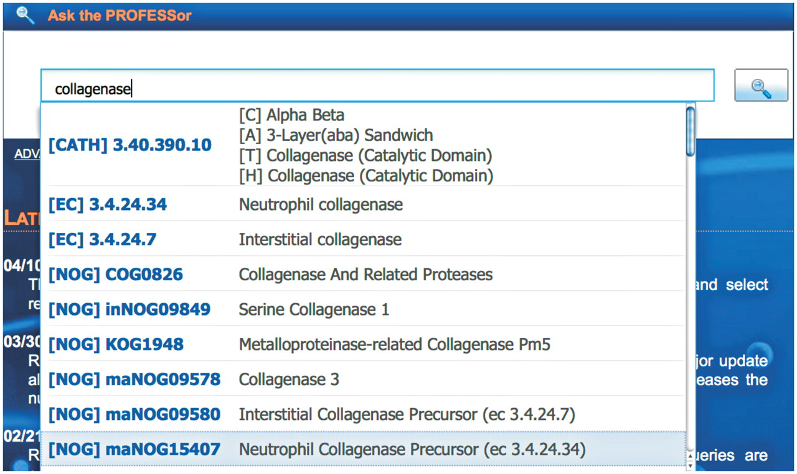
Figure 4. The PROFESSor query system. The PROFESSor is a dynamic search tool generated from the core databases to help ...
Notes:
Figure 4. The PROFESSor query system. The PROFESSor is a dynamic search tool generated from the core databases to help the user to refine complex queries. Using the PROFESSor users are given suggestions for extending their search words/phrases that helps them rapidly and accurately find all functional, structure and sequence information about a particular protein and its relation to other protein functions, folds or ligands.
Unless provided in the caption above, the following copyright applies to the content of this slide: © The Author(s) 2010. Published by Oxford University Press.This is Open Access article distributed under the terms of the Creative Commons Attribution Non-Commercial License (http://creativecommons.org/licenses/by-nc/2.5), which permits unrestricted non-commercial use, distribution, and reproduction in any medium, provided the original work is properly cited.

