Slide 1
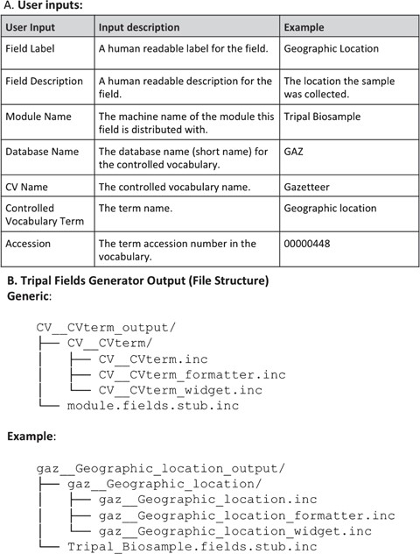
Figure 2 Input and output for TFG. The command line program prompts the user to provide a series of inputs (A) and ...
Notes:
Figure 2 Input and output for TFG. The command line program prompts the user to provide a series of inputs (A) and checks the database to determine if the specified controlled vocabulary term exists. If it does, the software produces a set of files in the correct directory structure to generate the field (B). An example is given using the ‘Geographic location’ term from the Gazetteer vocabulary for a mock module named Tripal_Biosample (C). This demonstrates how the user’s inputs are structured into the file names. These inputs are also used to build all the necessary code variables and functions in each file, leaving only the essential custom coding for the function bodies for the developer to finish.
Unless provided in the caption above, the following copyright applies to the content of this slide: © The Author(s) 2018. Published by Oxford University Press.This is an Open Access article distributed under the terms of the Creative Commons Attribution License (http://creativecommons.org/licenses/by/4.0/), which permits unrestricted reuse, distribution, and reproduction in any medium, provided the original work is properly cited.

