Slide 1
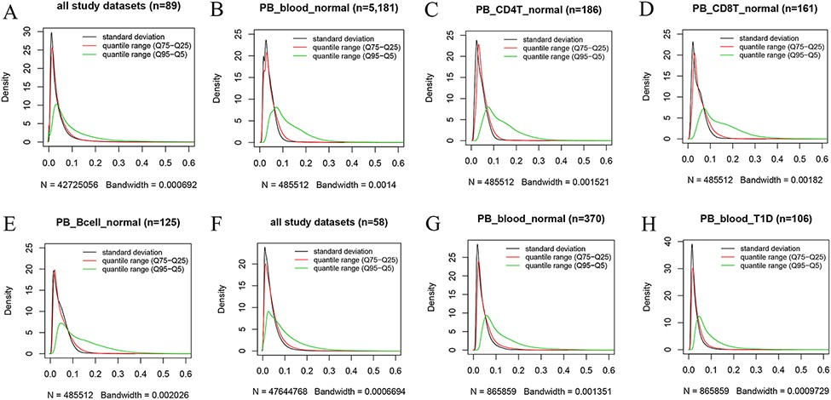
Figure 4. Kernel density estimation to show frequency distributions of standard deviation and quantile ranges. Figures ...
Notes:
Figure 4. Kernel density estimation to show frequency distributions of standard deviation and quantile ranges. Figures A to E are from the 450k platform and indicate all study datasets (A), normal peripheral blood samples (B), normal peripheral CD4+ T cells (C), normal peripheral CD8+ T cells (D) and normal peripheral B cells (E). Figures F, G and H are from the 850k platform and indicate all study datasets (F), normal peripheral blood samples (B) and peripheral blood samples from individuals with type-1 diabetes.
Unless provided in the caption above, the following copyright applies to the content of this slide: © The Author(s) 2022. Published by Oxford University Press.This is an Open Access article distributed under the terms of the Creative Commons Attribution License (https://creativecommons.org/licenses/by/4.0/), which permits unrestricted reuse, distribution, and reproduction in any medium, provided the original work is properly cited.

