Slide 1
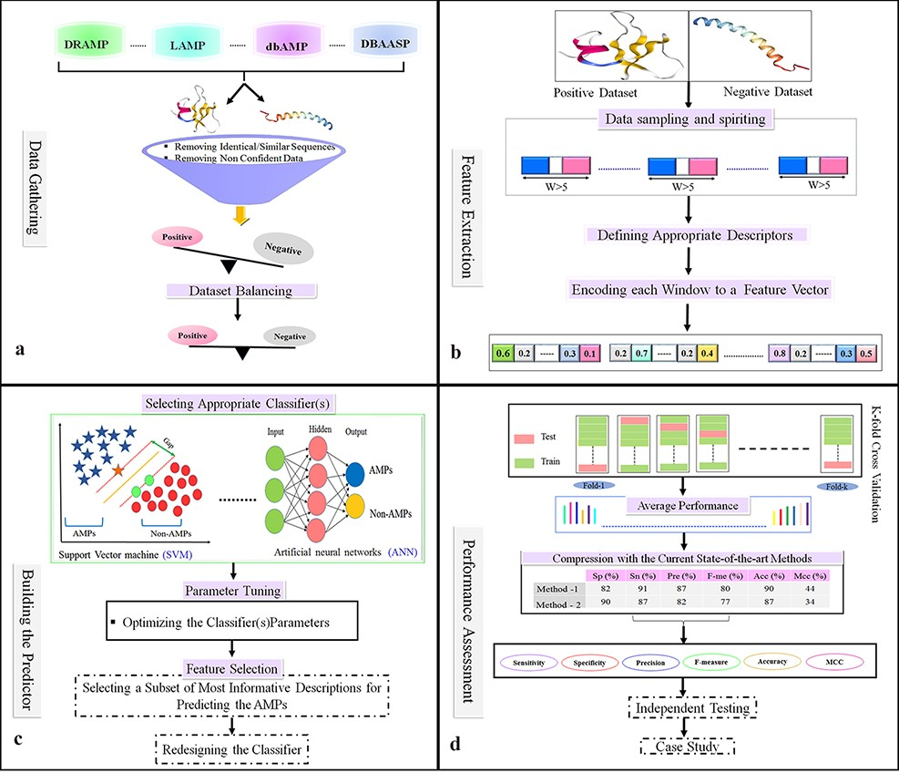
Figure 4. Flowchart of the statistical and machine learning techniques for the detection of AMPs. (a) Collection of ...
Notes:
Figure 4. Flowchart of the statistical and machine learning techniques for the detection of AMPs. (a) Collection of data and creation of datasets. (b) Feature selection. (c) Designing training and testing models. (d) Evaluation of model performance.
Unless provided in the caption above, the following copyright applies to the content of this slide: © The Author(s) 2022. Published by Oxford University Press.This is an Open Access article distributed under the terms of the Creative Commons Attribution License (https://creativecommons.org/licenses/by/4.0/), which permits unrestricted reuse, distribution, and reproduction in any medium, provided the original work is properly cited.

