Slide 1
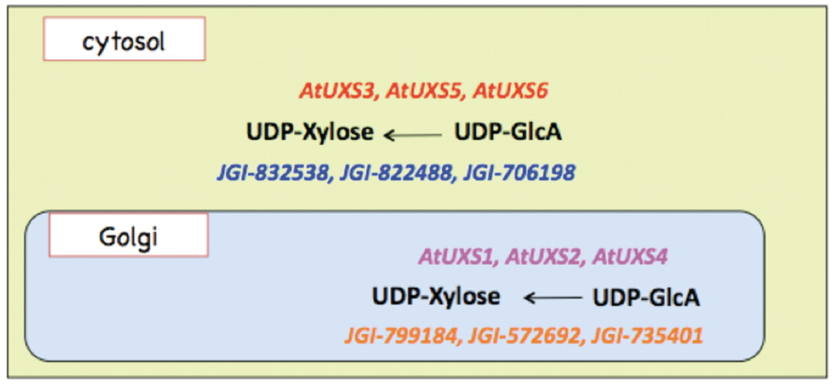
Figure 8. Cytosolic and Golgi isoforms of Arabidopsis and Populus UDP-xylose synthase. The cytosolic isoforms of the ...
Notes:
Figure 8. Cytosolic and Golgi isoforms of Arabidopsis and Populus UDP-xylose synthase. The cytosolic isoforms of the Arabidopsis and Populus enzymes are color coded in red and blue, respectively. The Golgi isoforms of Arabidopsis and Populus UDP-d-xylose species are color-coded in pink and orange, respectively.
Unless provided in the caption above, the following copyright applies to the content of this slide: © The Author(s) 2012. Published by Oxford University Press.This is an Open Access article distributed under the terms of the Creative Commons Attribution Non-Commercial License (http://creativecommons.org/licenses/by-nc/3.0), which permits unrestricted non-commercial use, distribution, and reproduction in any medium, provided the original work is properly cited.

