Slide 1
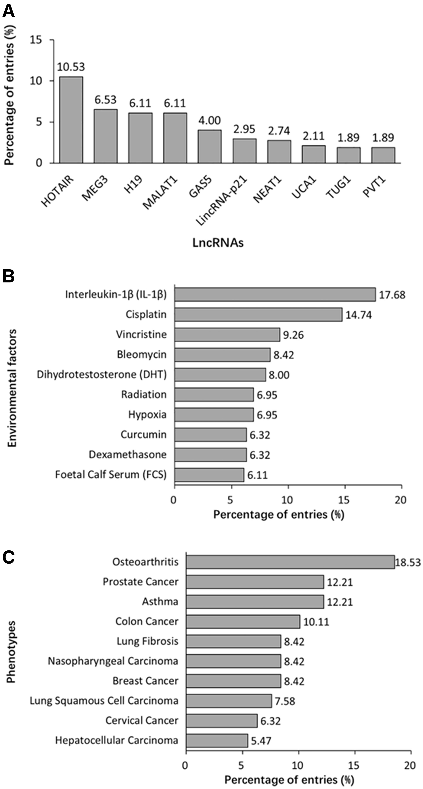
Figure 5. Summary statistics about lncRNA, EF and phenotype data registered in the database. (A) Distribution of top 10 ...
Notes:
Figure 5. Summary statistics about lncRNA, EF and phenotype data registered in the database. (A) Distribution of top 10 lncRNAs. (B) Distribution of top 10 EFs. (C) Distribution of top 10 phenotypes.
Unless provided in the caption above, the following copyright applies to the content of this slide: © The Author(s) 2017. Published by Oxford University Press.This is an Open Access article distributed under the terms of the Creative Commons Attribution License (http://creativecommons.org/licenses/by/4.0/), which permits unrestricted reuse, distribution, and reproduction in any medium, provided the original work is properly cited.

