Slide 1
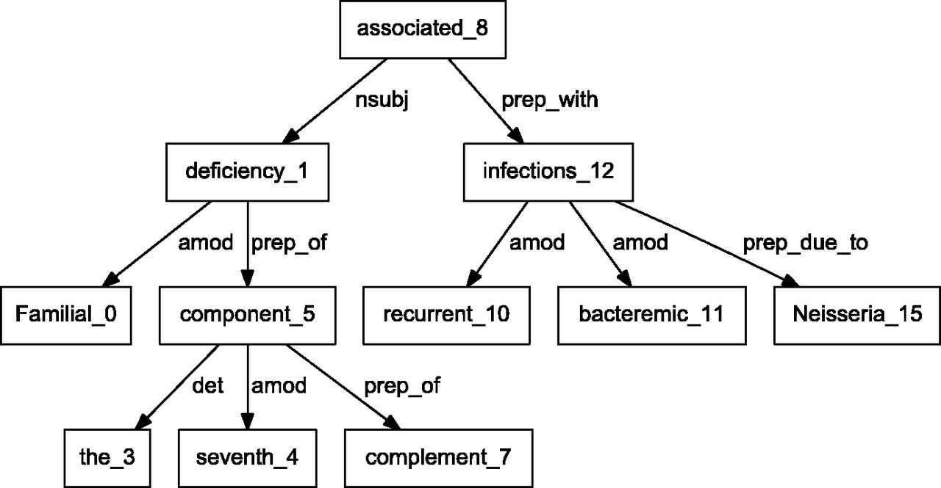
Figure 4. Dependency graph of ‘Familial deficiency of the seventh component of complement associated with recurrent ...
Notes:
Figure 4. Dependency graph of ‘Familial deficiency of the seventh component of complement associated with recurrent bacteremic infections due to Neisseria’ using Stanford parser.
Unless provided in the caption above, the following copyright applies to the content of this slide: Published by Oxford University Press. This work is written by US Government employees and is in the public domain in the US.

