Slide 1
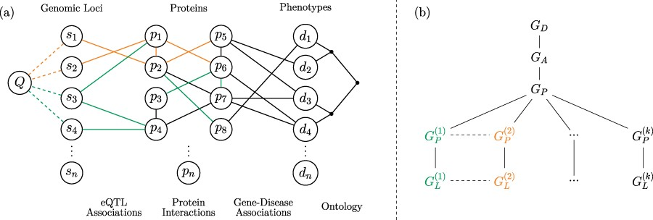
Fig. 1 Versioned heterogeneous network. (a) An example of a versioned network that is used to model the relationship ...
Notes:
Fig. 1 Versioned heterogeneous network. (a) An example of a versioned network that is used to model the relationship between genomic loci, proteins and diseases. The vertices consist of genomic loci, proteins and disease phenotypes, edges represent tissue-specific eQTL interactions, tissue-specific PPIs, gene–disease associations and relationships between diseases in the context of a disease ontology. Different versions represent interactions that occur within specific tissues. The interactions that occur in different versions are shown using different colors, where black edges represent generic interactions/associations. A proximity query on this network can be formulated using any subset of loci, proteins, diseases or any combination of these. As an example, vertex Q visualizes a sample query that aims to retrieve the diseases most closely associated with one or more genomic loci or a genomic region. (b) The version tree used to represent the integrated heterogeneous network in (a). The root node represents the generic disease ontology network. Version $G_A$ contains the generic gene–disease association network. $G_P$ represents the generic PPI network, consisting of the edges that are shared by the tissue-specific PPIs. The next level of the tree splits off into the different tissue-specific PPI networks, as shown using different colors. At the final level, the corresponding tissue-specific eQTL networks are added.
Unless provided in the caption above, the following copyright applies to the content of this slide: © The Author(s) 2020. Published by Oxford University Press.This is an Open Access article distributed under the terms of the Creative Commons Attribution License (http://creativecommons.org/licenses/by/4.0/), which permits unrestricted reuse, distribution, and reproduction in any medium, provided the original work is properly cited.

Slide 2
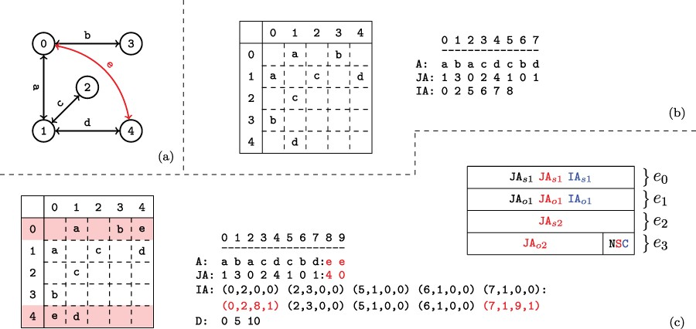
Fig. 2 Versioned compressed sparse row (CSR) format. (a) A sample two version network in which the first version ...
Notes:
Fig. 2 Versioned compressed sparse row (CSR) format. (a) A sample two version network in which the first version consists of the black edges and the second version includes an additional edge shown in red. (b) The adjacency matrix and three arrays used to represent the first version of the network. (c) The adjacency matrix and arrays used to store both versions of the network in the proposed data structure and the memory layout for the elements of the augmented $\textit{IA}$ array. For the adjacency matrix, the colons denote where the second version’s data has been appended. For the memory layout, each $\textit{IA}$ element is comprised of four segments $(e_{0..3})$. Note that the type flags $(e_4)$ are stored in the least significant bits of $e_3$. The subscripts $o$ and $s$ refer to a starting index and length respectively in the $A$ and $\textit{JA}$ arrays. The last bits of $e_3$ are used to store a set of flags denoting the row status: normal, split or compressed. These are used to describe how the rest of the entries in $\textit{IA}$ should be interpreted. The meaning of each $(e_{0..3})$ value is color coded based on the flag. Note that only one interpretation is active for each entry of $\textit{IA}$ at a time.
Unless provided in the caption above, the following copyright applies to the content of this slide: © The Author(s) 2020. Published by Oxford University Press.This is an Open Access article distributed under the terms of the Creative Commons Attribution License (http://creativecommons.org/licenses/by/4.0/), which permits unrestricted reuse, distribution, and reproduction in any medium, provided the original work is properly cited.

Slide 3
Fig. 3 Joining/maintaining a split row. The structure of the $\textit{JA}$ array and associated augmented ...
Notes:
Fig. 3 Joining/maintaining a split row. The structure of the $\textit{JA}$ array and associated augmented $\textit{IA}$ element, before (upper panel) and after (lower panel) the addition of an edge to the adjacency list of a vertex. In each $\textit{JA}$ array, the green (orange) segment shows the part of the adjacency list that is pointed by the $e_0$ and $e_1$ ($e_2$ and $e_3$) fields of the respective entry in the $\textit{IA}$ array. In the example on the left, the split row is maintained since $(e_1+1)e_3)$.
Unless provided in the caption above, the following copyright applies to the content of this slide: © The Author(s) 2020. Published by Oxford University Press.This is an Open Access article distributed under the terms of the Creative Commons Attribution License (http://creativecommons.org/licenses/by/4.0/), which permits unrestricted reuse, distribution, and reproduction in any medium, provided the original work is properly cited.

Slide 4
Fig. 4 Compression of augmented IA arrays. The values of $\textit{IA}$ corresponding to the second network version ...
Notes:
Fig. 4 Compression of augmented IA arrays. The values of $\textit{IA}$ corresponding to the second network version for the example in Figure 2. (a) The range of unchanged $\textit{IA}$ elements is removed from the array and replaced with a $C$ flag set element representing their range in the previous version. Thus the length of the augmented $\textit{IA}$ array is decreased. However, the compression performance using the first version as a keyframe is determined to be too low. Thus the uncompressed IA segment is instead appended, and the key-frame for the new version is set to itself rather than its parent. Note that the initial network version is its own key-frame. (b) Motivating example for key-framing $\textit{IA}$ array segments. The initial version, $d_0$ is not compressed as it does not have a reference version. Versions $d_1$ and $d_2$ retain ranges contained within the initial segment. However, by version $d_3$ the new IA segment is unable to be compressed when basing on the initial version.
Unless provided in the caption above, the following copyright applies to the content of this slide: © The Author(s) 2020. Published by Oxford University Press.This is an Open Access article distributed under the terms of the Creative Commons Attribution License (http://creativecommons.org/licenses/by/4.0/), which permits unrestricted reuse, distribution, and reproduction in any medium, provided the original work is properly cited.

Slide 5
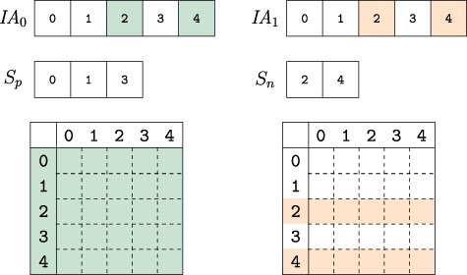
Fig. 5 Composing versions. The uncompressed IA array segments for the versions composed are compared. Colored ...
Notes:
Fig. 5 Composing versions. The uncompressed IA array segments for the versions composed are compared. Colored indexes represent elements that are changed from their parent version. The vertex indexes are partitioned into two sets based on whether they are identical across all composed versions $S_p$ or not $S_n$. When collecting the edge weights from each version, the indexes in $S_p$ only need to be accessed from one version while those in set $S_n$ must be accessed for each version, thus reducing the number of memory accesses to extract and compose network versions.
Unless provided in the caption above, the following copyright applies to the content of this slide: © The Author(s) 2020. Published by Oxford University Press.This is an Open Access article distributed under the terms of the Creative Commons Attribution License (http://creativecommons.org/licenses/by/4.0/), which permits unrestricted reuse, distribution, and reproduction in any medium, provided the original work is properly cited.

Slide 6
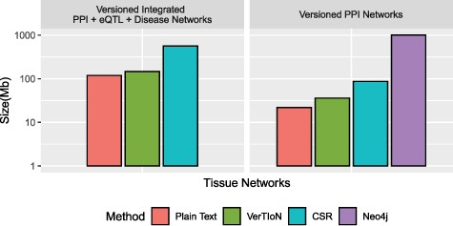
Fig. 6 Compression performance. Comparison of different methods in terms of the storage space they require for the ...
Notes:
Fig. 6 Compression performance. Comparison of different methods in terms of the storage space they require for the tissue-specific PPI versions alone and the full set of PPI+eQTL+disease networks outlined in Figure 1. Here CSR refers to the total space required for storing each version separately with a standard CSR representation, whereas VerTIoN refers to the total space required by VerTIoN to store all versions, by exploiting the edge overlap.
Unless provided in the caption above, the following copyright applies to the content of this slide: © The Author(s) 2020. Published by Oxford University Press.This is an Open Access article distributed under the terms of the Creative Commons Attribution License (http://creativecommons.org/licenses/by/4.0/), which permits unrestricted reuse, distribution, and reproduction in any medium, provided the original work is properly cited.

Slide 7
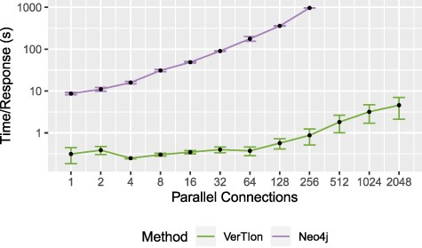
Fig. 7 Throughput for random walk-based network proximity queries. The average time until server response for a set ...
Notes:
Fig. 7 Throughput for random walk-based network proximity queries. The average time until server response for a set of parallel connections using a Neo4j database installation and VerTIoN. After 256 parallel requests, Neo4j becomes unstable and begins failing to respond to queries.
Unless provided in the caption above, the following copyright applies to the content of this slide: © The Author(s) 2020. Published by Oxford University Press.This is an Open Access article distributed under the terms of the Creative Commons Attribution License (http://creativecommons.org/licenses/by/4.0/), which permits unrestricted reuse, distribution, and reproduction in any medium, provided the original work is properly cited.

Slide 8
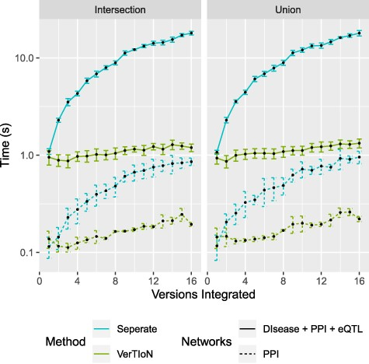
Fig. 8 Processing time for integrating versions. Shows a run-time comparison between loading and integrating ...
Notes:
Fig. 8 Processing time for integrating versions. Shows a run-time comparison between loading and integrating tissue-specific networks when stored separately as CSR matrices and the VerTIoN structure. Each point represents 10 iterations of randomly chosen sets of network versions.
Unless provided in the caption above, the following copyright applies to the content of this slide: © The Author(s) 2020. Published by Oxford University Press.This is an Open Access article distributed under the terms of the Creative Commons Attribution License (http://creativecommons.org/licenses/by/4.0/), which permits unrestricted reuse, distribution, and reproduction in any medium, provided the original work is properly cited.

