Slide 1
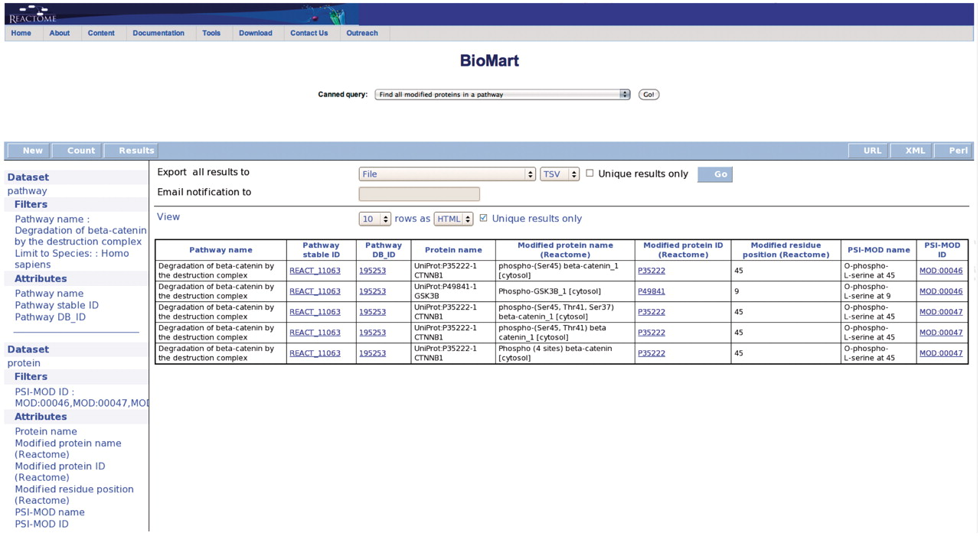
Figure 3. Results of finding all modified proteins in a pathway. The user is then able to inspect the retrieved ...
Notes:
Figure 3. Results of finding all modified proteins in a pathway. The user is then able to inspect the retrieved proteins for the kinds of modification present on each protein (PSI-MOD), the modified residue in the protein, the cell compartment of the modified protein and the position of the modified residue on the protein if known (Modified Residue coordinate).
Unless provided in the caption above, the following copyright applies to the content of this slide: © The Author(s) 2011. Published by Oxford University Press.This is Open Access article distributed under the terms of the Creative Commons Attribution Non-Commercial License (http://creativecommons.org/licenses/by-nc/2.5), which permits unrestricted non-commercial use, distribution, and reproduction in any medium, provided the original work is properly cited.

