Slide 1
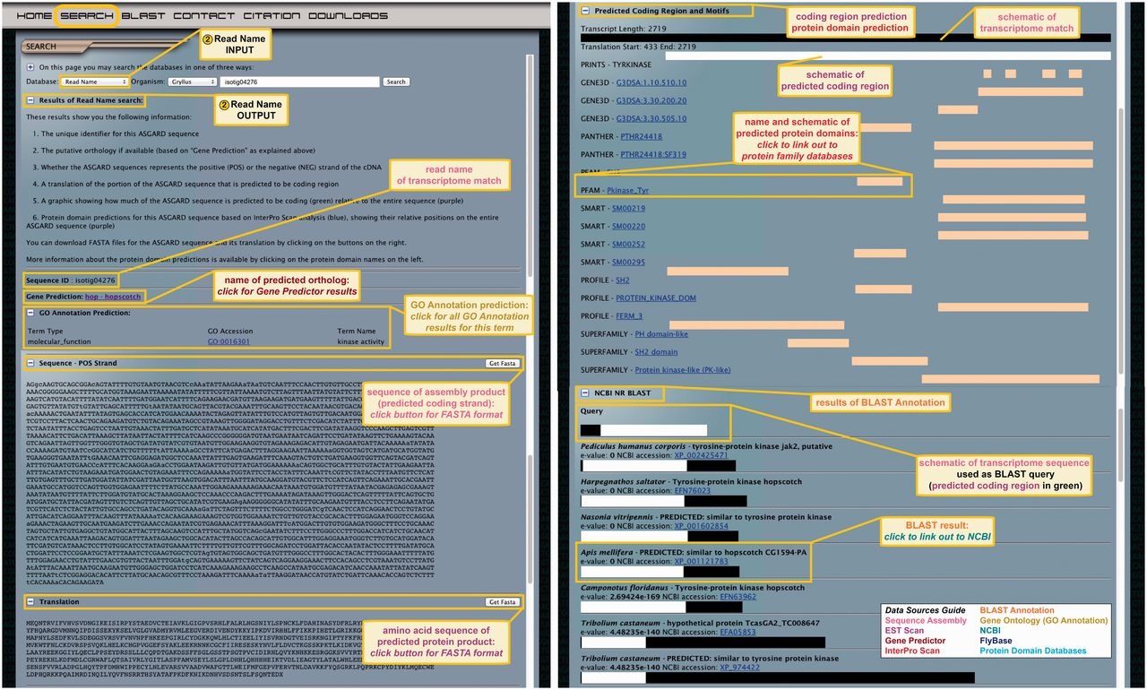
Figure 4 ASGARD Read Name search. The input user interface allows users to enter an assembly product (isotig or ...
Notes:
Figure 4 ASGARD Read Name search. The input user interface allows users to enter an assembly product (isotig or singleton) unique identifier (read name) obtained with any of the other search methods (Figures 3 and 5–7). In this example, read name isotig04276 was obtained in a Gene Prediction search (Figure 3) as a putative G. bimaculatus JAK ortholog. The output of read name searches provides all annotation data for the selected assembly product.
Unless provided in the caption above, the following copyright applies to the content of this slide: © The Author(s) 2012. Published by Oxford University Press.This is an Open Access article distributed under the terms of the Creative Commons Attribution License (http://creativecommons.org/licenses/by-nc/3.0/), which permits non-commercial reuse, distribution, and reproduction in any medium, provided the original work is properly cited. For commercial re-use, please contact journals.permissions@oup.com.

