Slide 1
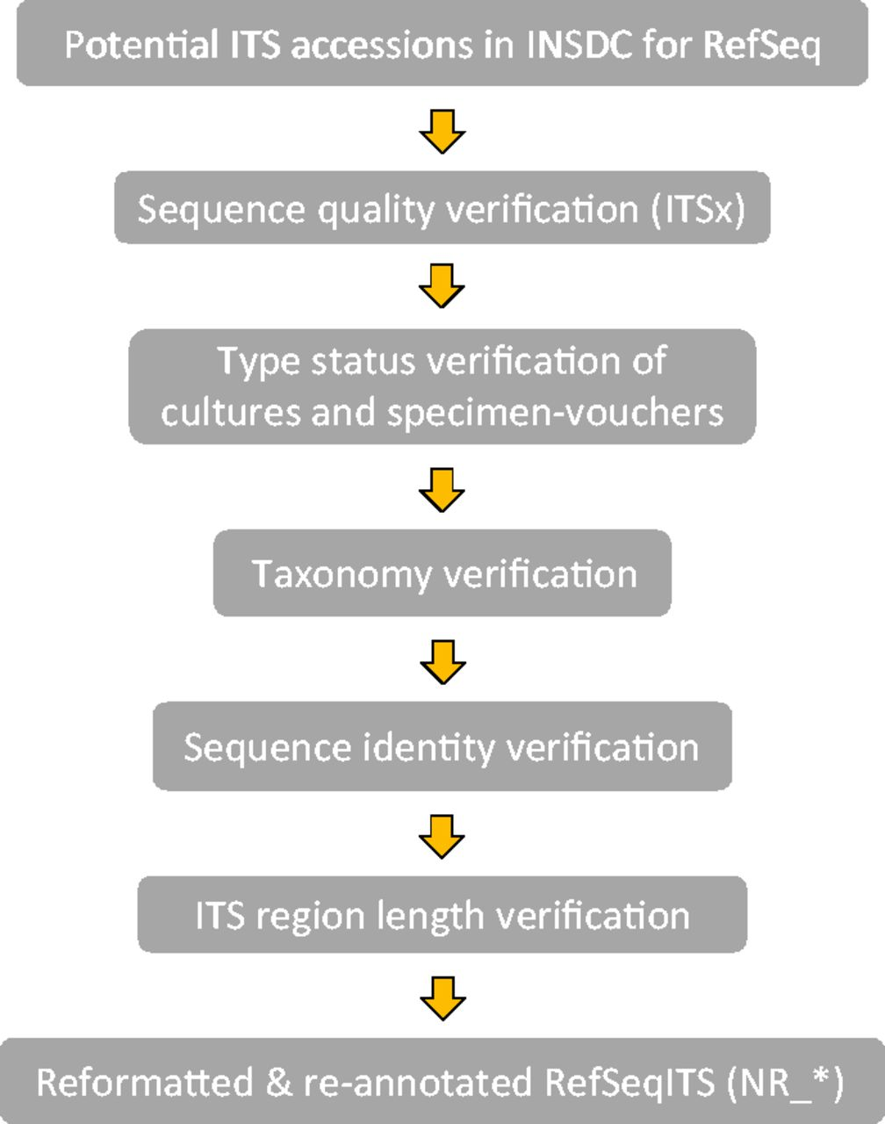
Figure 1. Workflow of the ITS verification for RTL ITS.
Notes:
Figure 1. Workflow of the ITS verification for RTL ITS.
Unless provided in the caption above, the following copyright applies to the content of this slide: Published by Oxford University Press 2013. This work is written by US Government employees and is in the public domain in the US.

Slide 2
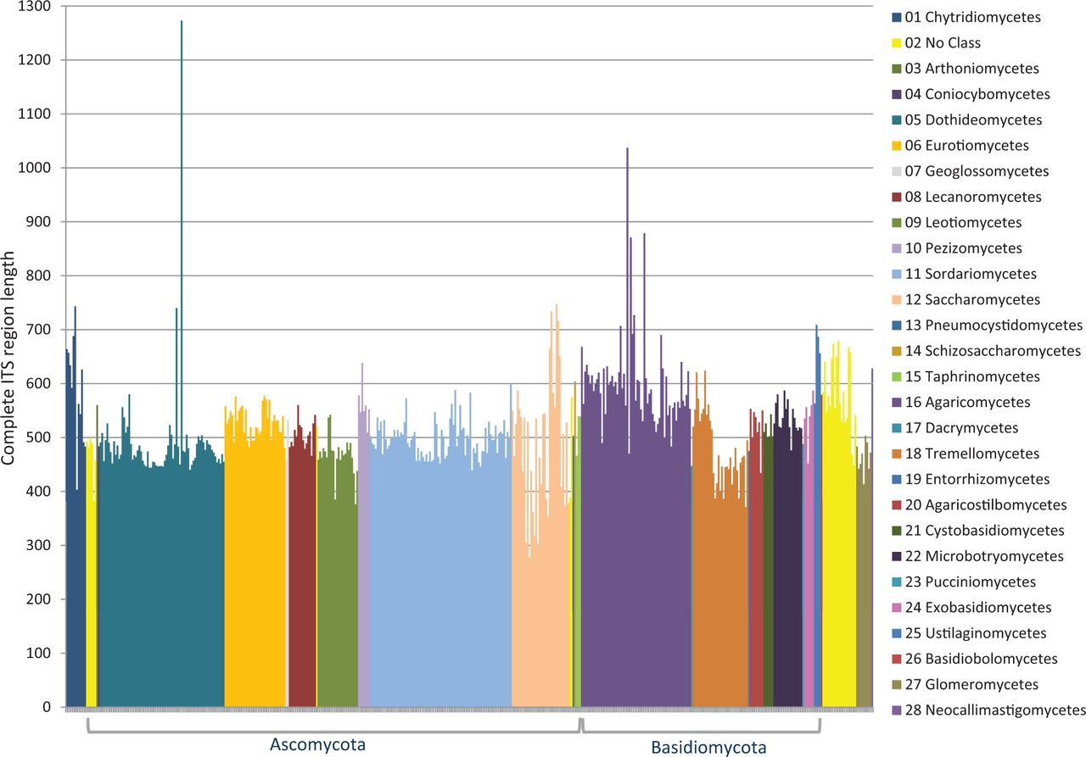
Figure 2. ITS length variation of complete ITS regions in the RTL data set according to class.
Notes:
Figure 2. ITS length variation of complete ITS regions in the RTL data set according to class.
Unless provided in the caption above, the following copyright applies to the content of this slide: Published by Oxford University Press 2013. This work is written by US Government employees and is in the public domain in the US.

Slide 3
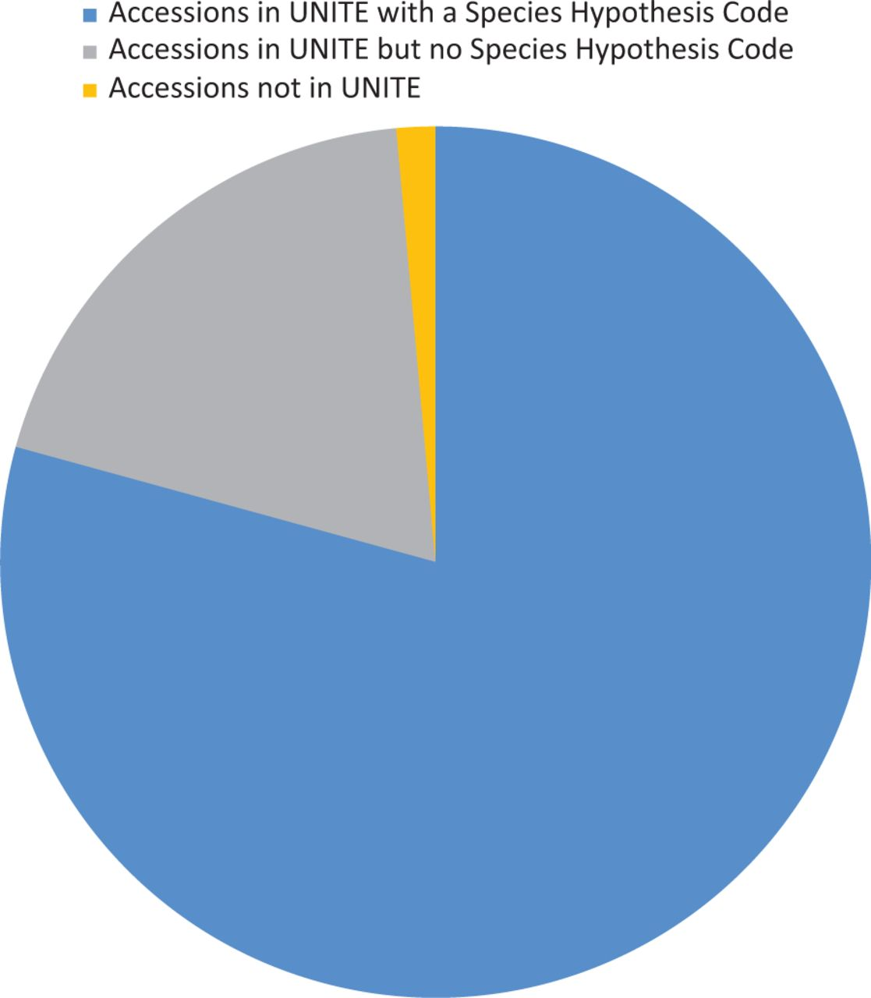
Figure 3. Diagram showing the proportion of accessions associated with UNITE (version 6) data.
Notes:
Figure 3. Diagram showing the proportion of accessions associated with UNITE (version 6) data.
Unless provided in the caption above, the following copyright applies to the content of this slide: Published by Oxford University Press 2013. This work is written by US Government employees and is in the public domain in the US.

Slide 4
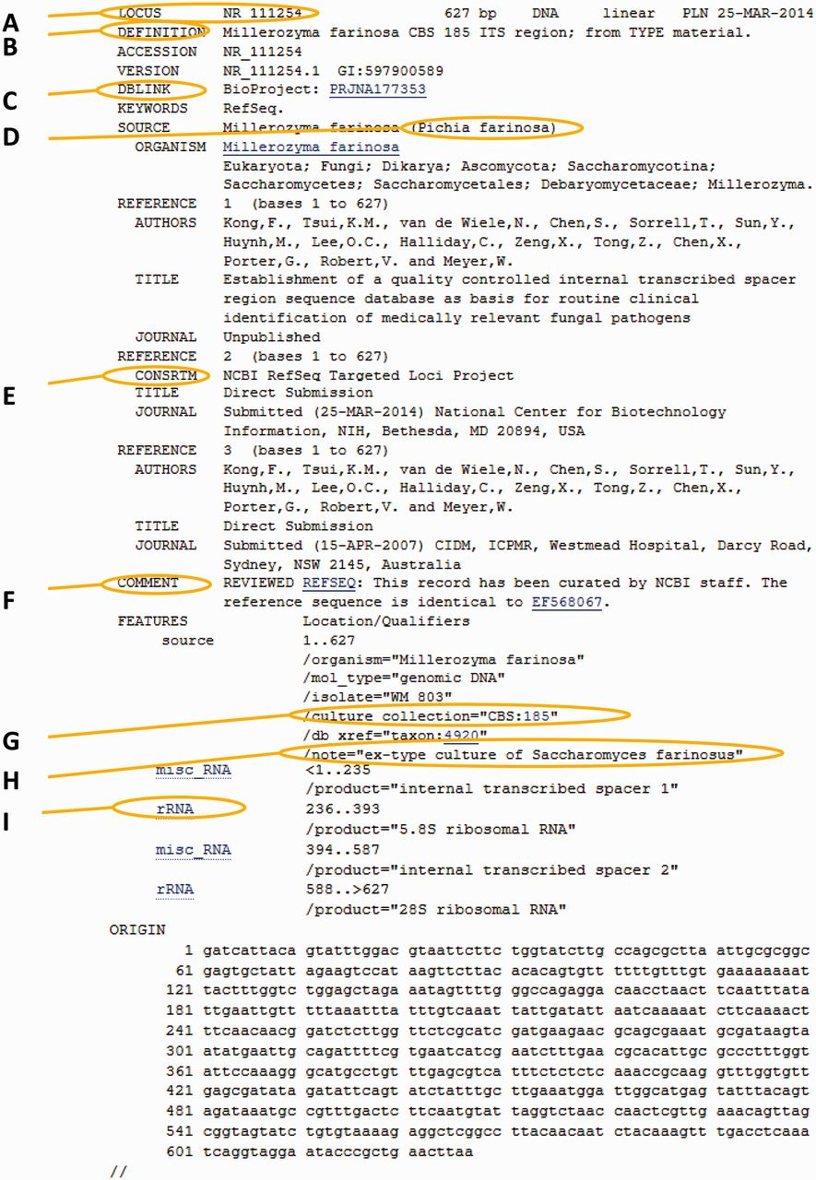
Figure 4. Anatomy of an RTL record. The marked areas indicate most common additions to the original nucleotide record. ...
Notes:
Figure 4. Anatomy of an RTL record. The marked areas indicate most common additions to the original nucleotide record. (A) New RTL accession number; (B) new simplified definition line; (C) Bioproject number for the ITS-targeted loci project; (D) GenBank synonym of current taxonomic name (used in cases of common usage); (E) label indicating that this is a RefSeq record; (F) comment regarding the source of the record; (G) the culture collection or specimen voucher presented as a validated structured triplet or doublet that can link directly to a relevant outside culture or specimen page; (H) additional information on the type and basionym name; (I) the ITS entry of all records was re-annotated to indicate the spacers and ribosomal genes.
Unless provided in the caption above, the following copyright applies to the content of this slide: Published by Oxford University Press 2013. This work is written by US Government employees and is in the public domain in the US.

Slide 5
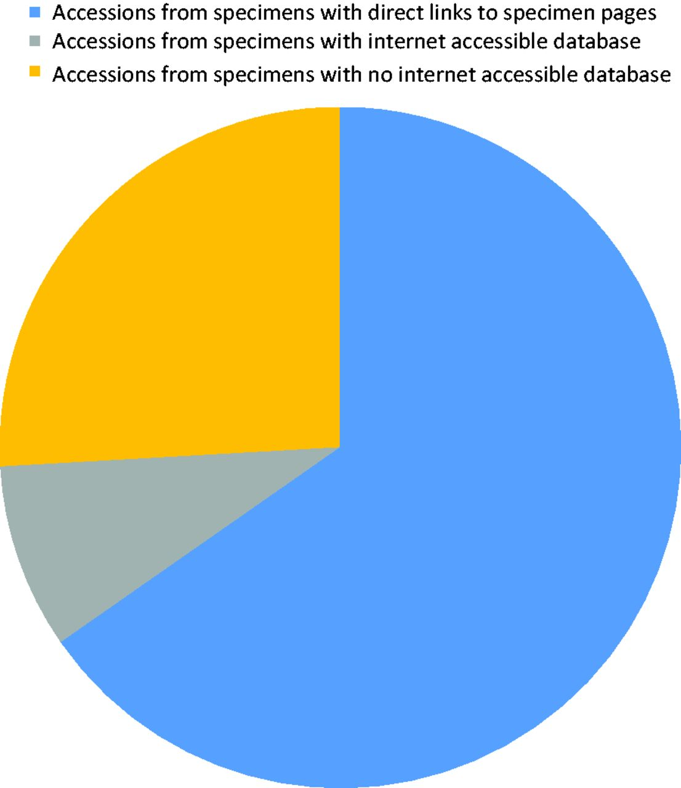
Figure 5. Diagram showing the proportion of accessions that originated from specimens associated with a collection that ...
Notes:
Figure 5. Diagram showing the proportion of accessions that originated from specimens associated with a collection that has an online database.
Unless provided in the caption above, the following copyright applies to the content of this slide: Published by Oxford University Press 2013. This work is written by US Government employees and is in the public domain in the US.

Slide 6
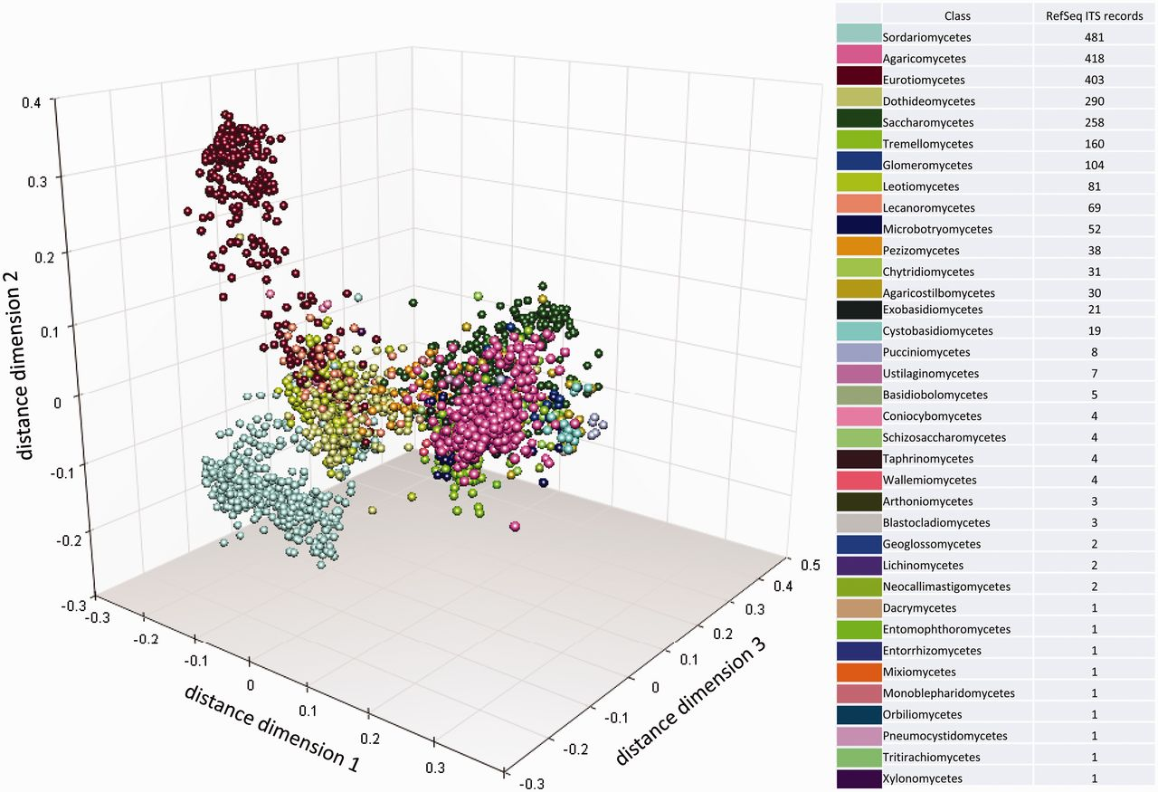
Figure 6. Multidimensional scaling clustering of RTL ITS sequences and coloring, according to the NCBI Taxonomy ...
Notes:
Figure 6. Multidimensional scaling clustering of RTL ITS sequences and coloring, according to the NCBI Taxonomy classification at class rank. Each marker represents an individual sequence.
Unless provided in the caption above, the following copyright applies to the content of this slide: Published by Oxford University Press 2013. This work is written by US Government employees and is in the public domain in the US.

Slide 7
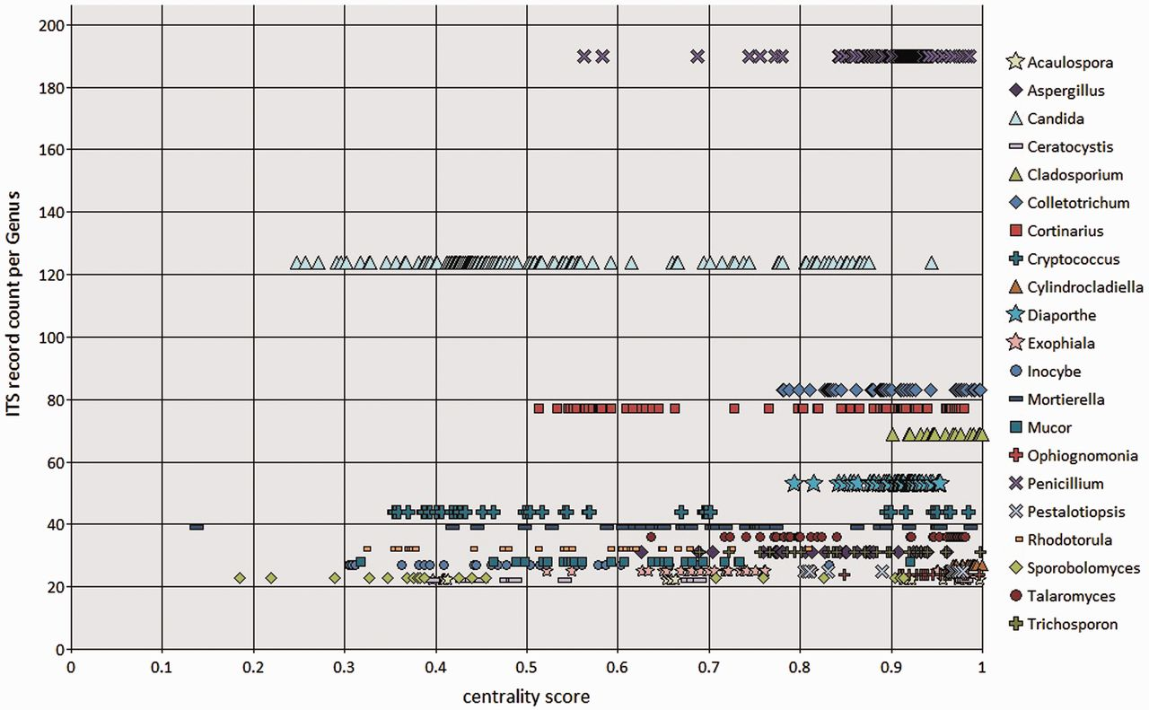
Figure 7. BioloMICS centrality scores of ITS sequences at genus rank, showing genera with ≥20 ITS records in the RefSeq ...
Notes:
Figure 7. BioloMICS centrality scores of ITS sequences at genus rank, showing genera with ≥20 ITS records in the RefSeq data set. Each marker represents an individual sequence.
Unless provided in the caption above, the following copyright applies to the content of this slide: Published by Oxford University Press 2013. This work is written by US Government employees and is in the public domain in the US.

