Slide 1
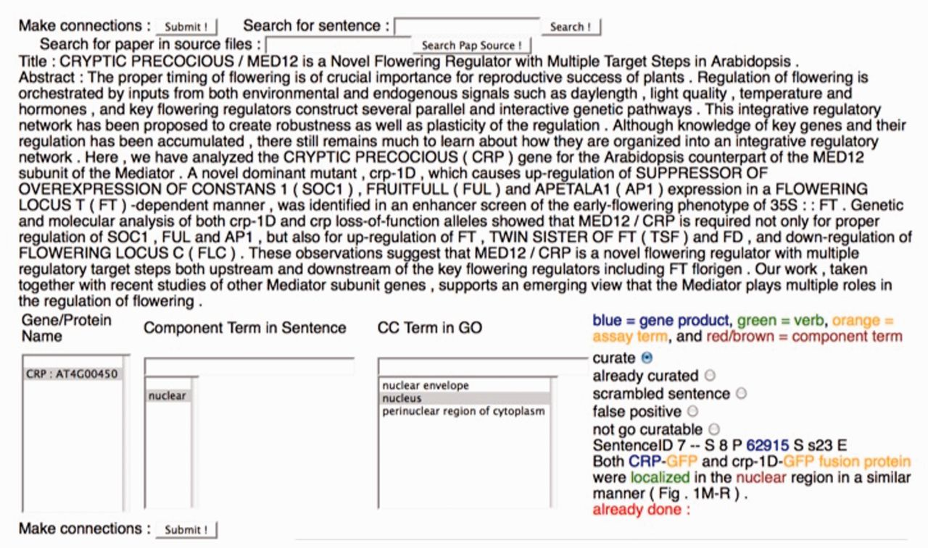
Figure 3 The Textpresso for CCC Curation Form. A screenshot of the curation form used for the Textpresso for CCC ...
Notes:
Figure 3 The Textpresso for CCC Curation Form. A screenshot of the curation form used for the Textpresso for CCC evaluation is shown. Textpresso sentences are displayed on the bottom right corner of the form, with matches to each of the Textpresso categories highlighted and color coded. The title and abstract of the paper are shown at the top. On the bottom left side of the form are three curation boxes containing, from left to right, the identified gene product, the component term from the retrieved sentence and suggested GO terms based on the previous curation. To make a GO annotation, the curator makes a selection from each of the boxes, highlighted in gray, selects the curate radio button above the sentence and presses Submit to commit the annotation to the curation database. Additional radio buttons allow curators to further classify sentences, if needed. These additional actions were not part of the current BioCreative evaluation.
Unless provided in the caption above, the following copyright applies to the content of this slide: © The Author(s) 2012. Published by Oxford University Press.This is an Open Access article distributed under the terms of the Creative Commons Attribution License (http://creativecommons.org/licenses/by-nc/3.0/), which permits non-commercial reuse, distribution, and reproduction in any medium, provided the original work is properly cited. For commercial re-use, please contact journals.permissions@oup.com.

