Slide 1
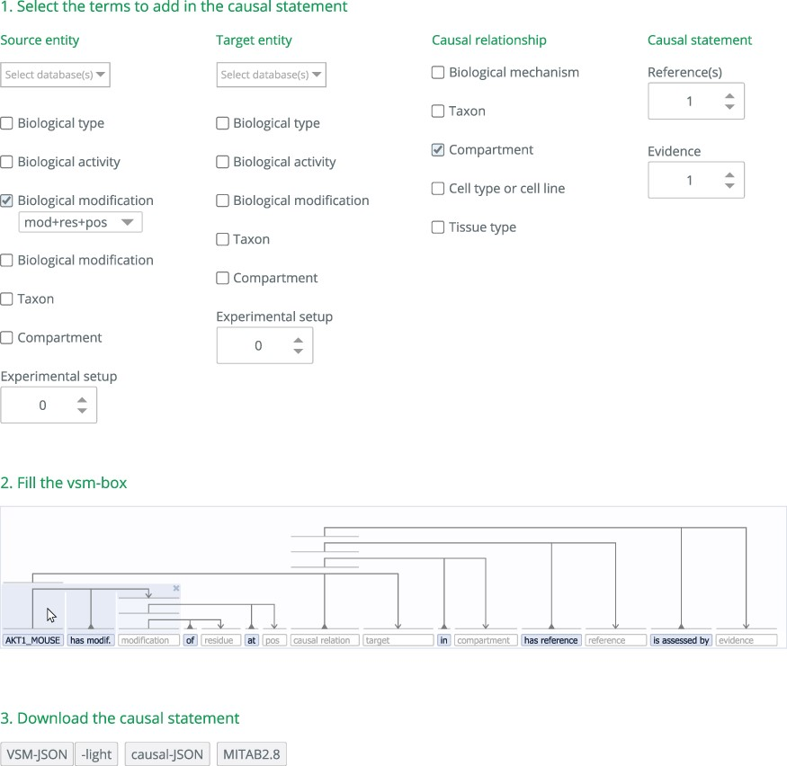
Figure 1. Steps for building a causal statement in causalBuilder. In Step 1, the different annotation features ...
Notes:
Figure 1. Steps for building a causal statement in causalBuilder. In Step 1, the different annotation features supported by MI2CAST can be selected in causalBuilder's interactive selection panel (larger than shown). Here, a ‘biological modification’ for the source entity is selected as well as the ‘compartment’ where the causal relationship occurs. In Step 2, the VSM-template that is created based on these selections contains the requested fields that need to be filled with annotations. The panel shows the mandatory field for ‘source entity’(already filled with an ‘AKT1_MOUSE’ annotation), and other empty fields for ‘[biological] modification’, ‘causal relation’, ‘target [entity]’, ‘compartment’, ‘reference [paper]’, and ‘evidence’ (hinted in lightgrey). Some VSM-terms are pre-filled (e.g., ‘has modif.’) and define the relation between empty fields. On top, pre-added VSM-connectors assign each term to one or more semantic subunits (all groups of three here); and note that connectors always attach to terms, not to other connectors. Mousing over the VSM-connectors highlights terms connected together in a triple. Here, it shows that the ‘modification’ term relates to the ‘AKT1_MOUSE’ source entity. As text is being typed as a VSM-term, an autocomplete panel appears. It presents matching terms and their description (a combination of definition, identifier, etc.), fetched from online controlled vocabularies relevant for that field, facilitated by the UniBioDicts software (see Step 2, below) (13). In Step 3, after the template is filled, the resulting causal statement can be downloaded in several formats.
Unless provided in the caption above, the following copyright applies to the content of this slide: © The Author(s) 2021. Published by Oxford University Press.This is an Open Access article distributed under the terms of the Creative Commons Attribution License (http://creativecommons.org/licenses/by/4.0/), which permits unrestricted reuse, distribution, and reproduction in any medium, provided the original work is properly cited.

