Slide 1
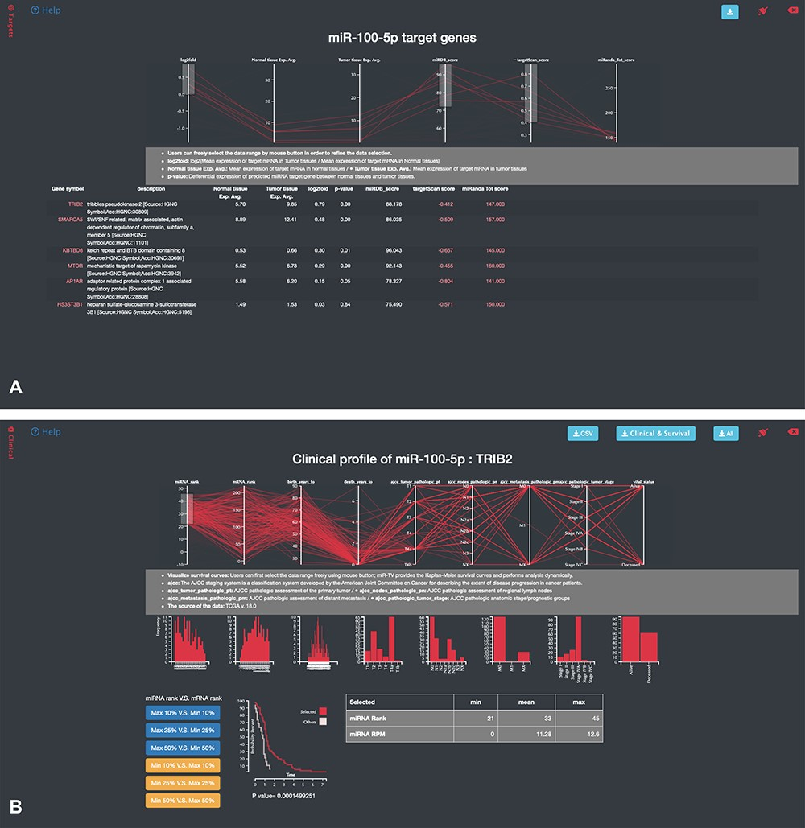
Figure 4 Specific-overview miRNA–target gene interface of miR-TV. (A) Users can enter the miRNA target gene ...
Notes:
Figure 4 Specific-overview miRNA–target gene interface of miR-TV. (A) Users can enter the miRNA target gene interrogation interface by clicking either the green colored ‘Predicted mRNA Targets’ button or the @Targets black side menu bar. Multiple features of miRNA/mRNA expression and target prediction scores are displayed and can be easily filtered according to the user’s criteria by clicking and dragging the mouse to make a selection. Lines connect all information for any given target gene, and by moving the mouse over any given gene symbol, users can view the connected information, which is highlighted by a bold line. Additional prediction information is displayed by clicking the targetScan score and miRanda Tot score links; (B) by clicking on any target gene, users can enter the specific-overview interface for individual target gene interrogation. In this interface, users can further interrogate clinical information and miRNA/mRNA expression information by clicking the green colored ‘Clinical Information on Target mRNA’ button. Users can select different miRNA and mRNA expression groups to interrogate the expression relationship of miRNA–mRNA gene pairs. In addition, different clinical information features can be freely interrogated by clicking and dragging the mouse to make a selection. Preset buttons on the lower left panel can be used to examine the inverse relationship between the miRNA and target mRNA. The Kaplan–Meier survival curve plot and expression information is then displayed to dynamically reflect the user’s changes. The survival graph and detailed expression information can also be retrieved by using the download button on the top panel.
Unless provided in the caption above, the following copyright applies to the content of this slide: © The Author(s) 2020. Published by Oxford University Press. All rights reserved. For Permissions, please email: journals.permissions@oup.comThis is an Open Access article distributed under the terms of the Creative Commons Attribution License (http://creativecommons.org/licenses/by/4.0/), which permits unrestricted reuse, distribution, and reproduction in any medium, provided the original work is properly cited.

