Slide 1
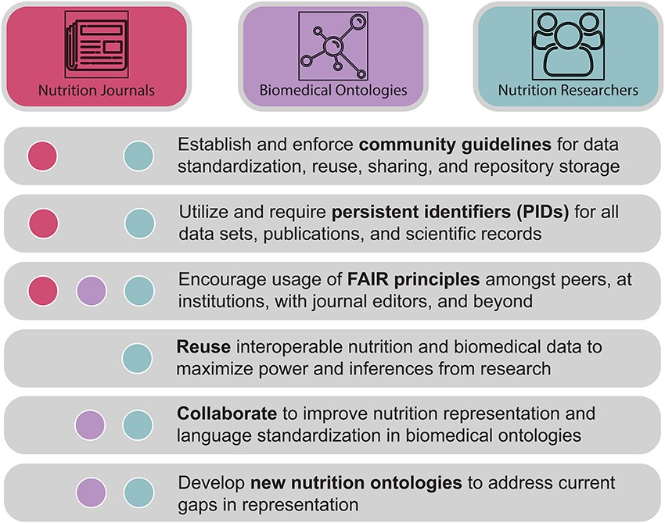
Figure 4. A call to action. Nutri-informatics stakeholders such as nutrition researchers, biomedical ontology ...
Notes:
Figure 4. A call to action. Nutri-informatics stakeholders such as nutrition researchers, biomedical ontology developers and academic journal communities are needed to realize the connectivity and analyzability of nutrition data. Key tasks are described here, including actions to improve data interoperability, identifiability and collaboration between communities.
Unless provided in the caption above, the following copyright applies to the content of this slide: © The Author(s) 2021. Published by Oxford University Press.This is an Open Access article distributed under the terms of the Creative Commons Attribution License (http://creativecommons.org/licenses/by/4.0/), which permits unrestricted reuse, distribution, and reproduction in any medium, provided the original work is properly cited.

