Slide 1
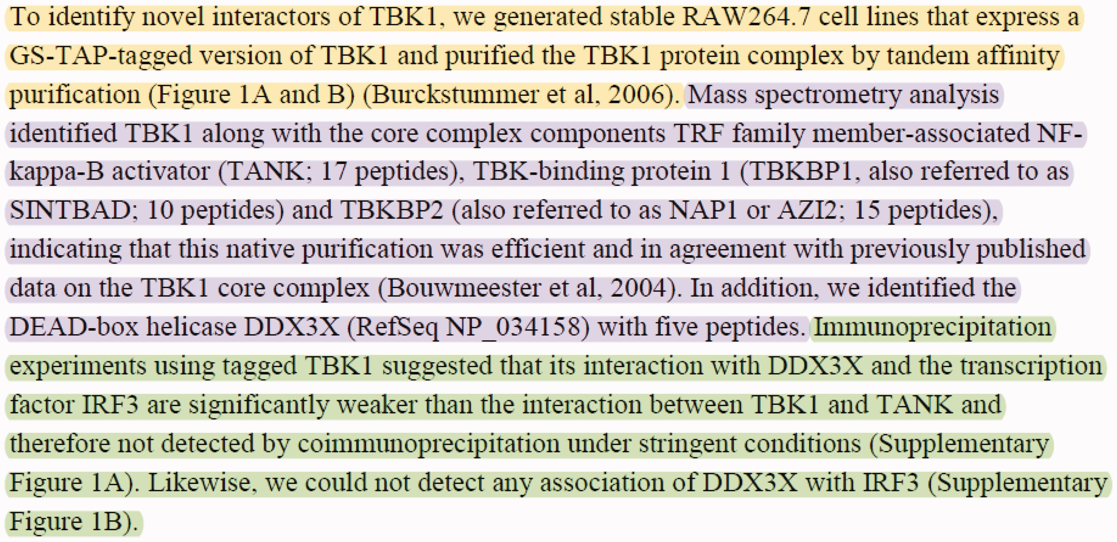
Figure 1. Sample text with multiple PPIs and experimental methods taken from the Results section of (30). The text ...
Notes:
Figure 1. Sample text with multiple PPIs and experimental methods taken from the Results section of (30). The text describes three experimental interaction detection methods used to identify the proteins interacting with the ‘TBK1’ protein. The passages describing the experimental interaction detection methods ‘tandem affinity purification’ (MI:0676), ‘mass spectrometry studies of complexes’ (MI:0069), and ‘coimmunoprecipitation’ (MI:0019) are highlighted with yellow, purple and green, respectively.
Unless provided in the caption above, the following copyright applies to the content of this slide: © The Author(s) 2017. Published by Oxford University Press.This is an Open Access article distributed under the terms of the Creative Commons Attribution License (http://creativecommons.org/licenses/by/4.0/), which permits unrestricted reuse, distribution, and reproduction in any medium, provided the original work is properly cited.

Slide 2
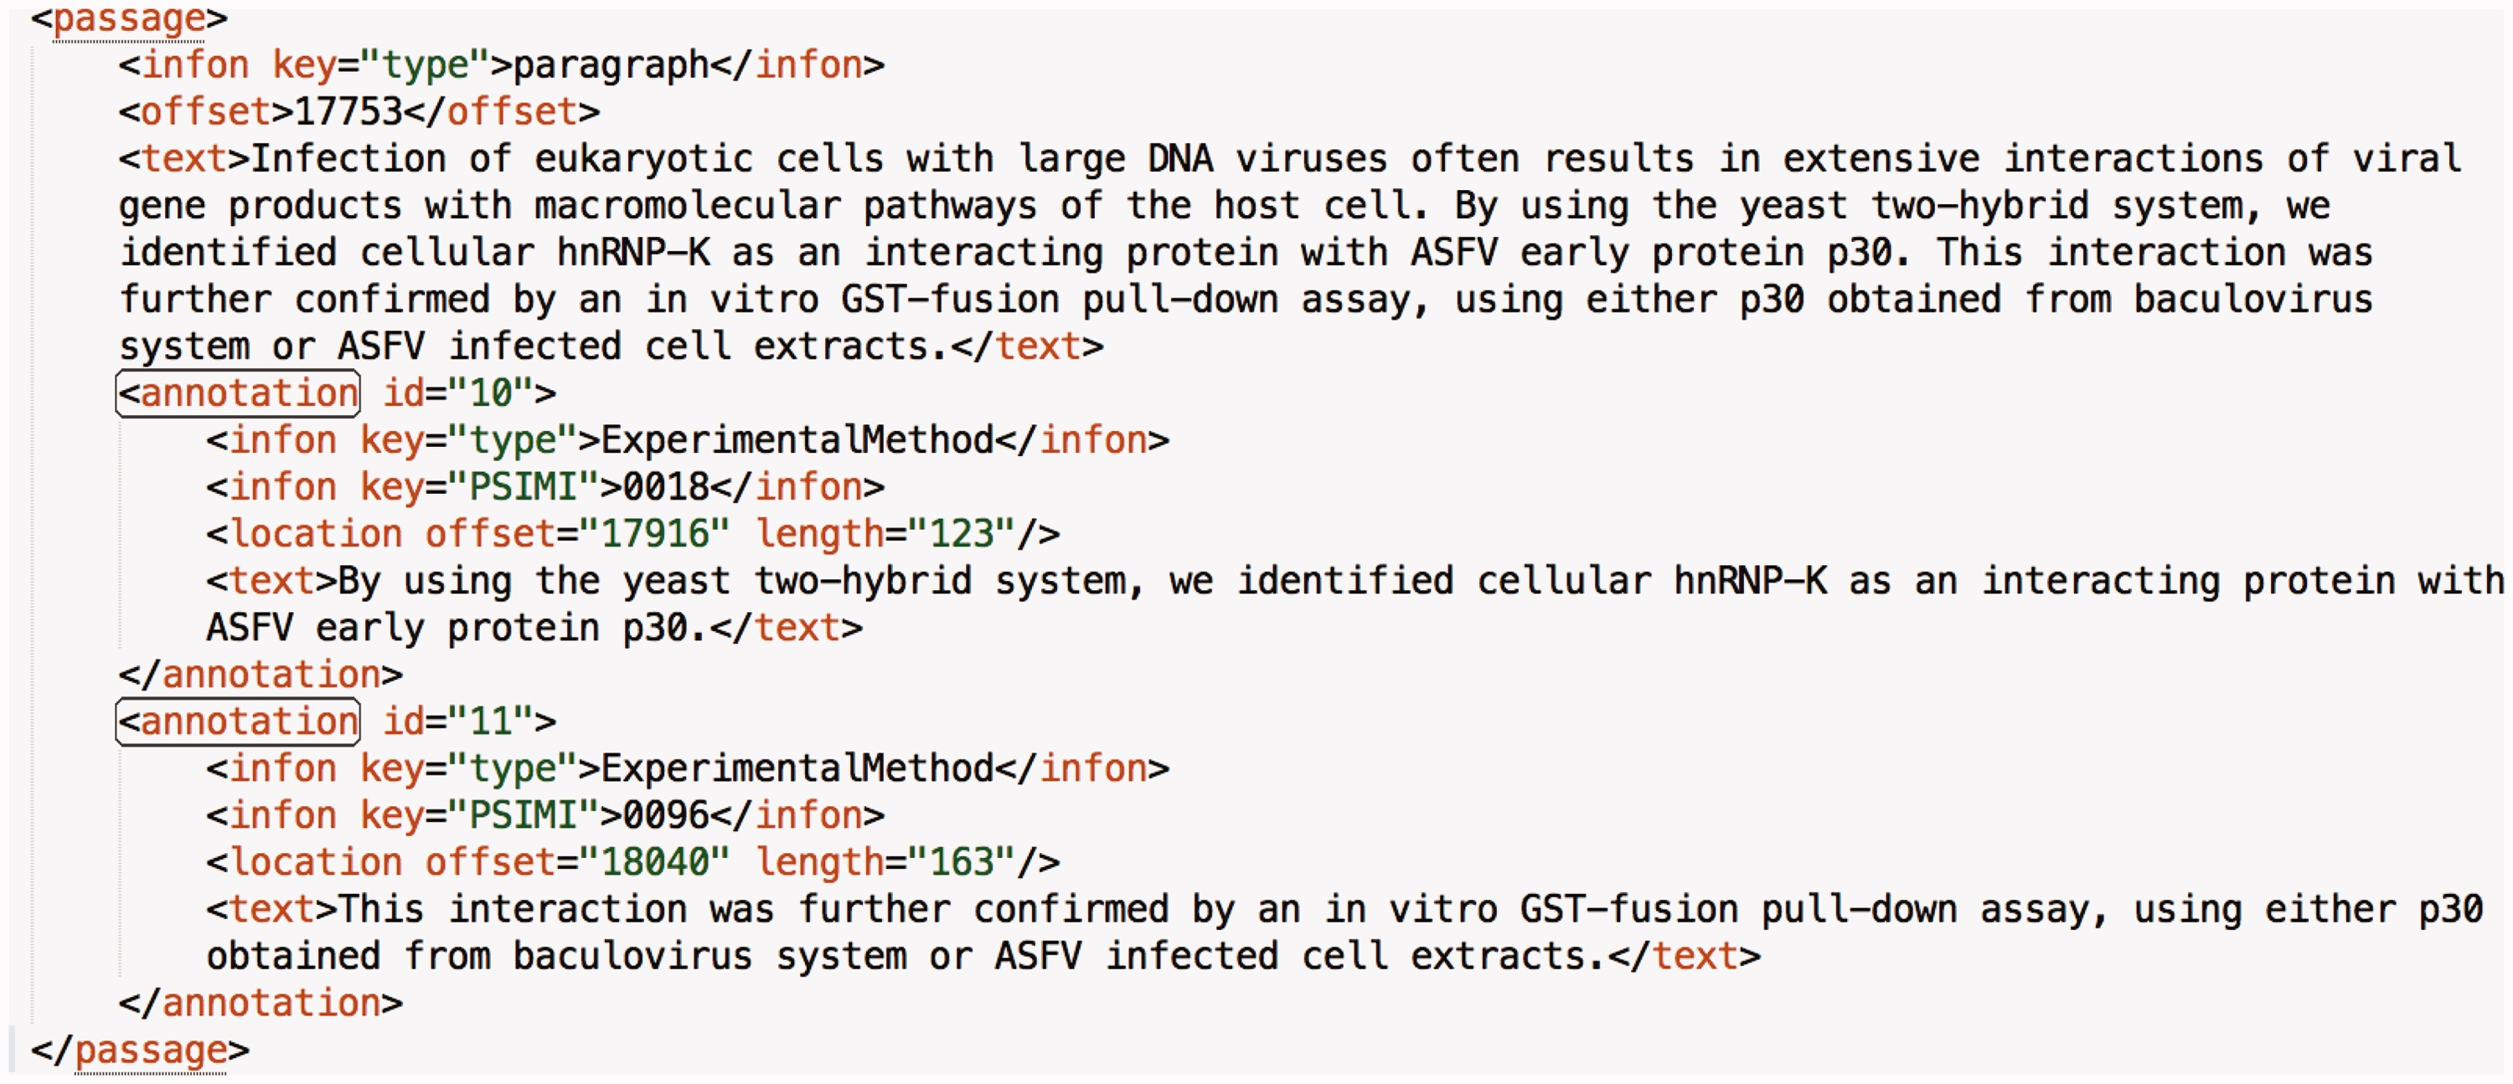
Figure 2. A sample annotation from a paragraph of an article in the data set. Each annotation has an identifier that is ...
Notes:
Figure 2. A sample annotation from a paragraph of an article in the data set. Each annotation has an identifier that is incremented by one throughout the article. Moreover, the value of the ‘type’ infon is static and set to ‘ExperimentalMethod’ for all annotations. The value of the ‘PSIMI’ infon is set to the PSI-MI identifier of the interaction detection method. The ‘text’ tag holds the annotated sentence(s). The ‘location’ tag holds the position of the annotated portion in the article with the ‘offset’ and ‘length’ attributes.
Unless provided in the caption above, the following copyright applies to the content of this slide: © The Author(s) 2017. Published by Oxford University Press.This is an Open Access article distributed under the terms of the Creative Commons Attribution License (http://creativecommons.org/licenses/by/4.0/), which permits unrestricted reuse, distribution, and reproduction in any medium, provided the original work is properly cited.

Slide 3
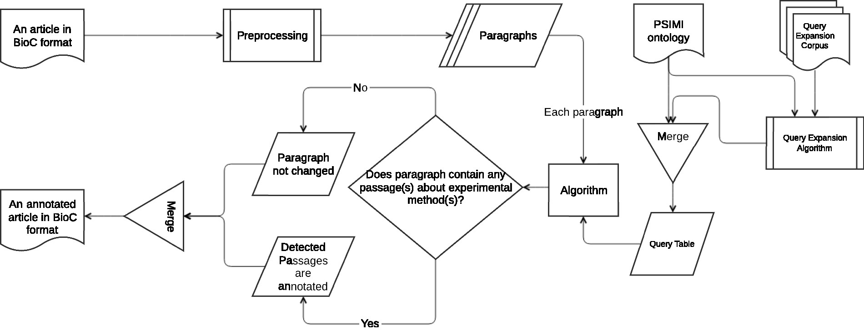
Figure 3. Overall system workflow.
Notes:
Figure 3. Overall system workflow.
Unless provided in the caption above, the following copyright applies to the content of this slide: © The Author(s) 2017. Published by Oxford University Press.This is an Open Access article distributed under the terms of the Creative Commons Attribution License (http://creativecommons.org/licenses/by/4.0/), which permits unrestricted reuse, distribution, and reproduction in any medium, provided the original work is properly cited.

Slide 4
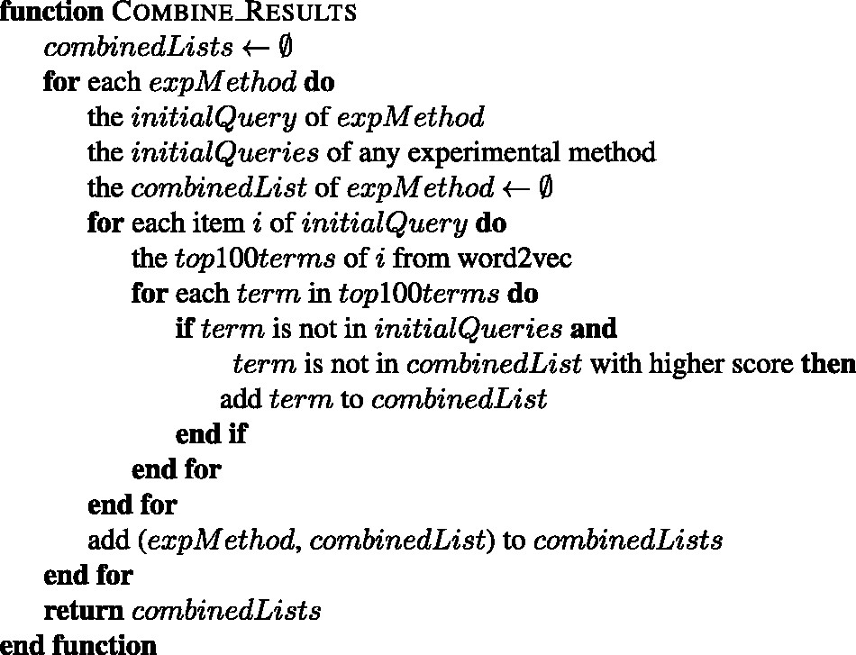
Figure 4. The algorithm for combining the word2vec results of each experimental method into one list.
Notes:
Figure 4. The algorithm for combining the word2vec results of each experimental method into one list.
Unless provided in the caption above, the following copyright applies to the content of this slide: © The Author(s) 2017. Published by Oxford University Press.This is an Open Access article distributed under the terms of the Creative Commons Attribution License (http://creativecommons.org/licenses/by/4.0/), which permits unrestricted reuse, distribution, and reproduction in any medium, provided the original work is properly cited.

Slide 5
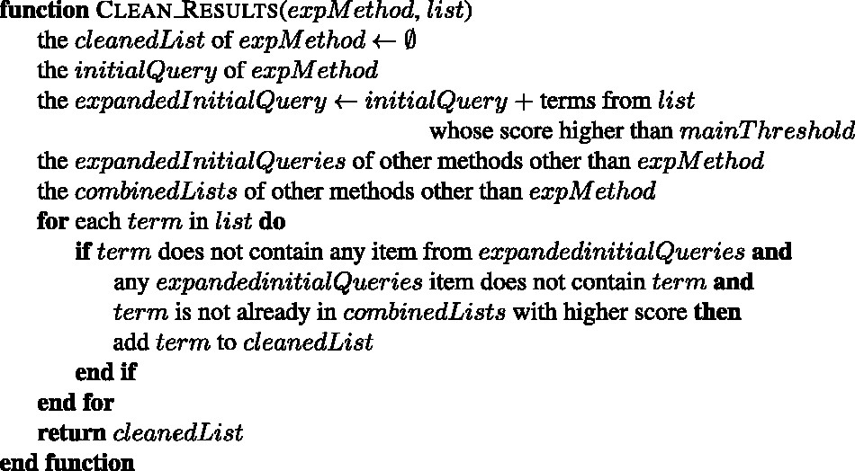
Figure 5. The algorithm for cleaning the given list of an experimental method.
Notes:
Figure 5. The algorithm for cleaning the given list of an experimental method.
Unless provided in the caption above, the following copyright applies to the content of this slide: © The Author(s) 2017. Published by Oxford University Press.This is an Open Access article distributed under the terms of the Creative Commons Attribution License (http://creativecommons.org/licenses/by/4.0/), which permits unrestricted reuse, distribution, and reproduction in any medium, provided the original work is properly cited.

Slide 6
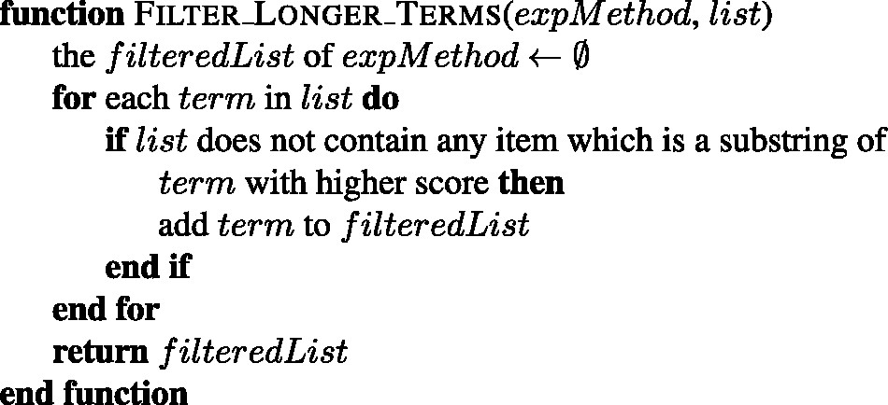
Figure 6. The algorithm for filtering the longer terms with lower scores from the given list of an experimental ...
Notes:
Figure 6. The algorithm for filtering the longer terms with lower scores from the given list of an experimental method.
Unless provided in the caption above, the following copyright applies to the content of this slide: © The Author(s) 2017. Published by Oxford University Press.This is an Open Access article distributed under the terms of the Creative Commons Attribution License (http://creativecommons.org/licenses/by/4.0/), which permits unrestricted reuse, distribution, and reproduction in any medium, provided the original work is properly cited.

Slide 7
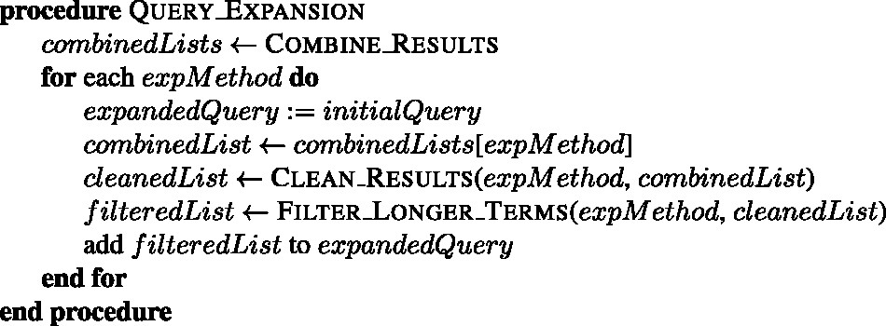
Figure 7. The query expansion algorithm of wor2vec approach.
Notes:
Figure 7. The query expansion algorithm of wor2vec approach.
Unless provided in the caption above, the following copyright applies to the content of this slide: © The Author(s) 2017. Published by Oxford University Press.This is an Open Access article distributed under the terms of the Creative Commons Attribution License (http://creativecommons.org/licenses/by/4.0/), which permits unrestricted reuse, distribution, and reproduction in any medium, provided the original work is properly cited.

Slide 8
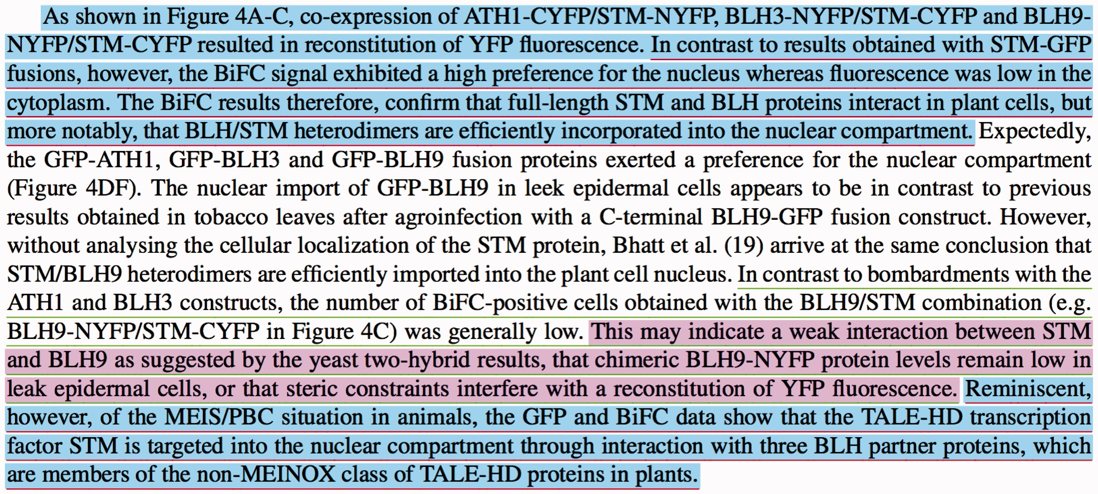
Figure 8. An example paragraph which shows our evaluation logic over three sample manual and system annotations. The ...
Notes:
Figure 8. An example paragraph which shows our evaluation logic over three sample manual and system annotations. The manually annotated passages are underlined with red and green for ‘bimolecular fluorescence complementation’ (MI:0809) and ‘two hybrid’ (MI:0018) experimental methods, respectively. The annotated passages by the system are colored with blue and purple for ‘bimolecular fluorescence complementation’ (MI:0809) and ‘two hybrid’ (MI:0018) experimental methods, respectively.
Unless provided in the caption above, the following copyright applies to the content of this slide: © The Author(s) 2017. Published by Oxford University Press.This is an Open Access article distributed under the terms of the Creative Commons Attribution License (http://creativecommons.org/licenses/by/4.0/), which permits unrestricted reuse, distribution, and reproduction in any medium, provided the original work is properly cited.

