Slide 1
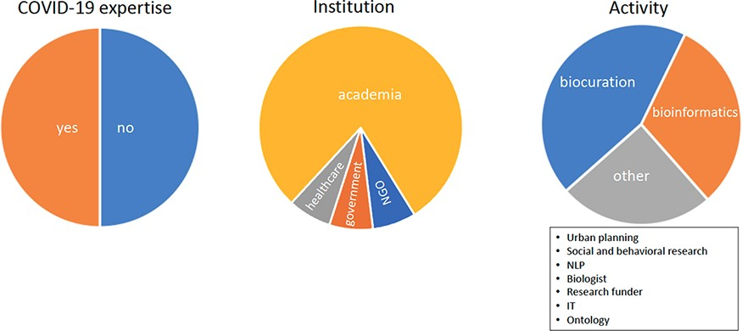
Figure 1. Pie charts show the COVID-19 expertise, the place of employment and the position roles of users.
Notes:
Figure 1. Pie charts show the COVID-19 expertise, the place of employment and the position roles of users.
Unless provided in the caption above, the following copyright applies to the content of this slide: © The Author(s) 2022. Published by Oxford University Press.This is an Open Access article distributed under the terms of the Creative Commons Attribution-NonCommercial License (https://creativecommons.org/licenses/by-nc/4.0/), which permits non-commercial re-use, distribution, and reproduction in any medium, provided the original work is properly cited. For commercial re-use, please contact journals.permissions@oup.com

Slide 2
Figure 2. System information table with links to user activities.
Notes:
Figure 2. System information table with links to user activities.
Unless provided in the caption above, the following copyright applies to the content of this slide: © The Author(s) 2022. Published by Oxford University Press.This is an Open Access article distributed under the terms of the Creative Commons Attribution-NonCommercial License (https://creativecommons.org/licenses/by-nc/4.0/), which permits non-commercial re-use, distribution, and reproduction in any medium, provided the original work is properly cited. For commercial re-use, please contact journals.permissions@oup.com

Slide 3
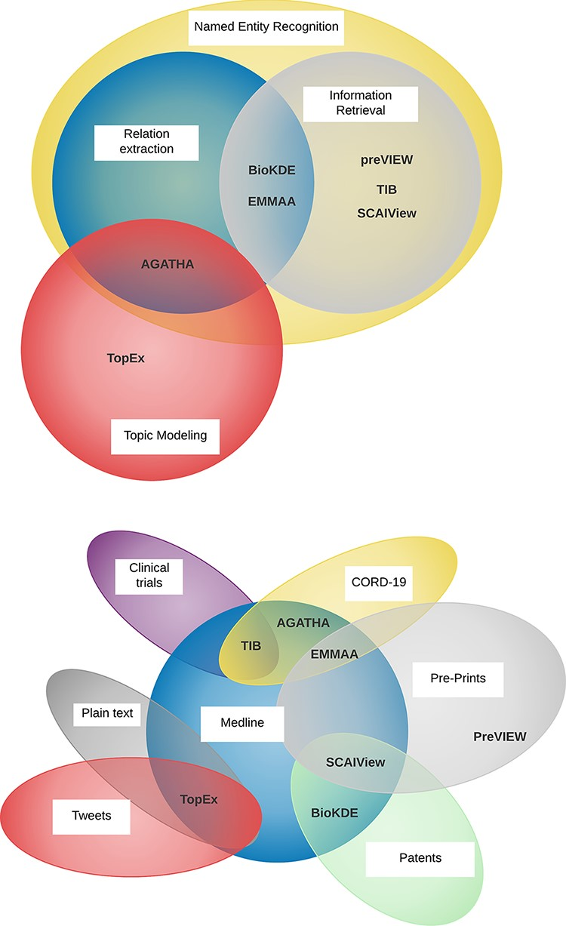
Figure 3. Venn diagrams showing the diversity of the tasks performed by the participating NLP teams (top) and the ...
Notes:
Figure 3. Venn diagrams showing the diversity of the tasks performed by the participating NLP teams (top) and the various sources of textual data (bottom).
Unless provided in the caption above, the following copyright applies to the content of this slide: © The Author(s) 2022. Published by Oxford University Press.This is an Open Access article distributed under the terms of the Creative Commons Attribution-NonCommercial License (https://creativecommons.org/licenses/by-nc/4.0/), which permits non-commercial re-use, distribution, and reproduction in any medium, provided the original work is properly cited. For commercial re-use, please contact journals.permissions@oup.com

Slide 4
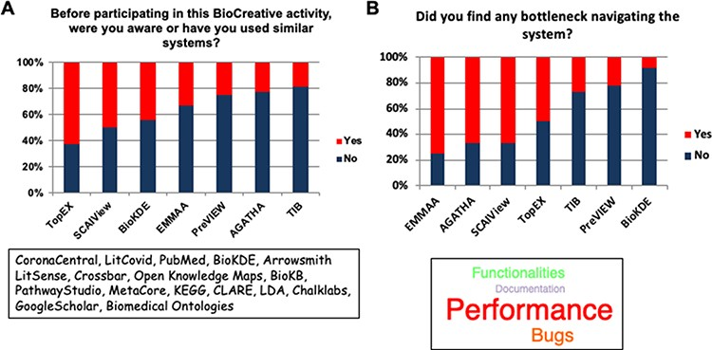
Figure 4. The two bar plots display the familiarity of the users with systems similar to the ones participating in ...
Notes:
Figure 4. The two bar plots display the familiarity of the users with systems similar to the ones participating in Track IV (A) and the most common bottlenecks encountered in the evaluation of the systems (B).
Unless provided in the caption above, the following copyright applies to the content of this slide: © The Author(s) 2022. Published by Oxford University Press.This is an Open Access article distributed under the terms of the Creative Commons Attribution-NonCommercial License (https://creativecommons.org/licenses/by-nc/4.0/), which permits non-commercial re-use, distribution, and reproduction in any medium, provided the original work is properly cited. For commercial re-use, please contact journals.permissions@oup.com

Slide 5
Figure 5. Word cloud representation generated with aggregated user comments about their favorite system features. ...
Notes:
Figure 5. Word cloud representation generated with aggregated user comments about their favorite system features. Comments identified unique aspects of the systems such as comprehensive sources for preprints in preVIEW, highlighting concepts in semantic search engines like SCAIView filters and data organization in TIB, graph capabilities and interactivity in BioKDE and EMMAA, topic paths in AGATHA and finding trends in TopEX.
Unless provided in the caption above, the following copyright applies to the content of this slide: © The Author(s) 2022. Published by Oxford University Press.This is an Open Access article distributed under the terms of the Creative Commons Attribution-NonCommercial License (https://creativecommons.org/licenses/by-nc/4.0/), which permits non-commercial re-use, distribution, and reproduction in any medium, provided the original work is properly cited. For commercial re-use, please contact journals.permissions@oup.com

Slide 6
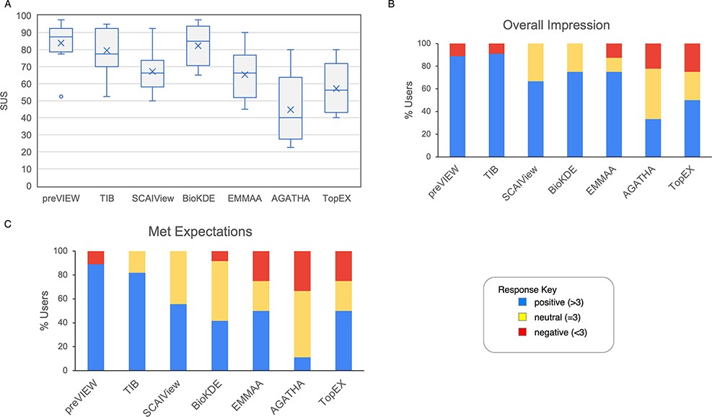
Figure 6. Results from questions evaluated with a Likert scale. (A) The boxplot represents the SUS distribution for ...
Notes:
Figure 6. Results from questions evaluated with a Likert scale. (A) The boxplot represents the SUS distribution for each system. The X represents the mean, the horizontal line within the box is the median and the circle is an outlier. (B) Aggregate response to the ‘Overall impression’ for the systems. Scores >3, <3 and =3 were labeled as positive, negative and neutral impression, respectively. (C) Aggregate response to the question ‘meeting expectations’.
Unless provided in the caption above, the following copyright applies to the content of this slide: © The Author(s) 2022. Published by Oxford University Press.This is an Open Access article distributed under the terms of the Creative Commons Attribution-NonCommercial License (https://creativecommons.org/licenses/by-nc/4.0/), which permits non-commercial re-use, distribution, and reproduction in any medium, provided the original work is properly cited. For commercial re-use, please contact journals.permissions@oup.com

