Slide 1
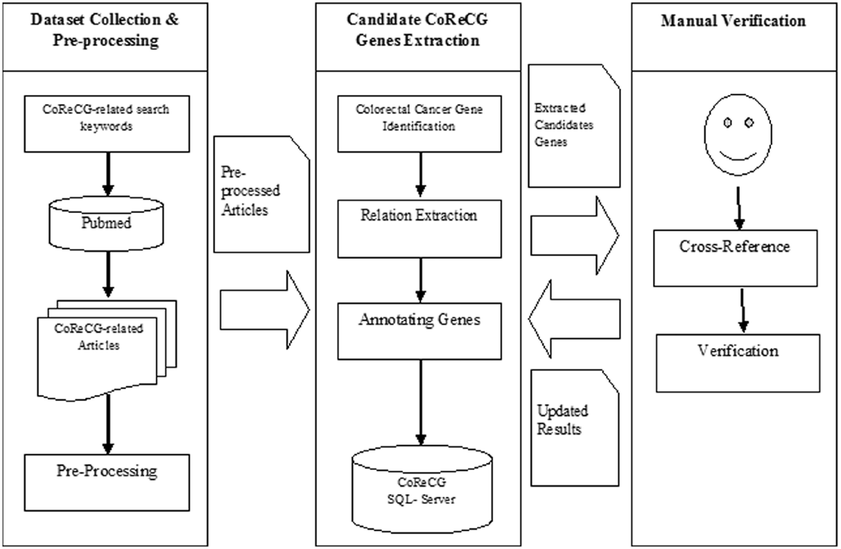
Figure 2. The flowchart of CoReCG data collection. The figure shows the steps involved in collecting data for CoReCG ...
Notes:
Figure 2. The flowchart of CoReCG data collection. The figure shows the steps involved in collecting data for CoReCG which includes, preprocessing of data using related keywords against pubmed to fetch relevant articles, followed by the extraction of information from literature and annotation and submitting information in CoReCG, the whole process were manually curated and verified from cross references and updating in CoReCG.
Unless provided in the caption above, the following copyright applies to the content of this slide: © The Author(s) 2016. Published by Oxford University Press. This is an Open Access article distributed under the terms of the Creative Commons Attribution License ( http://creativecommons.org/licenses/by/4.0/ ), which permits unrestricted reuse, distribution, and reproduction in any medium, provided the original work is properly cited.

