Slide 1
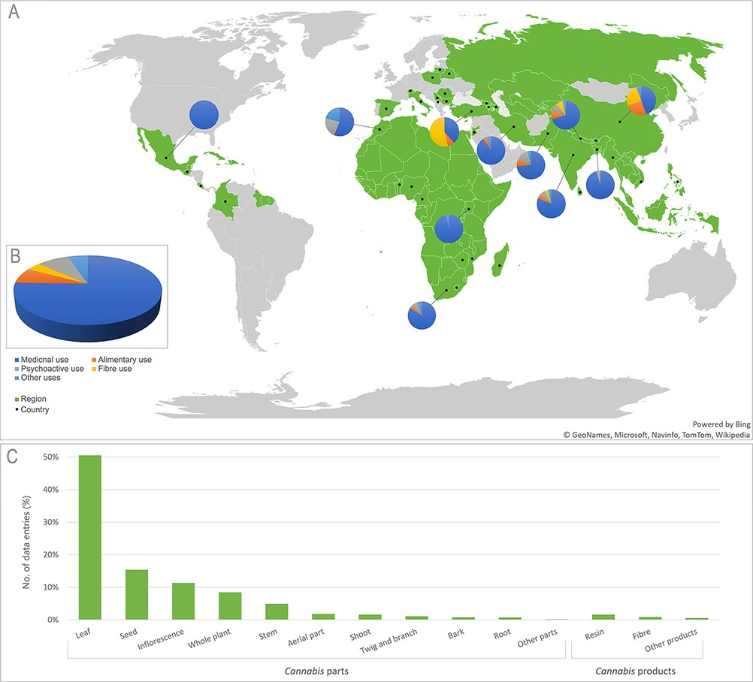
Figure 2. (A) Map of world regions (green) and countries (•) represented in the CANNUSE database, with pie charts ...
Notes:
Figure 2. (A) Map of world regions (green) and countries (•) represented in the CANNUSE database, with pie charts showing distribution of uses in the countries with over 50 records. The background map was produced using the Excel Office. (B) Distribution of Cannabis uses presented in the database. (C) Distribution of Cannabis parts and products presented in the CANNUSE database (in %).
Unless provided in the caption above, the following copyright applies to the content of this slide: © The Author(s) 2021. Published by Oxford University Press.This is an Open Access article distributed under the terms of the Creative Commons Attribution License (http://creativecommons.org/licenses/by/4.0/), which permits unrestricted reuse, distribution, and reproduction in any medium, provided the original work is properly cited.

