Slide 1
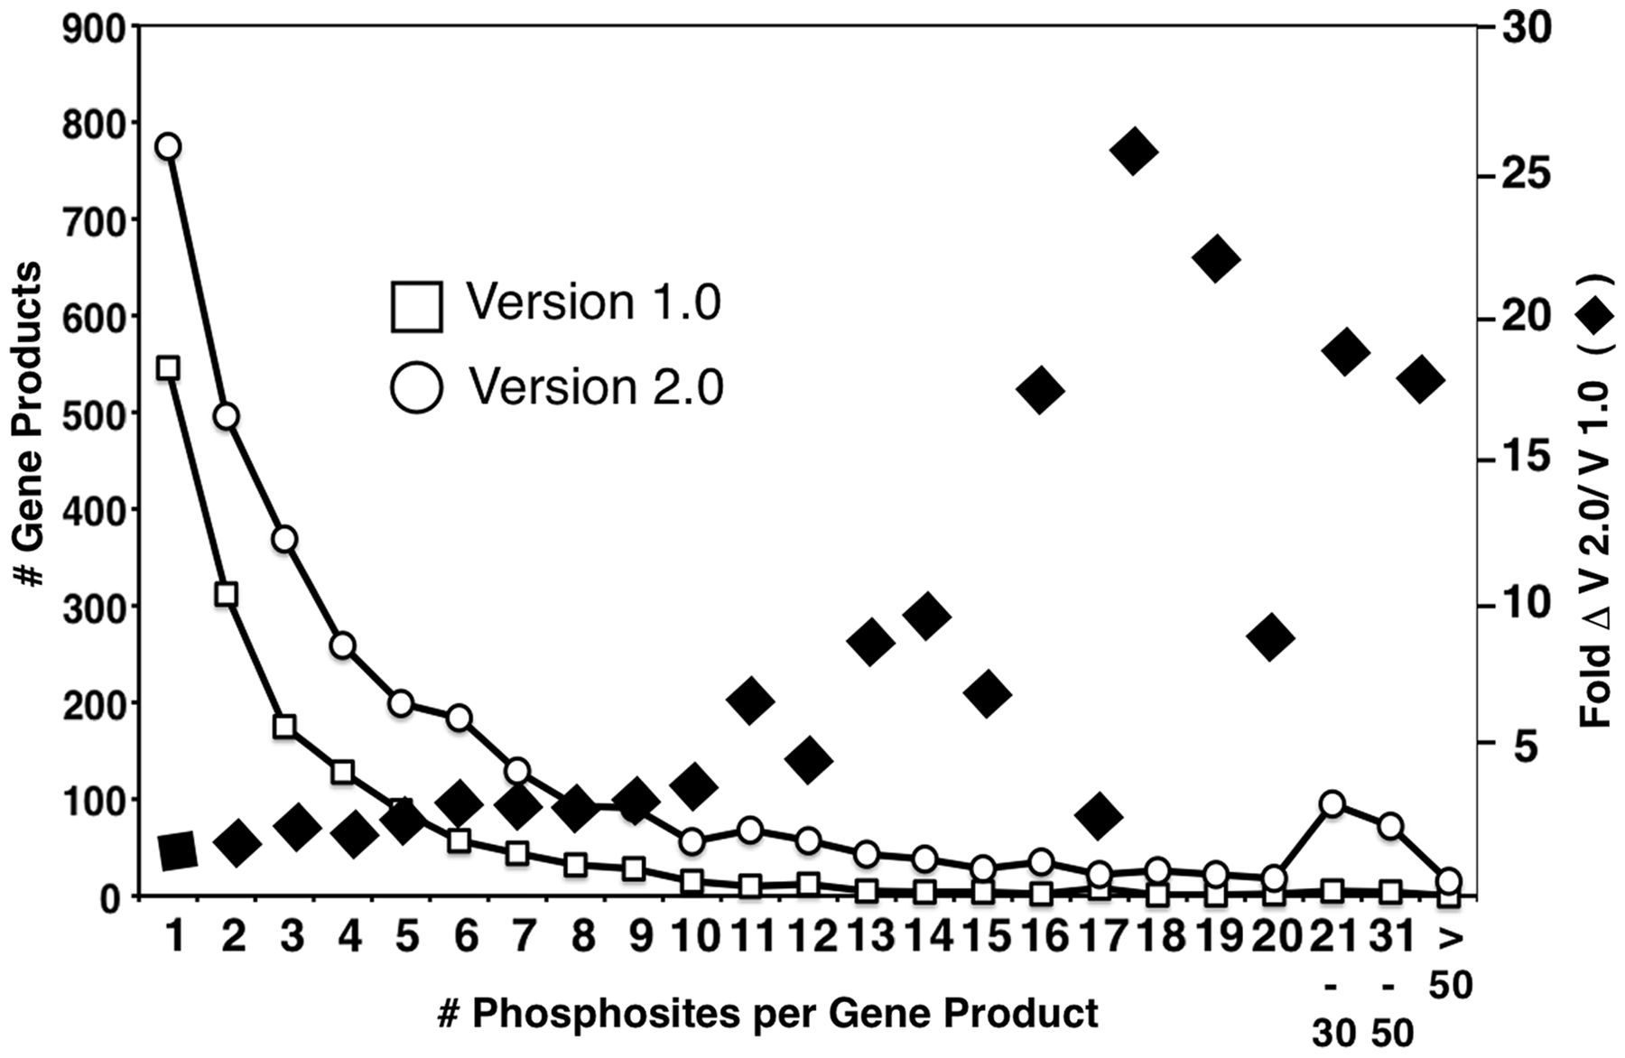
Figure 2. Distribution of multiply phosphorylated proteins in PhosphoGRID versions 1.0 and 2.0. Proteins with the ...
Notes:
Figure 2. Distribution of multiply phosphorylated proteins in PhosphoGRID versions 1.0 and 2.0. Proteins with the indicated number of unique phosphorylated residues in PhosphoGRID versions 1.0 (open box) and 2.0 (open circle). The fold change in the number of phosphosites per protein between V 1.0 and 2.0 are indicated by black diamonds.
Unless provided in the caption above, the following copyright applies to the content of this slide: © The Author(s) 2013. Published by Oxford University Press.This is an Open Access article distributed under the terms of the Creative Commons Attribution License (http://creativecommons.org/licenses/by/3.0/), which permits unrestricted reuse, distribution, and reproduction in any medium, provided the original work is properly cited.

