Slide 1
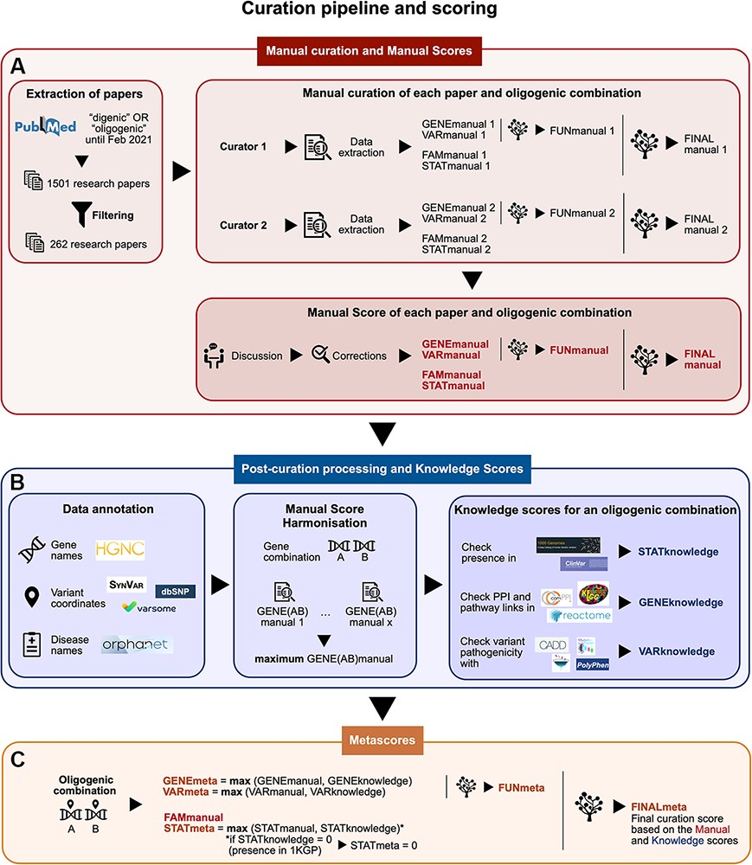
Figure 1. Summary of the curation pipeline for the creation of the (A) Manual scores, (B) Knowledge scores and (C) ...
Notes:
Figure 1. Summary of the curation pipeline for the creation of the (A) Manual scores, (B) Knowledge scores and (C) Metascores for each oligogenic combination. (A) Research articles were selected using the keywords ‘digenic OR oligogenic’ in PubMed (https://pubmed.ncbi.nlm.nih.gov/), leading from a total of 1501 articles to 262 articles after filtering (see Materials and Methods, Supplementary Data, File 1). Two different curators independently extracted information and curated each article, assigning Manual scores. These scores include the FAMmanual, STATmanual, GENEmanual and VARmanual scores. The last two are used in a decision tree to assign the FUNmanual score, while all of the scores are used in another decision tree to create the FINALmanual score (see Materials and Methods, Supplementary Data, File 1). A discussion then took place to reach a consensus for the Manual Scores. All oligogenic variant combinations were evaluated as separate entities with their own evidence, regardless of whether they were described in the same or different articles. (B) The data were then processed to formalize the available information (see Materials and Methods, Supplementary Data, File 1). The disease names were formalized using the Orphanet database (https://www.orpha.net/). The gene names were formalized according to the gene nomenclature guidelines from the HGNC database (33). The variants were processed by the software Synvar (http://goldorak.hesge.ch/synvar/), and the databases Varsome (34) and dbSNP (35), to obtain genomic coordinates. To correct for the literature bias, the GENEmanual score for each gene pair was harmonized among all articles by assigning the maximum GENEmanual found for that gene pair, and all affected scores (FUNmanual and FINALmanual) were recalculated. To compensate for missing information in the articles due to no prior access to current knowledge, Knowledge scores were assigned per oligogenic combination: the STATknowledge score by checking the presence of the oligogenic combination in the 1000 Genomes project (30) and ClinVar (36), the GENEknowledge score by checking the PPI and KEGG (38) or Reactome (39) pathway links of the involved genes and the VARknowledge score by using variant pathogenicity information from different pathogenicity predictors: SIFT (40), MutationTaster2 (41), CADD (42) and Polyphen2 (43). (C) Finally, both Manual and Knowledge scores are combined in order to create the confidence Metascores for each type of evidence STATmeta, GENEmeta and VARmeta scores—by assigning the maximum score found between their corresponding Manual and Knowledge score (see Materials and Methods, Supplementary Data, File 1). One exception occurs in this rule: if the STATknowledge is 0 due to the fact that the combination is found in an individual of the 1000 Genomes project, then it replaces the STATmanual and, therefore, the STATmeta is also 0. The same procedure as in the manual curation is then followed when decision trees were used to define the FUNmeta and FINALmeta scores.
Unless provided in the caption above, the following copyright applies to the content of this slide: © The Author(s) 2022. Published by Oxford University Press.This is an Open Access article distributed under the terms of the Creative Commons Attribution License (https://creativecommons.org/licenses/by/4.0/), which permits unrestricted reuse, distribution, and reproduction in any medium, provided the original work is properly cited.

