Slide 1
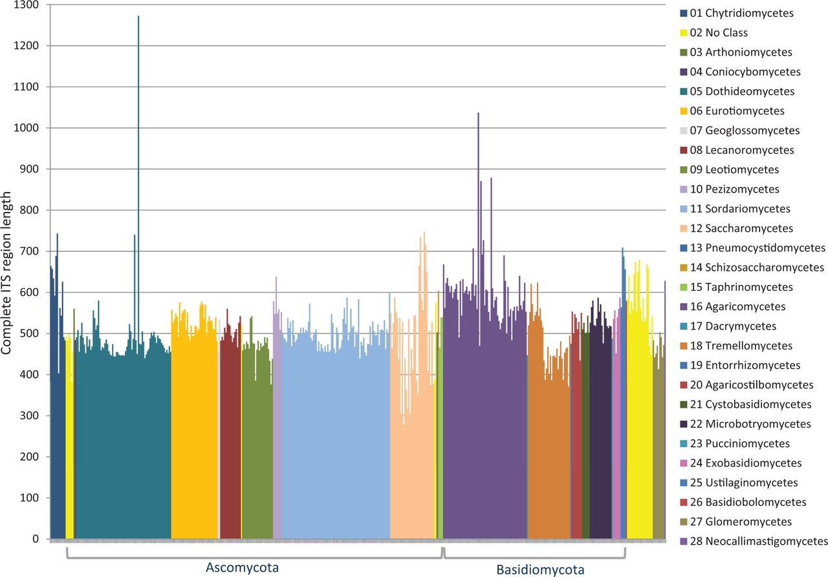
Figure 2. ITS length variation of complete ITS regions in the RTL data set according to class.
Notes:
Figure 2. ITS length variation of complete ITS regions in the RTL data set according to class.
Unless provided in the caption above, the following copyright applies to the content of this slide: Published by Oxford University Press 2013. This work is written by US Government employees and is in the public domain in the US.

