Slide 1
Figure 1 Map Overview page of the Tripal MapViewer user interface. Site visitors can view the linkage group glyphs for ...
Notes:
Figure 1 Map Overview page of the Tripal MapViewer user interface. Site visitors can view the linkage group glyphs for a map and by clicking on one, open the main MapViewer page.
Unless provided in the caption above, the following copyright applies to the content of this slide: © The Author(s) 2019. Published by Oxford University Press.This work is written by US Government employees and is in the public domain in the US.

Slide 2
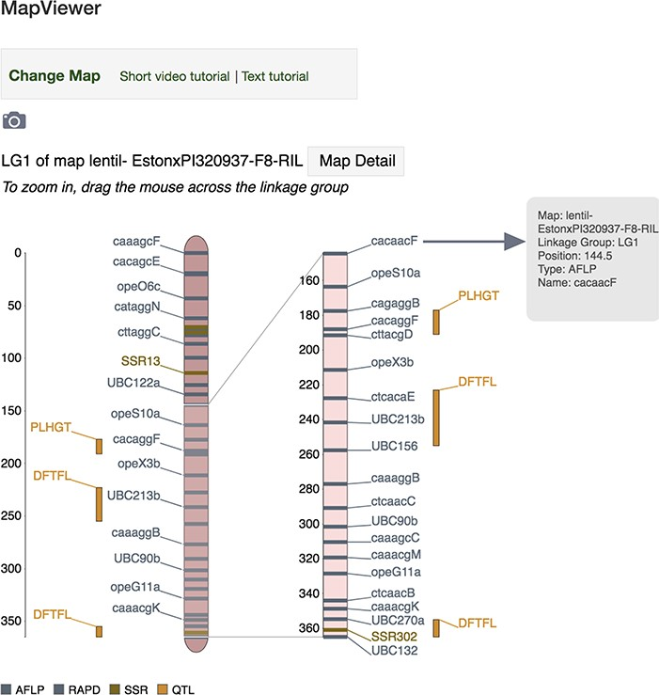
Figure 2 MapViewer main page displaying interactive linkage group interface. Hover above a locus (genetic marker, MTL ...
Notes:
Figure 2 MapViewer main page displaying interactive linkage group interface. Hover above a locus (genetic marker, MTL or QTL) or its label on the zoomed view and a tooltip dialog will appear showing more detailed information about the locus such as map, linkage group, position, type and name. Click on a locus or its label to launch the associated corresponding genetic marker, MTL or QTL Tripal page.
Unless provided in the caption above, the following copyright applies to the content of this slide: © The Author(s) 2019. Published by Oxford University Press.This work is written by US Government employees and is in the public domain in the US.

Slide 3
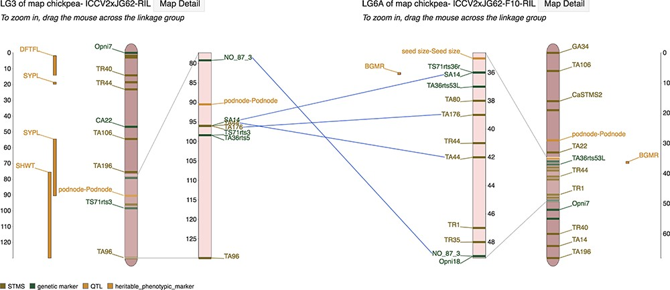
Figure 3 Marker correspondences on the MapViewer main interface page showing lines drawn between linkage groups ...
Notes:
Figure 3 Marker correspondences on the MapViewer main interface page showing lines drawn between linkage groups connecting markers that are shared between the reference and comparison linkage group.
Unless provided in the caption above, the following copyright applies to the content of this slide: © The Author(s) 2019. Published by Oxford University Press.This work is written by US Government employees and is in the public domain in the US.

Slide 4
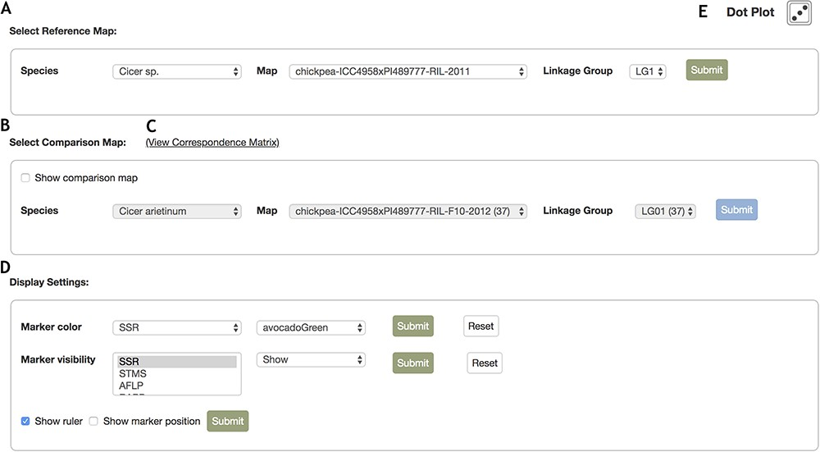
Figure 4 Control Panel interface for the MapViewer main page. The control panel provides configuration options for the ...
Notes:
Figure 4 Control Panel interface for the MapViewer main page. The control panel provides configuration options for the display of linkage groups, markers and rulers. A. The reference map can be configured with the drop list selector toolbar. After selecting a species, the options for maps belonging to the species are automatically updated and similarly, selecting a map automatically updates the linkage group field with all relevant linkage group display options. B. Interface where the comparison linkage group is specified. When the map or linkage group in the reference toolbar is modified, the comparison map toolbar is automatically updated with maps and linkage groups that contain correspondences to the reference map and linkage group. Additionally, map and linkage group fields provide the number of marker correspondences in parentheses beside the items in the map and linkage group fields to provide better informed browsing choices. C. Links to the Correspondence Matrix page launching graphical display of correspondences for the reference and comparison map. D. Marker color and visibility controls for the reference and comparison linkage groups. E. Launches Dot plot display for markers in common between reference and comparison linkage groups.
Unless provided in the caption above, the following copyright applies to the content of this slide: © The Author(s) 2019. Published by Oxford University Press.This work is written by US Government employees and is in the public domain in the US.

Slide 5
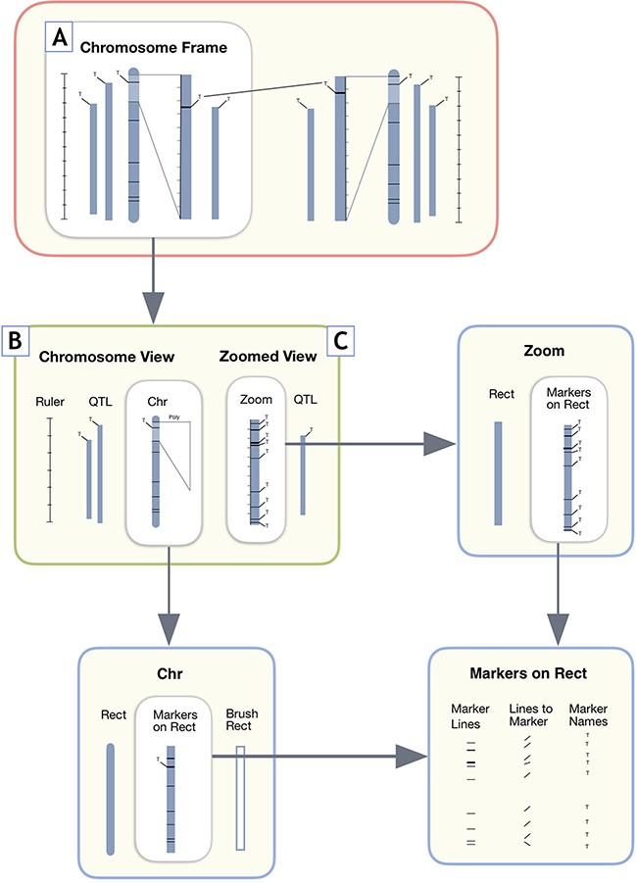
Figure 5 User interface design components for MapViewer linkage group display. A. The Chromosome Frame, which acts as ...
Notes:
Figure 5 User interface design components for MapViewer linkage group display. A. The Chromosome Frame, which acts as a container for the other drawing elements. B. Chromosome View is a child element of the Chromosome Frame parent. C. The Zoomed View child element draws the zoomed in region to the side of the full linkage group.
Unless provided in the caption above, the following copyright applies to the content of this slide: © The Author(s) 2019. Published by Oxford University Press.This work is written by US Government employees and is in the public domain in the US.

Slide 6
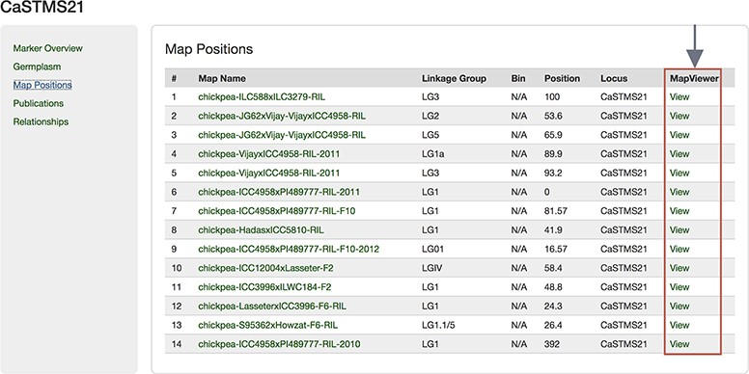
Figure 6 Map Positions table of a Marker page showing the link to MapViewer.
Notes:
Figure 6 Map Positions table of a Marker page showing the link to MapViewer.
Unless provided in the caption above, the following copyright applies to the content of this slide: © The Author(s) 2019. Published by Oxford University Press.This work is written by US Government employees and is in the public domain in the US.

Slide 7
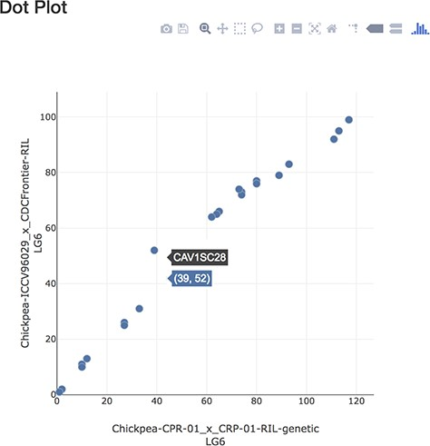
Figure 7 Dot plot page displaying markers in common between linkage groups.
Notes:
Figure 7 Dot plot page displaying markers in common between linkage groups.
Unless provided in the caption above, the following copyright applies to the content of this slide: © The Author(s) 2019. Published by Oxford University Press.This work is written by US Government employees and is in the public domain in the US.

Slide 8
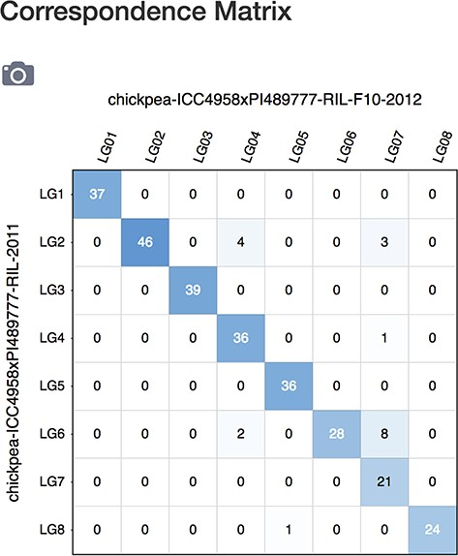
Figure 8 Correspondence matrix page showing number of correspondences between maps in a grid display.
Notes:
Figure 8 Correspondence matrix page showing number of correspondences between maps in a grid display.
Unless provided in the caption above, the following copyright applies to the content of this slide: © The Author(s) 2019. Published by Oxford University Press.This work is written by US Government employees and is in the public domain in the US.

Slide 9
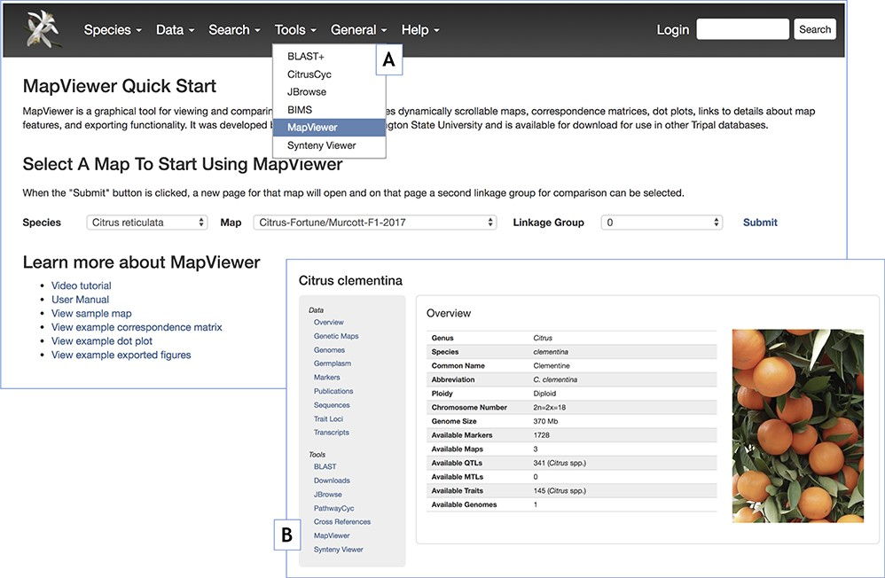
Figure 9 MapViewer Quick Start landing page introducing MapViewer functionality and providing usage instructions and ...
Notes:
Figure 9 MapViewer Quick Start landing page introducing MapViewer functionality and providing usage instructions and examples. A. Tools menu reference to the MapViewer landing page. B. Reference to the MapViewer landing page through the table of contents side panel in the Tripal Organism or Species pages.
Unless provided in the caption above, the following copyright applies to the content of this slide: © The Author(s) 2019. Published by Oxford University Press.This work is written by US Government employees and is in the public domain in the US.

Slide 10
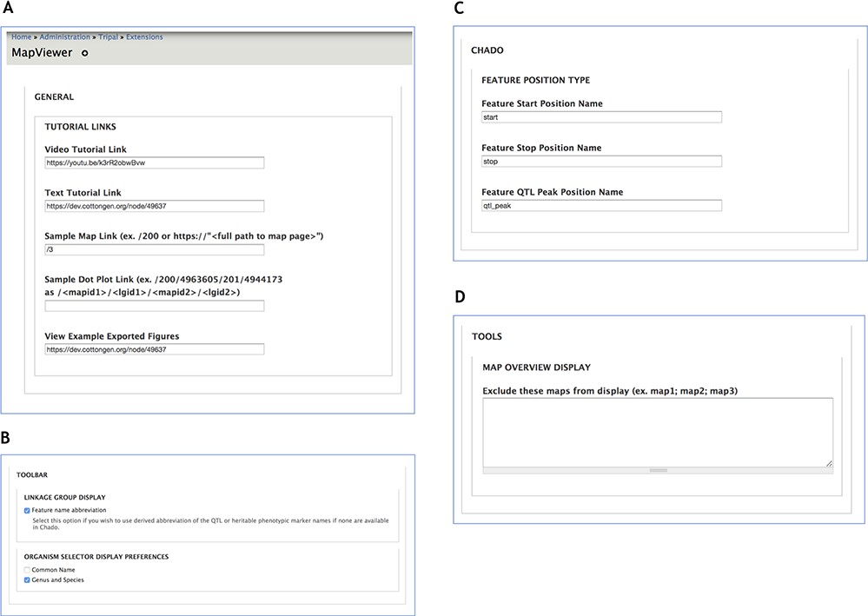
Figure 10 Administration page providing configuration options for MapViewer displays. A. The General section interface ...
Notes:
Figure 10 Administration page providing configuration options for MapViewer displays. A. The General section interface to configure links for tutorials and usage examples. B. Toolbar settings to specify feature name format. C. The Chado section provides way to customize Chado terminology for feature position names. D. Maps to be excluded from display by the MapViewer can be listed in the Tools section.
Unless provided in the caption above, the following copyright applies to the content of this slide: © The Author(s) 2019. Published by Oxford University Press.This work is written by US Government employees and is in the public domain in the US.

