Slide 1
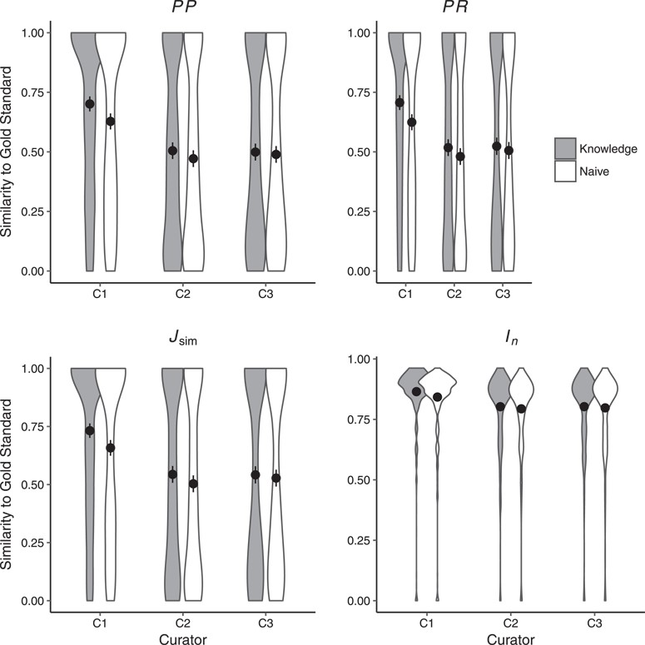
Figure 3 Similarity of human annotations to the gold standard in Naïve and Knowledge rounds. Shown are means across ...
Notes:
Figure 3 Similarity of human annotations to the gold standard in Naïve and Knowledge rounds. Shown are means across all 463 character states. Error bars represent two standard errors of the mean. Curators C1 (as per PP, PR, $J_{\mbox{sim}}$ and $I_n$) and C2 (as per PR, $J_{\mbox{sim}}$) were significantly closer to the gold standard in the Knowledge round as compared to the Naïve round. Detailed results are shown in Supplementary Materials, Table 2.
Unless provided in the caption above, the following copyright applies to the content of this slide: © The Author(s) 2018. Published by Oxford University Press.This is an Open Access article distributed under the terms of the Creative Commons Attribution License (http://creativecommons.org/licenses/by/4.0/), which permits unrestricted reuse, distribution, and reproduction in any medium, provided the original work is properly cited.

