Slide 1
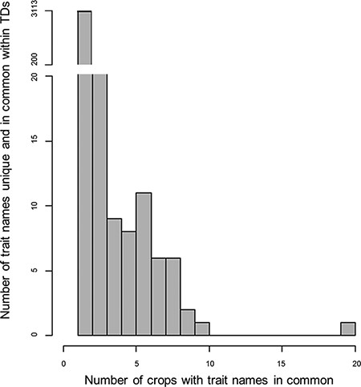
Figure 1. Histogram for the counts of trait names within the 28 Trait Dictionaries (TDs). The histogram represents 3627 ...
Notes:
Figure 1. Histogram for the counts of trait names within the 28 Trait Dictionaries (TDs). The histogram represents 3627 trait names within the TDs, along with the number of trait names across the TD for the 28 crop species. The gap in the data representing trait names that are repeated one or two times across the TDs was not plotted in the histogram; for more information, refer Supplementary Table S2 table.
Unless provided in the caption above, the following copyright applies to the content of this slide: © The Author(s) 2021. Published by Oxford University Press.This is an Open Access article distributed under the terms of the Creative Commons Attribution License (http://creativecommons.org/licenses/by/4.0/), which permits unrestricted reuse, distribution, and reproduction in any medium, provided the original work is properly cited.

Slide 2
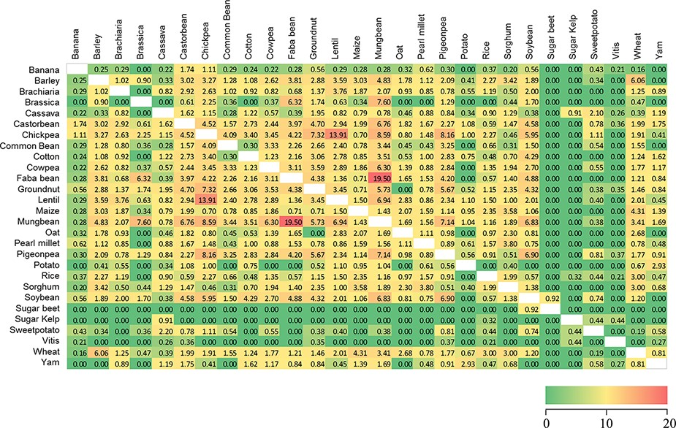
Figure 2. Similarity heatmap for the shared trait names across 28 Trait Dictionaries (TDs) in the Crop Ontology. Values ...
Notes:
Figure 2. Similarity heatmap for the shared trait names across 28 Trait Dictionaries (TDs) in the Crop Ontology. Values were calculated using the ‘simple matching coefficient’, colour gradient shading is relative to the pairwise percentage of trait names shared across the 28 TDs, with red indicating high values and green zero (Supplementary Table S3).
Unless provided in the caption above, the following copyright applies to the content of this slide: © The Author(s) 2021. Published by Oxford University Press.This is an Open Access article distributed under the terms of the Creative Commons Attribution License (http://creativecommons.org/licenses/by/4.0/), which permits unrestricted reuse, distribution, and reproduction in any medium, provided the original work is properly cited.

Slide 3
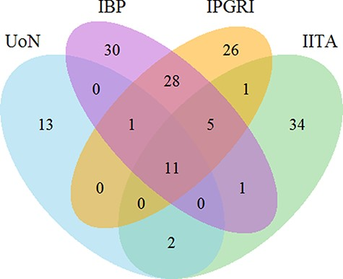
Figure 3. Venn diagram for the count of 230 trait names in bambara groundnut unique and shared across the different ...
Notes:
Figure 3. Venn diagram for the count of 230 trait names in bambara groundnut unique and shared across the different institutions. The numbers show the number of unique and shared trait names across the different institutions. Abbreviations in the sets are as follows: University of Nottingham (UoN), Integrated Breeding Platform (IBP), International Plant Genetic Resources Institute (IPGRI) and International Institute of Tropical Agriculture (IITA).
Unless provided in the caption above, the following copyright applies to the content of this slide: © The Author(s) 2021. Published by Oxford University Press.This is an Open Access article distributed under the terms of the Creative Commons Attribution License (http://creativecommons.org/licenses/by/4.0/), which permits unrestricted reuse, distribution, and reproduction in any medium, provided the original work is properly cited.

Slide 4
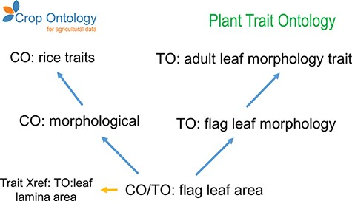
Figure 4. Example of granularity improvement for the CO for the ‘Flag leaf area’ term. Blue arrows represent the ‘is_a’ ...
Notes:
Figure 4. Example of granularity improvement for the CO for the ‘Flag leaf area’ term. Blue arrows represent the ‘is_a’ relationship. Abbreviations are related to existent ontologies: Crop Ontology (CO), Plant Trait Ontology (TO), Plant Ontology (PO), Phenotype and Trait Ontology (PATO) and Basic Formal Ontology (BFO).
Unless provided in the caption above, the following copyright applies to the content of this slide: © The Author(s) 2021. Published by Oxford University Press.This is an Open Access article distributed under the terms of the Creative Commons Attribution License (http://creativecommons.org/licenses/by/4.0/), which permits unrestricted reuse, distribution, and reproduction in any medium, provided the original work is properly cited.

