Slide 1
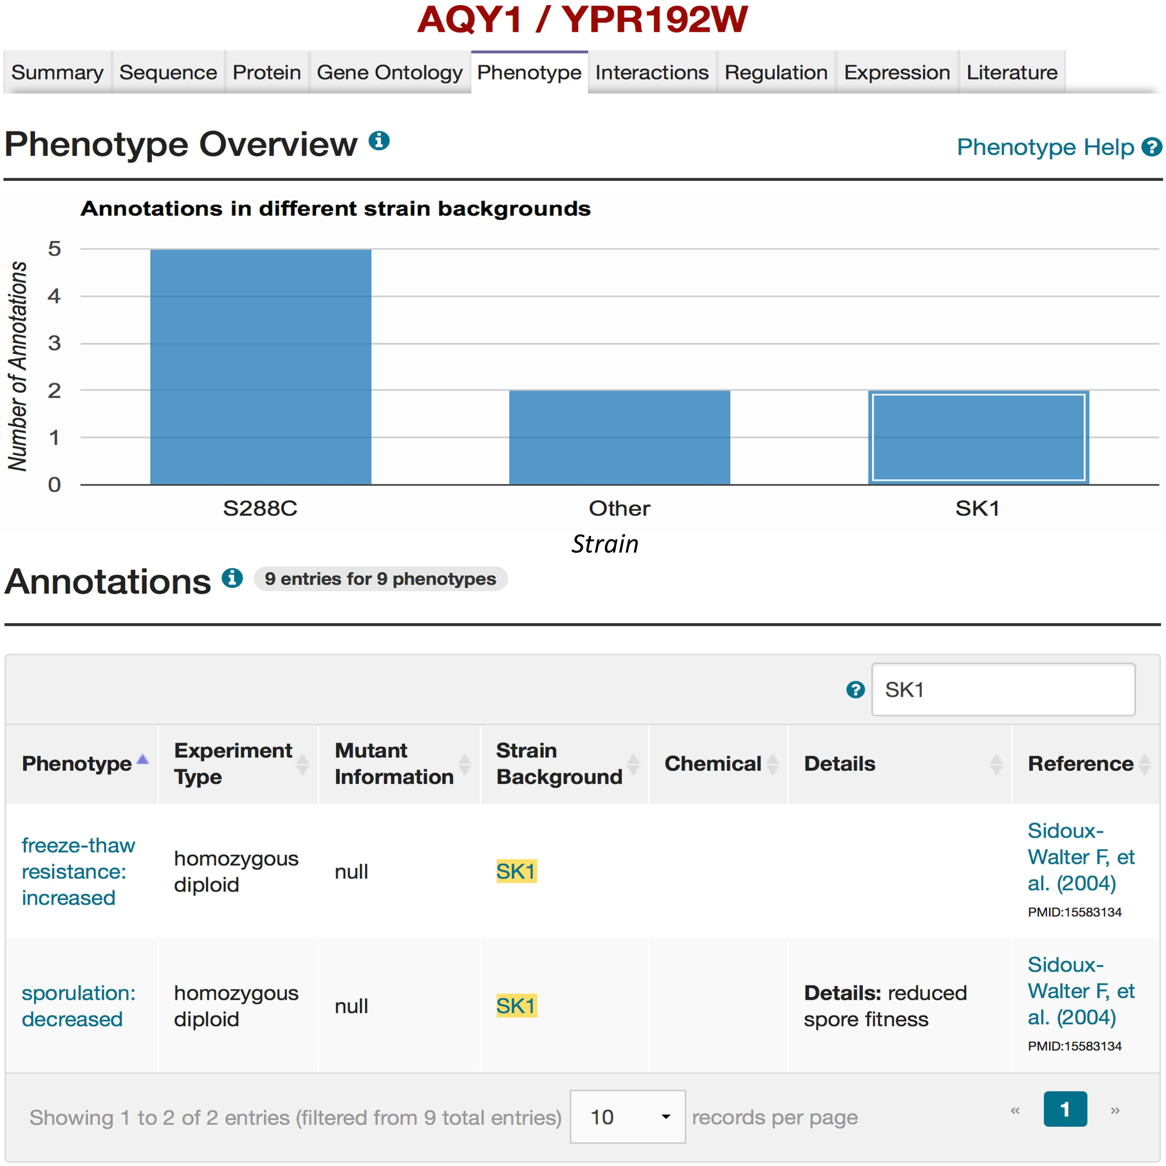
Figure 2. Mutant phenotypes for AQY1 gene in SGD. By querying for ‘ AQY1’ using the SGD search box, and selecting the ...
Notes:
Figure 2. Mutant phenotypes for AQY1 gene in SGD. By querying for ‘ AQY1’ using the SGD search box, and selecting the Phenotype tab on the AQY1 LSP, phenotype information for AQY1 can be viewed. A bar chart summarizes how many phenotypic annotations have been curated in different strain backgrounds (e.g. two mutant phenotypes in the SK1 strain background). If the box for SK1 in the bar chart is selected, the details of the two mutant phenotypes for AQY1 in the SK1 strain background will be listed in the Annotations section. Users also can refer to the relevant literature ( 27 ) that describes studies on the mutant phenotypes resulted from polymorphisms in the AQY1 gene in strain SK1 as shown in the “Reference” column of the table. Users can also access more information of the alternative strain (SK1) by selecting the strain name (highlighted in yellow) in the Annotations table (see Figure 3).
Unless provided in the caption above, the following copyright applies to the content of this slide: © The Author(s) 2016. Published by Oxford University Press. This is an Open Access article distributed under the terms of the Creative Commons Attribution License ( http://creativecommons.org/licenses/by/4.0/ ), which permits unrestricted reuse, distribution, and reproduction in any medium, provided the original work is properly cited.

