Slide 1
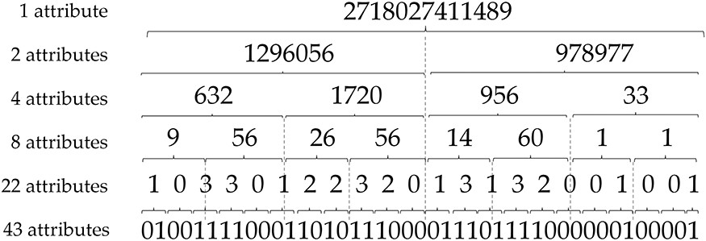
Figure 1. Spacer reduction strategy for predictive modelling with DTs.
Notes:
Figure 1. Spacer reduction strategy for predictive modelling with DTs.
Unless provided in the caption above, the following copyright applies to the content of this slide: © The Author(s) 2020. Published by Oxford University Press.This is an Open Access article distributed under the terms of the Creative Commons Attribution License (http://creativecommons.org/licenses/by/4.0/), which permits unrestricted reuse, distribution, and reproduction in any medium, provided the original work is properly cited.

Slide 2
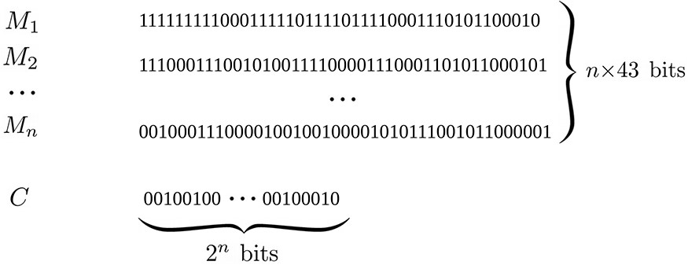
Figure 2. Binary representation for an EA solution.
Notes:
Figure 2. Binary representation for an EA solution.
Unless provided in the caption above, the following copyright applies to the content of this slide: © The Author(s) 2020. Published by Oxford University Press.This is an Open Access article distributed under the terms of the Creative Commons Attribution License (http://creativecommons.org/licenses/by/4.0/), which permits unrestricted reuse, distribution, and reproduction in any medium, provided the original work is properly cited.

Slide 3
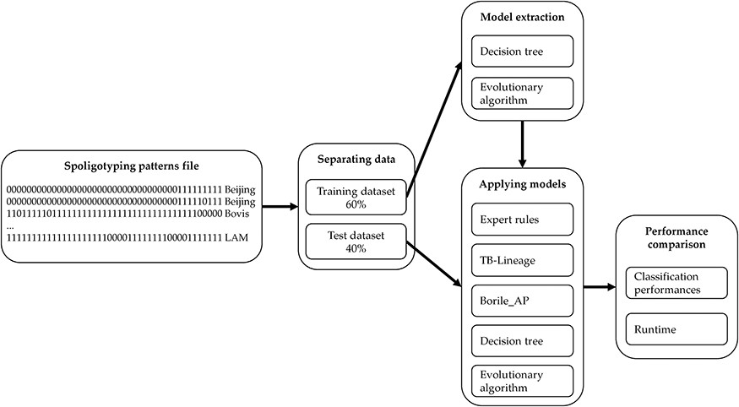
Figure 3. Methodology for comparing classification models.
Notes:
Figure 3. Methodology for comparing classification models.
Unless provided in the caption above, the following copyright applies to the content of this slide: © The Author(s) 2020. Published by Oxford University Press.This is an Open Access article distributed under the terms of the Creative Commons Attribution License (http://creativecommons.org/licenses/by/4.0/), which permits unrestricted reuse, distribution, and reproduction in any medium, provided the original work is properly cited.

Slide 4
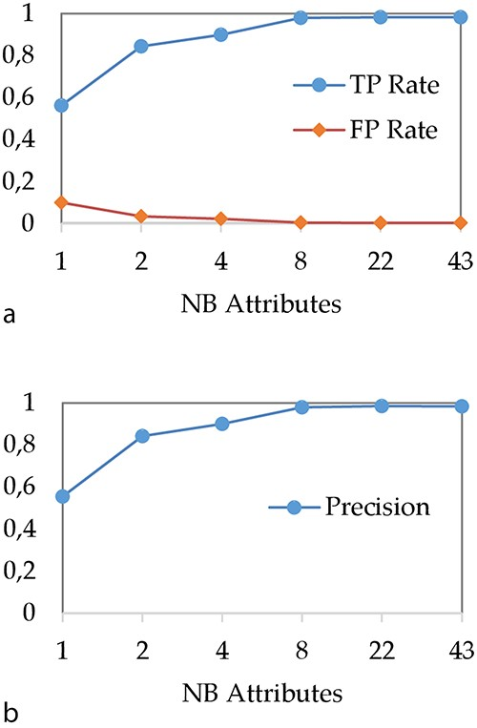
Figure 4. Impact of attribute reduction step on DT performances (a) TP and FP rates and (b) precision.
Notes:
Figure 4. Impact of attribute reduction step on DT performances (a) TP and FP rates and (b) precision.
Unless provided in the caption above, the following copyright applies to the content of this slide: © The Author(s) 2020. Published by Oxford University Press.This is an Open Access article distributed under the terms of the Creative Commons Attribution License (http://creativecommons.org/licenses/by/4.0/), which permits unrestricted reuse, distribution, and reproduction in any medium, provided the original work is properly cited.

Slide 5
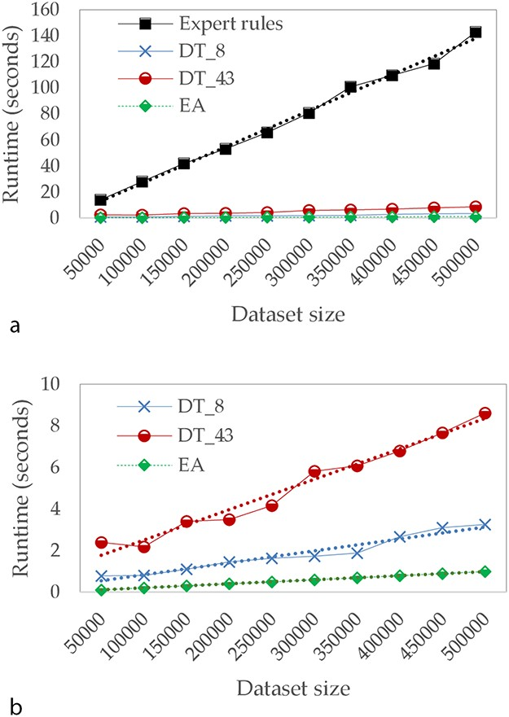
Figure 5. Comparison of runtime in seconds (a) for Expert rules and our approaches and (b) focused only on our ...
Notes:
Figure 5. Comparison of runtime in seconds (a) for Expert rules and our approaches and (b) focused only on our approaches.
Unless provided in the caption above, the following copyright applies to the content of this slide: © The Author(s) 2020. Published by Oxford University Press.This is an Open Access article distributed under the terms of the Creative Commons Attribution License (http://creativecommons.org/licenses/by/4.0/), which permits unrestricted reuse, distribution, and reproduction in any medium, provided the original work is properly cited.

Slide 6
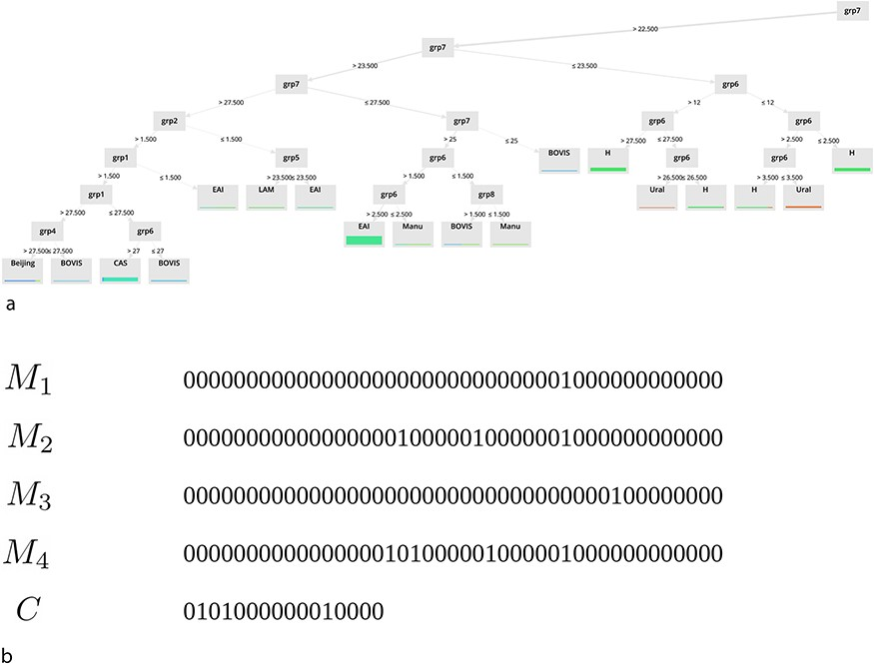
Figure 6. Examples of extracted models for (a) DT and (b) binary masks.
Notes:
Figure 6. Examples of extracted models for (a) DT and (b) binary masks.
Unless provided in the caption above, the following copyright applies to the content of this slide: © The Author(s) 2020. Published by Oxford University Press.This is an Open Access article distributed under the terms of the Creative Commons Attribution License (http://creativecommons.org/licenses/by/4.0/), which permits unrestricted reuse, distribution, and reproduction in any medium, provided the original work is properly cited.

