Slide 1
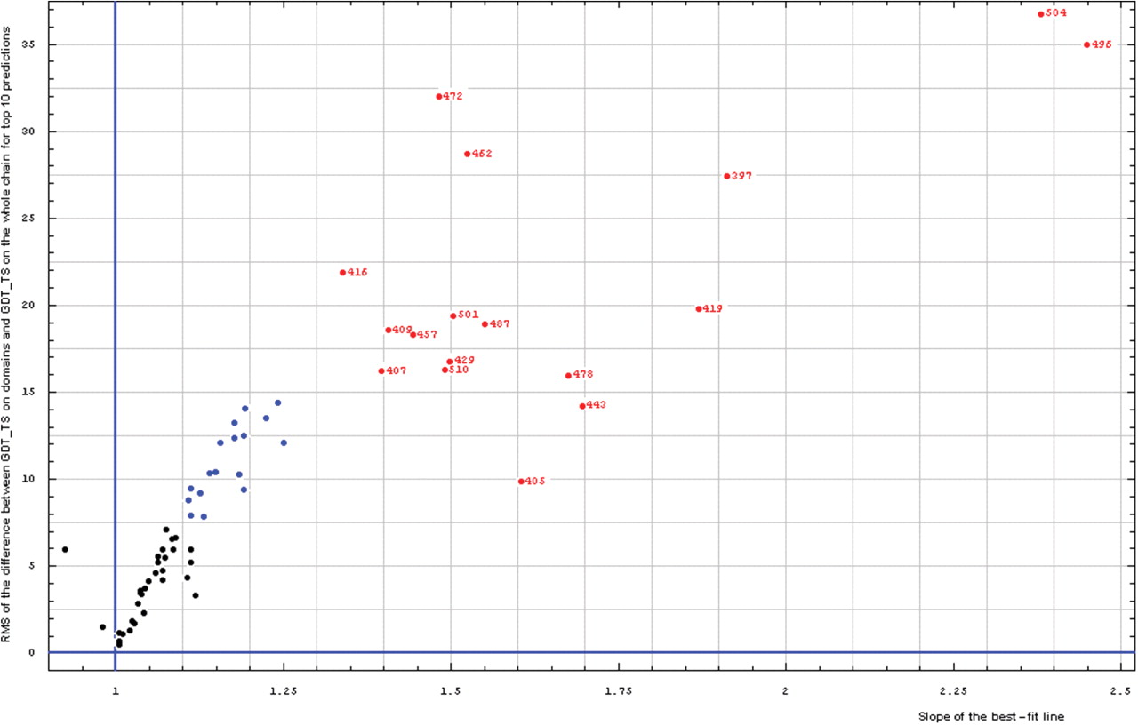
Figure 3. Correlation between RMS of the difference between GDT-TS on domains and GDT-TS on the whole chain (vertical ...
Notes:
Figure 3. Correlation between RMS of the difference between GDT-TS on domains and GDT-TS on the whole chain (vertical axis) and the slope of the best-fit line (horizontal axis), both computed on top 10 server predictions.
Unless provided in the caption above, the following copyright applies to the content of this slide: © 2009 The Author(s).This is Open Access article distributed under the terms of the Creative Commons Attribution Non-Commercial License (http://creativecommons.org/licenses/by-nc/2.0/uk/) which permits unrestricted non-commercial use, distribution, and reproduction in any medium, provided the original work is properly cited.

