Slide 1
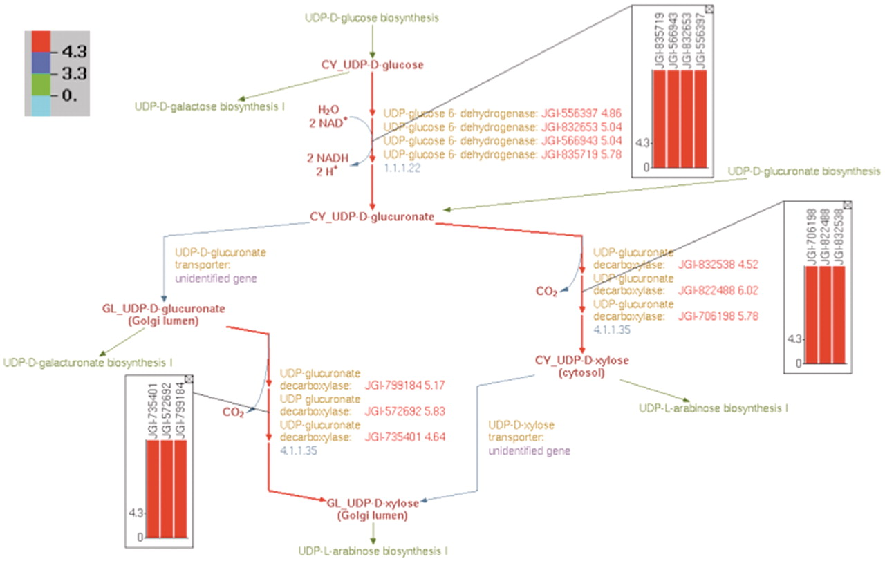
Figure 10. Overlay of log₂-transformed SNP abundance for genes in the UDP-d-xylose biosynthesis pathway. ...
Notes:
Figure 10. Overlay of log2-transformed SNP abundance for genes in the UDP-d-xylose biosynthesis pathway. Individual reaction representations are highlighted using the color code at the top left corner. The numbers in the color code define the ranges of the log2(SNP abundance) values of the genes in such a way that red, blue and green colors correspond to genes with high, medium and low SNP values, respectively. The reaction arrows for UDP-d-glucuronate formation, and for both the cytosolic and intra-Golgi conversions of UDP-d-glucuronate to UDP-d-xylose are highlighted in red since all the corresponding genes have high log2(SNP abundance). The color-coded log2(SNP abundance) values for the transcriptome genes encoding the enzymes catalyzing each reaction can be exhibited using pop-up bar diagrams, shown as inset figures. The absolute log2(SNP abundance) values for the genes that explicitly appear on the pathway diagram occur next to the corresponding gene locus tags and are color coded as well.
Unless provided in the caption above, the following copyright applies to the content of this slide: © The Author(s) 2012. Published by Oxford University Press.This is an Open Access article distributed under the terms of the Creative Commons Attribution Non-Commercial License (http://creativecommons.org/licenses/by-nc/3.0), which permits unrestricted non-commercial use, distribution, and reproduction in any medium, provided the original work is properly cited.

