Slide 1
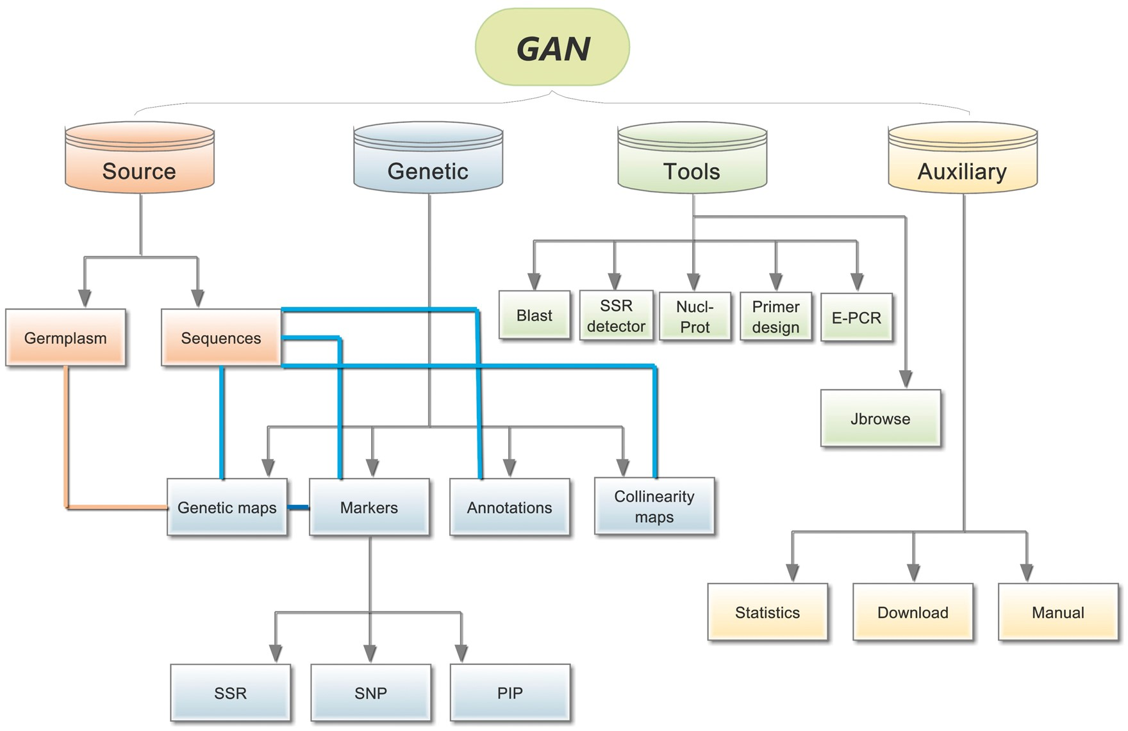
Figure 1. Overall GAN framework. The four different colours represent the four different main sections of GAN, Source, ...
Notes:
Figure 1. Overall GAN framework. The four different colours represent the four different main sections of GAN, Source, Genetics, Tools. Connections are illustrated between related subsections using straight lines with different colours.
Unless provided in the caption above, the following copyright applies to the content of this slide: © The Author(s) 2018. Published by Oxford University Press.This is an Open Access article distributed under the terms of the Creative Commons Attribution License (http://creativecommons.org/licenses/by/4.0/), which permits unrestricted reuse, distribution, and reproduction in any medium, provided the original work is properly cited.

Slide 2
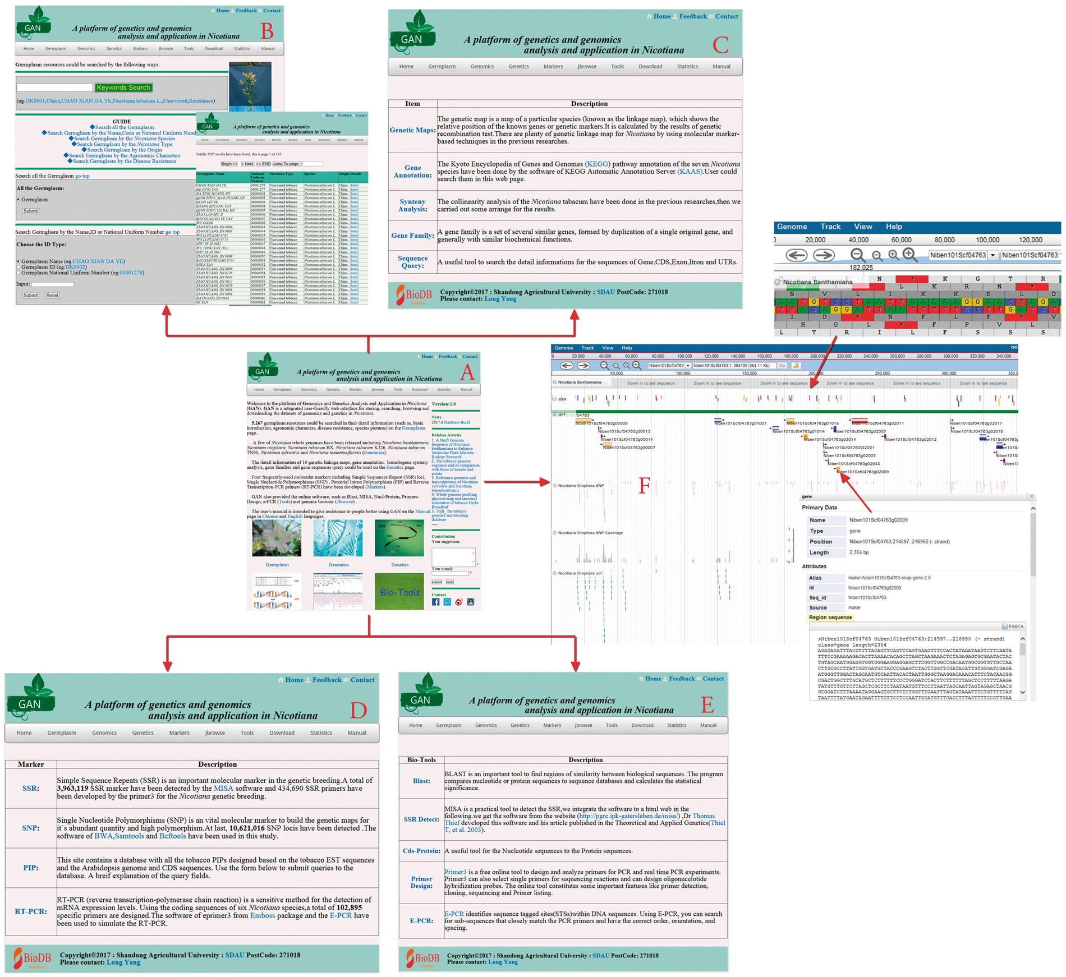
Figure 2. Main GAN Web page. (A) GAN homepage: provides quick entry paths to all main parts. (B) Germplasm page: stores ...
Notes:
Figure 2. Main GAN Web page. (A) GAN homepage: provides quick entry paths to all main parts. (B) Germplasm page: stores 5267 Nicotiana accessions, detailed information and a seven-mode search mechanism. (C) Genetics page: consists of genetic maps, gene annotations, synteny analyses, gene family identifications and sequence query. (D) Markers page: includes all SSR, SNP, PIP and RT-PCR markers in GAN. (E and F) Tools and JBrowse pages: allow access to online bioinformatics tools and the genome browser JBrowse for detailed information overlays and analyses.
Unless provided in the caption above, the following copyright applies to the content of this slide: © The Author(s) 2018. Published by Oxford University Press.This is an Open Access article distributed under the terms of the Creative Commons Attribution License (http://creativecommons.org/licenses/by/4.0/), which permits unrestricted reuse, distribution, and reproduction in any medium, provided the original work is properly cited.

Slide 3
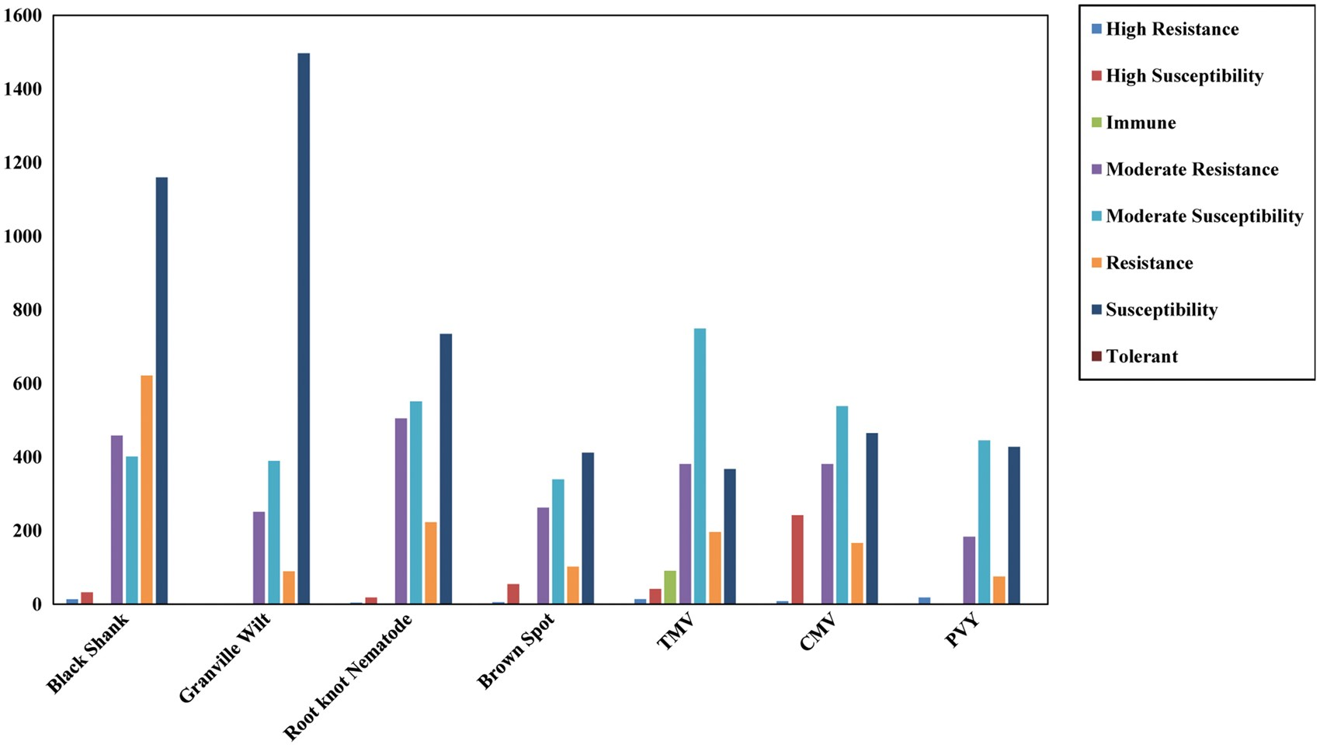
Figure 3. Detailed disease resistance information for the GAN Nicotiana accessions.
Notes:
Figure 3. Detailed disease resistance information for the GAN Nicotiana accessions.
Unless provided in the caption above, the following copyright applies to the content of this slide: © The Author(s) 2018. Published by Oxford University Press.This is an Open Access article distributed under the terms of the Creative Commons Attribution License (http://creativecommons.org/licenses/by/4.0/), which permits unrestricted reuse, distribution, and reproduction in any medium, provided the original work is properly cited.

