Slide 1
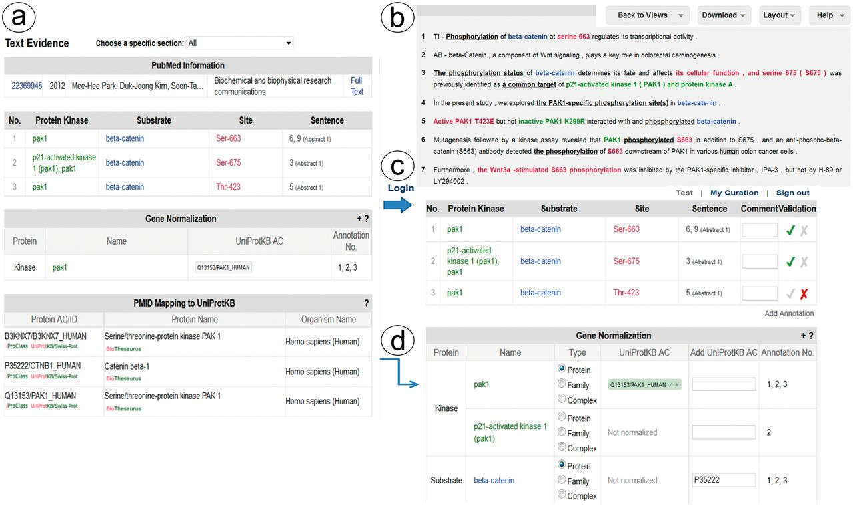
Figure 2. Snapshot of RLIMS-P text evidence page. The text evidence page contains two panels, one containing tables for ...
Notes:
Figure 2. Snapshot of RLIMS-P text evidence page. The text evidence page contains two panels, one containing tables for the article general information, the RLIMS-P annotation, the normalization and UniProtKB mapping (a); the other containing the text with color-coded entities (b). Once the user logs in, new boxes for editing and validating the annotation and normalization appear (c). The information in the mapping table can be used to assist in normalization task during curation (d).
Unless provided in the caption above, the following copyright applies to the content of this slide: © The Author(s) 2014. Published by Oxford University Press.This is an Open Access article distributed under the terms of the Creative Commons Attribution License (http://creativecommons.org/licenses/by/4.0/), which permits unrestricted reuse, distribution, and reproduction in any medium, provided the original work is properly cited.

