Slide 1
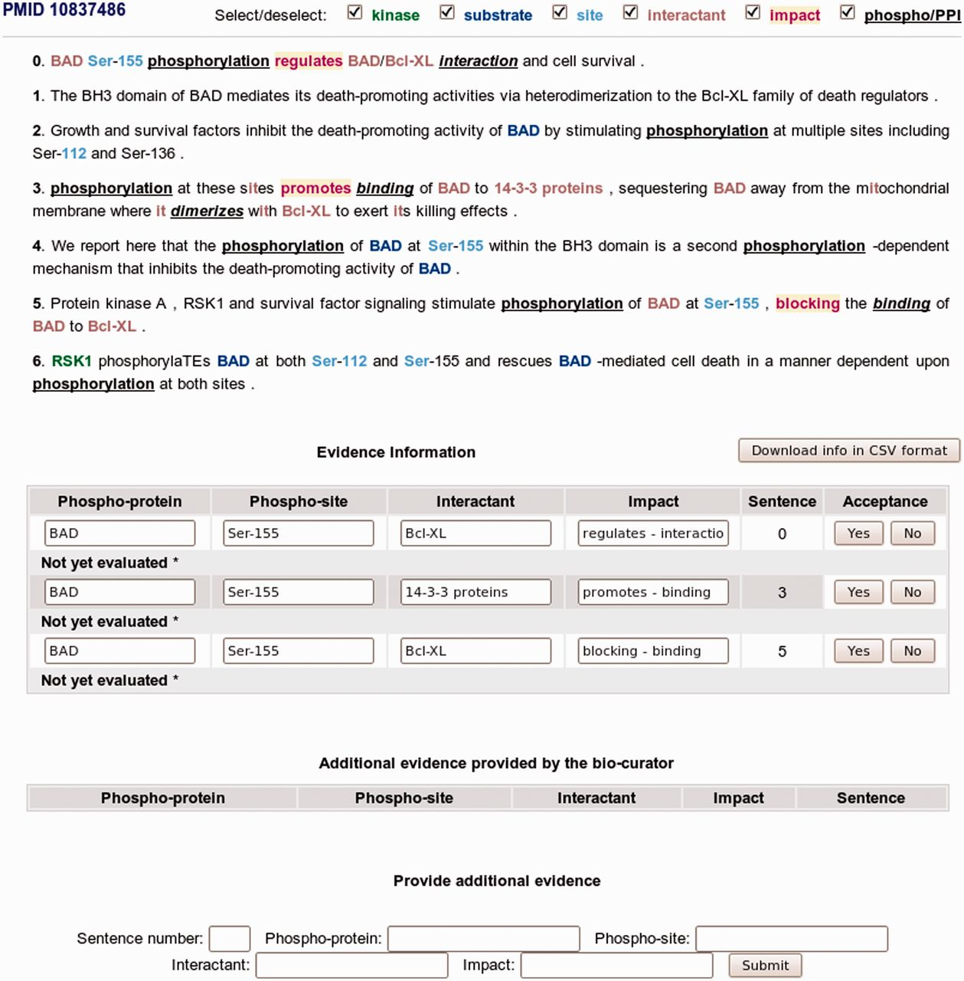
Figure 3 eFIP annotation interface with sentence evidence attribution of phosphorylated protein and interaction events ...
Notes:
Figure 3 eFIP annotation interface with sentence evidence attribution of phosphorylated protein and interaction events in PMID 10837486.
Unless provided in the caption above, the following copyright applies to the content of this slide: © The Author(s) 2012. Published by Oxford University Press.This is an Open Access article distributed under the terms of the Creative Commons Attribution License (http://creativecommons.org/licenses/by-nc/3.0/), which permits non-commercial reuse, distribution, and reproduction in any medium, provided the original work is properly cited. For commercial re-use, please contact journals.permissions@oup.com.

