Slide 1
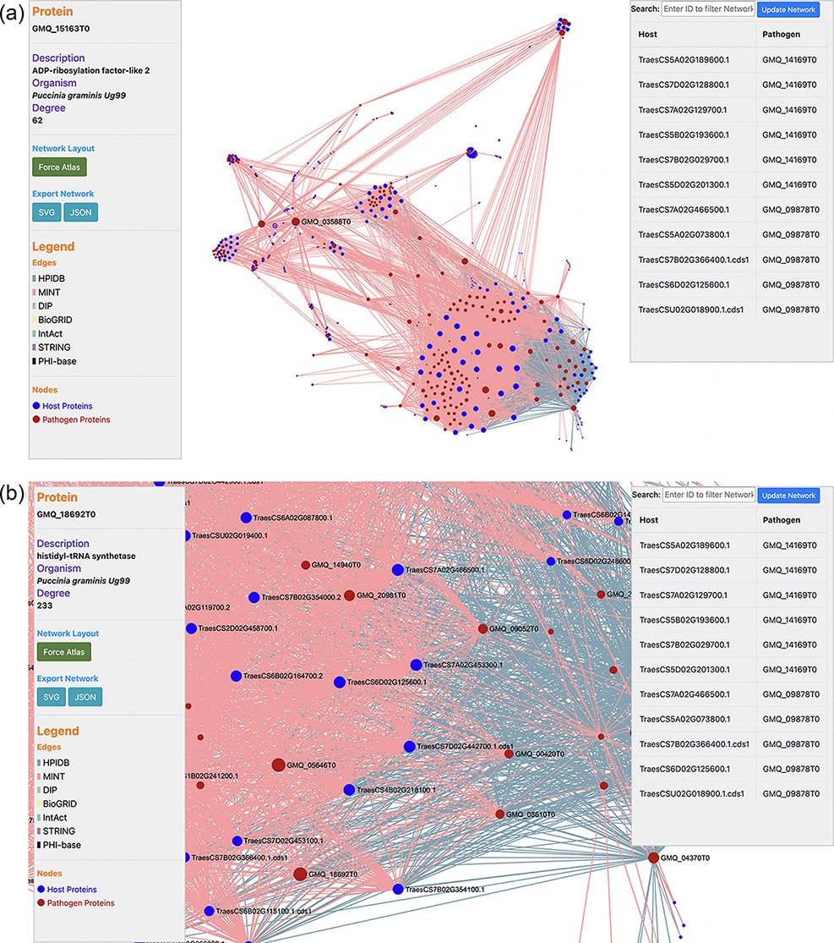
Figure 3. (a) Network visualization of the predicted interactome from the ‘Interactomics’ tool; (b) A zoomed-in version ...
Notes:
Figure 3. (a) Network visualization of the predicted interactome from the ‘Interactomics’ tool; (b) A zoomed-in version of the network to view proteins of interest. Users can click (or hover) on any node to view the description of a particular host/pathogen protein in the predicted network.
Unless provided in the caption above, the following copyright applies to the content of this slide: © The Author(s) 2022. Published by Oxford University Press.This is an Open Access article distributed under the terms of the Creative Commons Attribution License (https://creativecommons.org/licenses/by/4.0/), which permits unrestricted reuse, distribution, and reproduction in any medium, provided the original work is properly cited.

