Slide 1
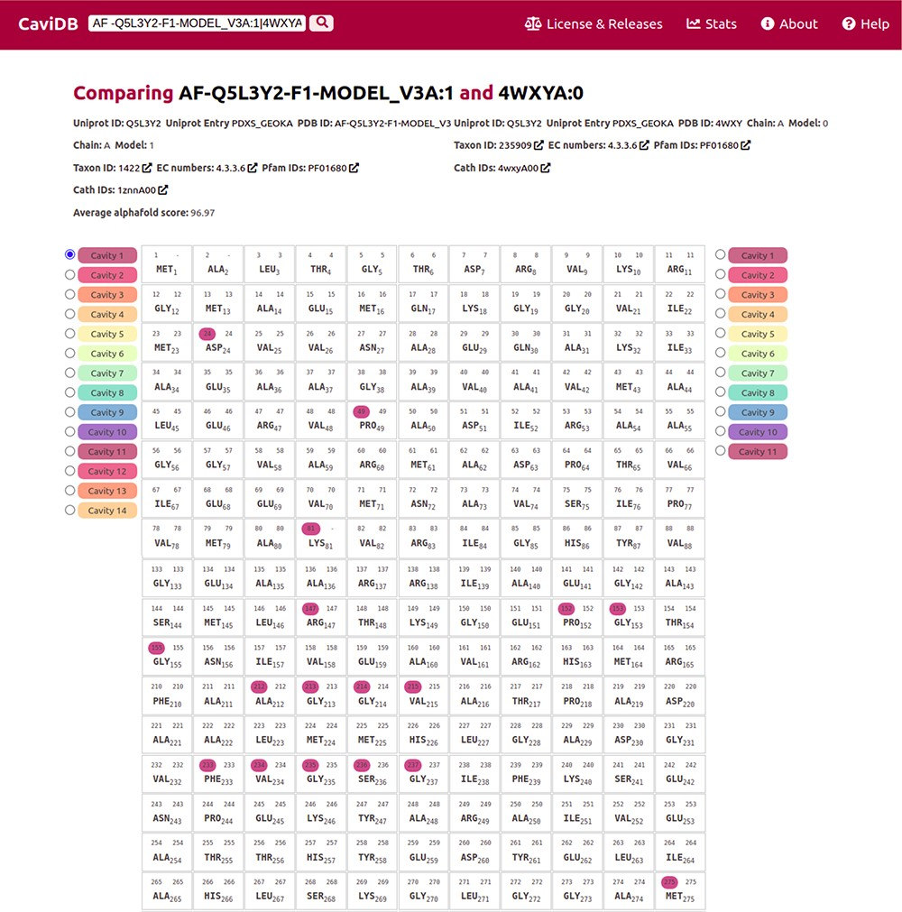
Figure 3. Comparison of the presence of cavities in PLP synthase conformers (UniProt ID Q5L3Y2). Using the expression ...
Notes:
Figure 3. Comparison of the presence of cavities in PLP synthase conformers (UniProt ID Q5L3Y2). Using the expression AF-Q5L3Y2-F1-MODEL_V3A:1|4WXYA:0 to search in CaviDB allows comparing the presence of cavities in both selected conformers. It can be seen that the AlphaFold model contains a biologically relevant cavity (Cavity 1) that contains the key residues described in the bibliography (56). This cavity is absent in other conformers due to the presence of disordered regions.
Unless provided in the caption above, the following copyright applies to the content of this slide: © The Author(s) 2023. Published by Oxford University Press.This is an Open Access article distributed under the terms of the Creative Commons Attribution License (https://creativecommons.org/licenses/by/4.0/), which permits unrestricted reuse, distribution, and reproduction in any medium, provided the original work is properly cited.

