Slide 1
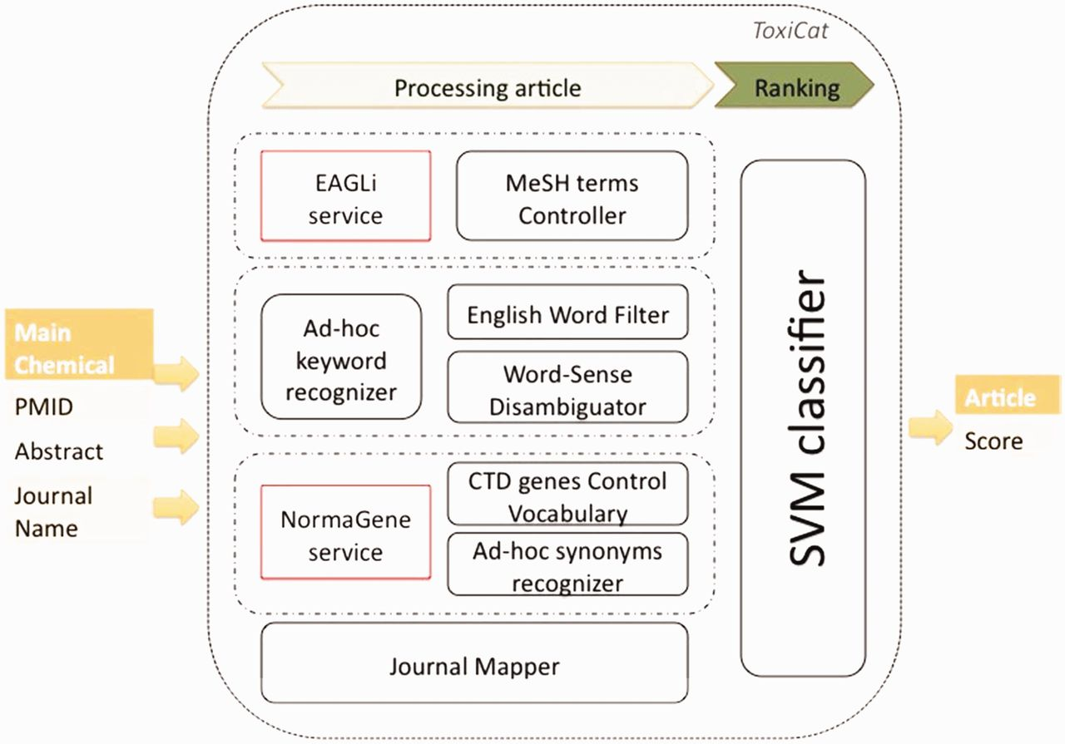
Figure 1 Workflow of ToxiCat and dependencies with existing online services.
Notes:
Figure 1 Workflow of ToxiCat and dependencies with existing online services.
Unless provided in the caption above, the following copyright applies to the content of this slide: © The Author(s) 2012. Published by Oxford University Press.This is an Open Access article distributed under the terms of the Creative Commons Attribution License (http://creativecommons.org/licenses/by-nc/3.0/), which permits non-commercial reuse, distribution, and reproduction in any medium, provided the original work is properly cited. For commercial re-use, please contact journals.permissions@oup.com.

Slide 2
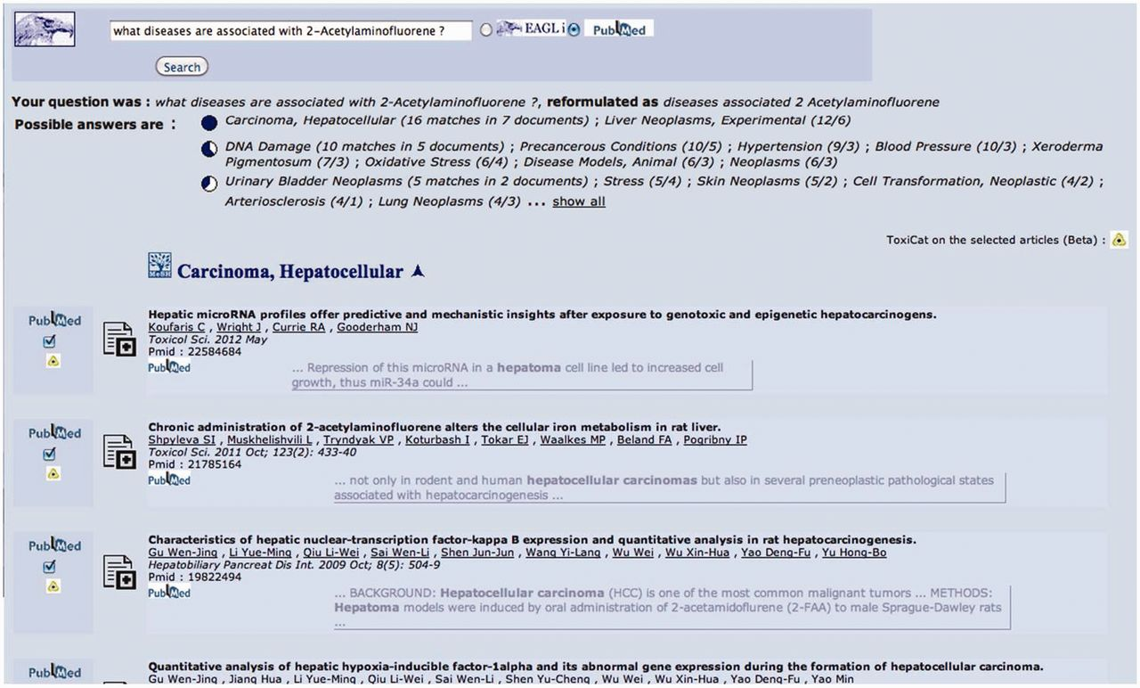
Figure 2 This is the starting point and also—if the user decides to click on the final questions generated by the ...
Notes:
Figure 2 This is the starting point and also—if the user decides to click on the final questions generated by the system, see Figure 5—the end point of the search and annotation process. Here, the user can select some PMIDs, which will be then sent to ToxiCat (Figure 3) to be prioritized (Figure 4) and finally processed to generate an annotation (Figures 4 and 5).
Unless provided in the caption above, the following copyright applies to the content of this slide: © The Author(s) 2012. Published by Oxford University Press.This is an Open Access article distributed under the terms of the Creative Commons Attribution License (http://creativecommons.org/licenses/by-nc/3.0/), which permits non-commercial reuse, distribution, and reproduction in any medium, provided the original work is properly cited. For commercial re-use, please contact journals.permissions@oup.com.

Slide 3
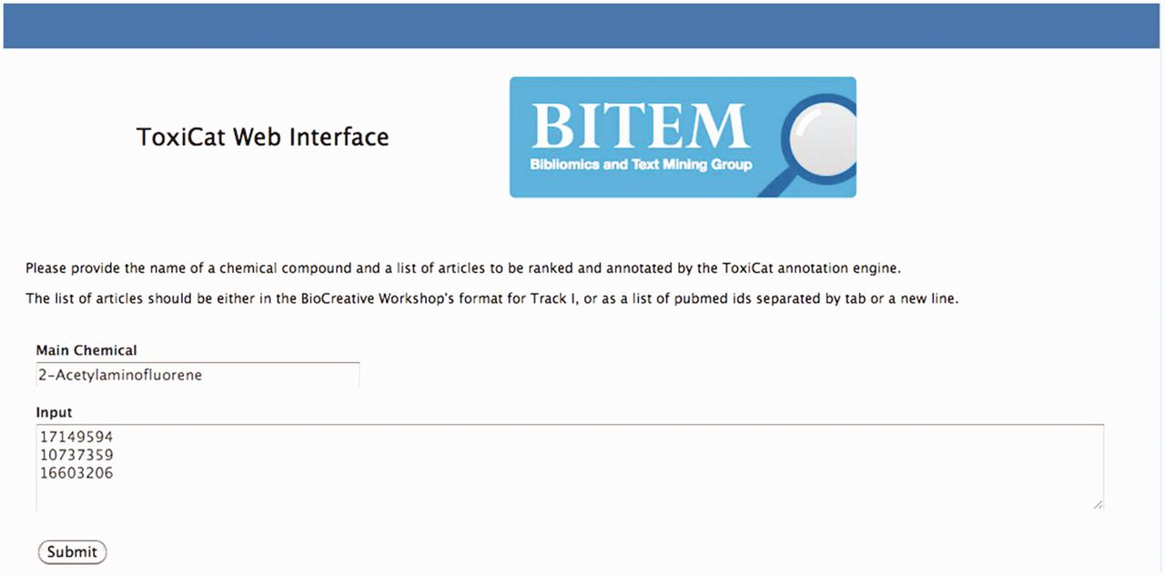
Figure 3 In this figure, 2-acetylaminofluorene is provided as input chemical compound together with a list of articles ...
Notes:
Figure 3 In this figure, 2-acetylaminofluorene is provided as input chemical compound together with a list of articles (PMIDs) selected in Figure 2. Users can go directly to this page if the PMIDs have been obtained from other sources.
Unless provided in the caption above, the following copyright applies to the content of this slide: © The Author(s) 2012. Published by Oxford University Press.This is an Open Access article distributed under the terms of the Creative Commons Attribution License (http://creativecommons.org/licenses/by-nc/3.0/), which permits non-commercial reuse, distribution, and reproduction in any medium, provided the original work is properly cited. For commercial re-use, please contact journals.permissions@oup.com.

Slide 4
Figure 4 The three selected PMIDs are ranked according to the statistical estimate (Score) computed by the SVM binary ...
Notes:
Figure 4 The three selected PMIDs are ranked according to the statistical estimate (Score) computed by the SVM binary classifier. Each information extraction module (Gene, Chemical, Disease) provides here a list of descriptors for each PMID together with some meta-data (Journal name, Title, etc.), which are used as features by the classifier.
Unless provided in the caption above, the following copyright applies to the content of this slide: © The Author(s) 2012. Published by Oxford University Press.This is an Open Access article distributed under the terms of the Creative Commons Attribution License (http://creativecommons.org/licenses/by-nc/3.0/), which permits non-commercial reuse, distribution, and reproduction in any medium, provided the original work is properly cited. For commercial re-use, please contact journals.permissions@oup.com.

Slide 5
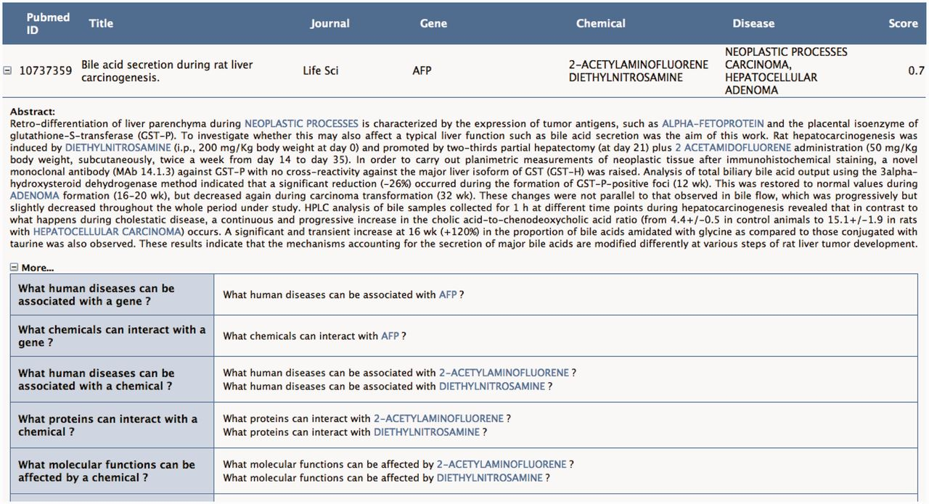
Figure 5 The user can request to visualize in the abstract the context of the annotation proposed in Figure 4. Toxicat ...
Notes:
Figure 5 The user can request to visualize in the abstract the context of the annotation proposed in Figure 4. Toxicat tags genes/proteins, chemicals and diseases in the abstract, providing a direct link to the CTD database for each of these entities. Finally, ToxiCat generates a set of questions (‘More…’) based on the entities that were earlier extracted. Optionally, the user can then return to the EAGLi’s question-answering engine to obtain more information. The user can also obtain a list of Gene Ontology descriptors proposed by the GOCat Gene Ontology categorizer (http://eagl.unige.ch/GOCat/) based on the content of the PMID, cf. last line of the table.
Unless provided in the caption above, the following copyright applies to the content of this slide: © The Author(s) 2012. Published by Oxford University Press.This is an Open Access article distributed under the terms of the Creative Commons Attribution License (http://creativecommons.org/licenses/by-nc/3.0/), which permits non-commercial reuse, distribution, and reproduction in any medium, provided the original work is properly cited. For commercial re-use, please contact journals.permissions@oup.com.

Slide 6
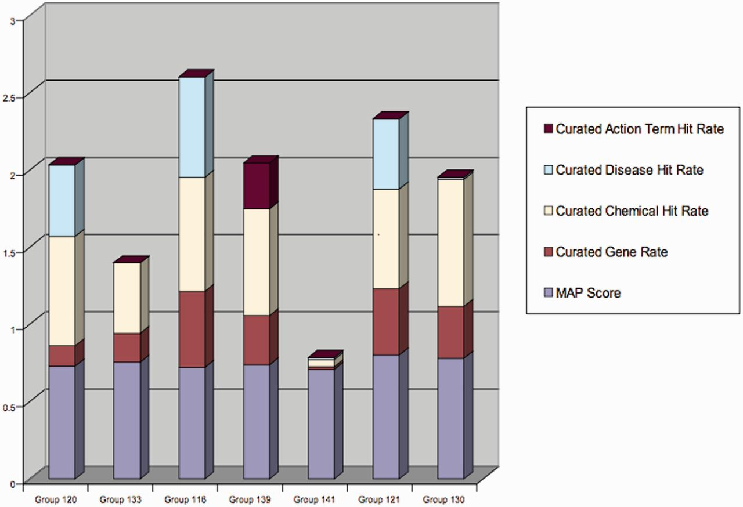
Figure 6 Aggregated scores of all participants in Track-I. ToxiCat is denoted under Team 120 (5).
Notes:
Figure 6 Aggregated scores of all participants in Track-I. ToxiCat is denoted under Team 120 (5).
Unless provided in the caption above, the following copyright applies to the content of this slide: © The Author(s) 2012. Published by Oxford University Press.This is an Open Access article distributed under the terms of the Creative Commons Attribution License (http://creativecommons.org/licenses/by-nc/3.0/), which permits non-commercial reuse, distribution, and reproduction in any medium, provided the original work is properly cited. For commercial re-use, please contact journals.permissions@oup.com.

