Slide 1
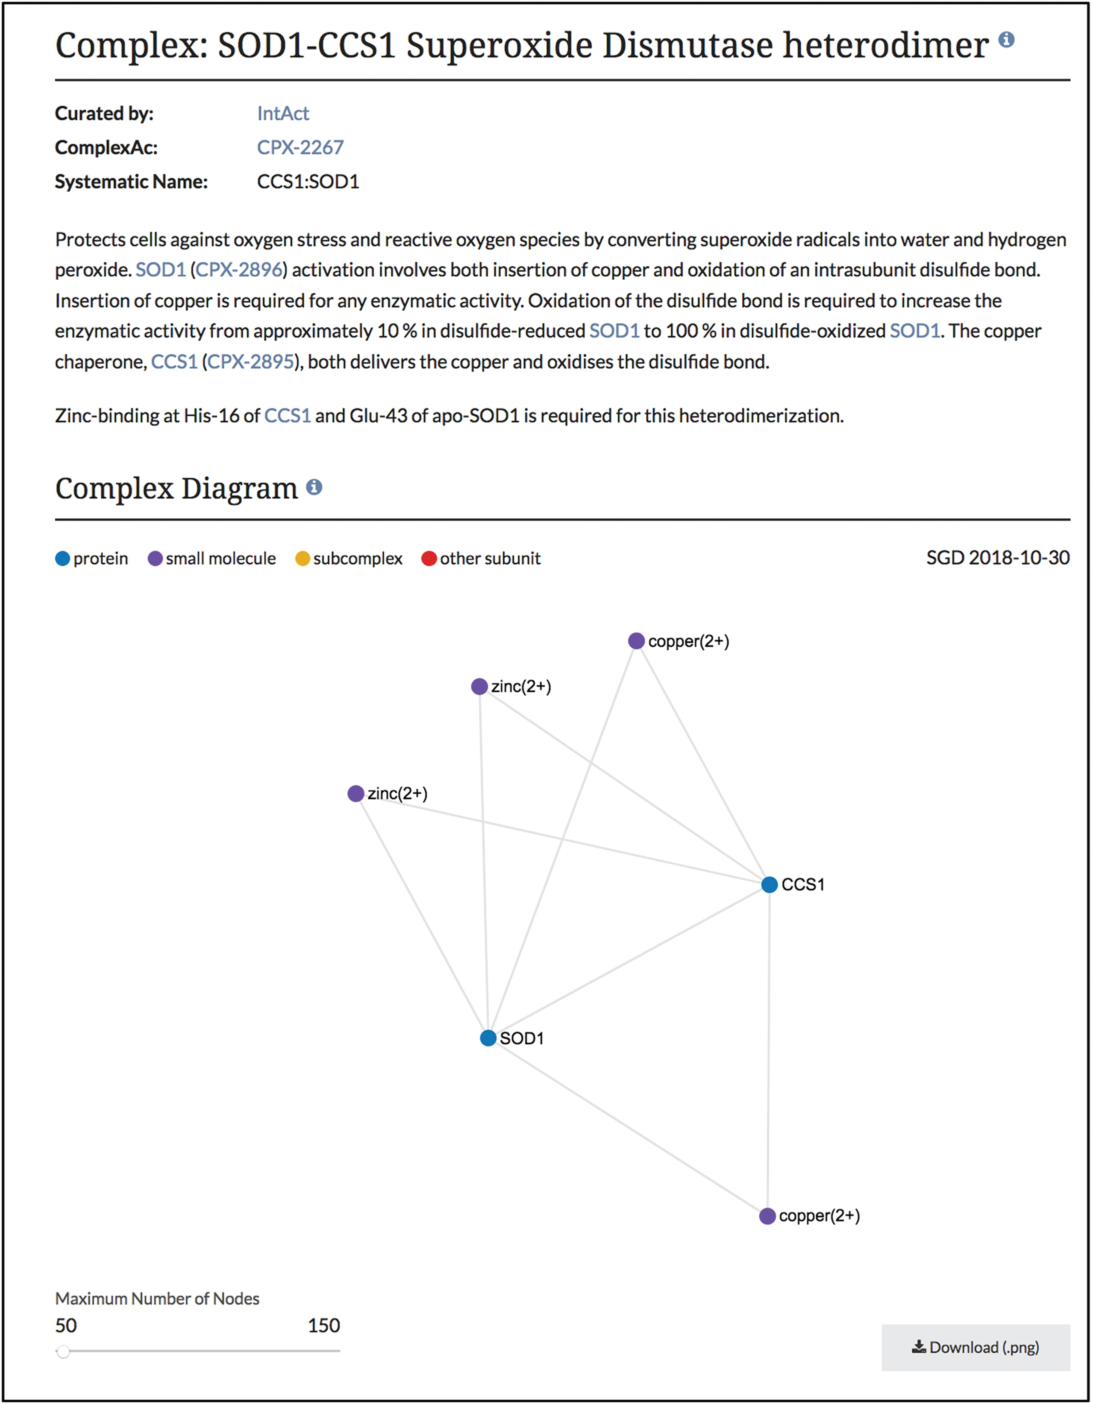
Figure 2 Summary and diagram sections of SOD1-CCS1 superoxide dismutase heterodimer page. Summary section that ...
Notes:
Figure 2 Summary and diagram sections of SOD1-CCS1 superoxide dismutase heterodimer page. Summary section that describes the function and composition of the SOD1-CCS1 superoxide dismutase complex. Individual interactions between subunits are shown in the Complex Diagram section. Complex diagrams can be downloaded as .png files. Complete page at www.yeastgenome.org/complex/CPX-2267.
Unless provided in the caption above, the following copyright applies to the content of this slide: © The Author(s) 2019. Published by Oxford University Press.This is an Open Access article distributed under the terms of the Creative Commons Attribution License (http://creativecommons.org/licenses/by/4.0/), which permits unrestricted reuse, distribution, and reproduction in any medium, provided the original work is properly cited.

