Slide 1
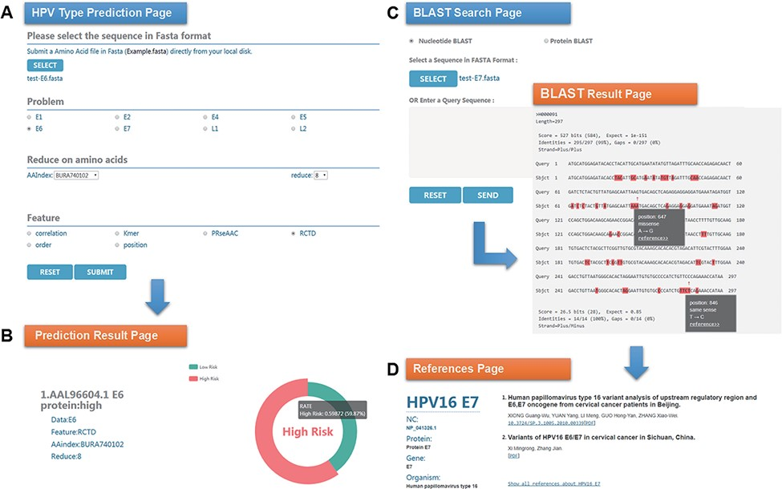
Figure 3. An example of HPVMD-C 1.0 usage: (A) Prediction page—Select optimal parameters: ‘E6’ data set, beta ...
Notes:
Figure 3. An example of HPVMD-C 1.0 usage: (A) Prediction page—Select optimal parameters: ‘E6’ data set, beta propensity characteristic index ‘BURA740102’, reduction number 8 and ‘RCTD’ feature; submit and get the result (B); (C) Blast search page and the result page—Use arrow to mark points that are different from the query sequence and highlight the mutation about this sequence in red; using mouse to slide over a mutation will pop up a detail box; references result page (D) will be displayed by clicking the references link.
Unless provided in the caption above, the following copyright applies to the content of this slide: © The Author(s) 2022. Published by Oxford University Press.This is an Open Access article distributed under the terms of the Creative Commons Attribution License (https://creativecommons.org/licenses/by/4.0/), which permits unrestricted reuse, distribution, and reproduction in any medium, provided the original work is properly cited.

