Slide 1
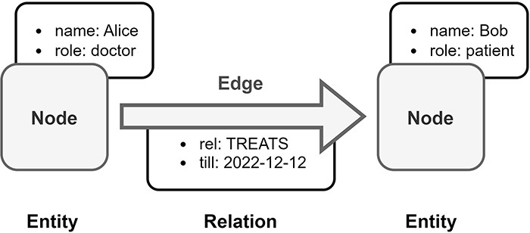
Figure 6. Overview of Labeled Property Graph (LPG). In this example, medical data is transformed into an LPG format. ...
Notes:
Figure 6. Overview of Labeled Property Graph (LPG). In this example, medical data is transformed into an LPG format. Alice is a doctor and Bob is a patient, both are represented as nodes in the LPG. The doctor–patient relationship between Alice and Bob is modeled by a directed edge in the LPG with an assigned property, which is the end date of Bob’s treatment by Alice.
Unless provided in the caption above, the following copyright applies to the content of this slide: © The Author(s) 2024. Published by Oxford University Press.This is an Open Access article distributed under the terms of the Creative Commons Attribution License (https://creativecommons.org/licenses/by/4.0/), which permits unrestricted reuse, distribution, and reproduction in any medium, provided the original work is properly cited.

