Slide 1
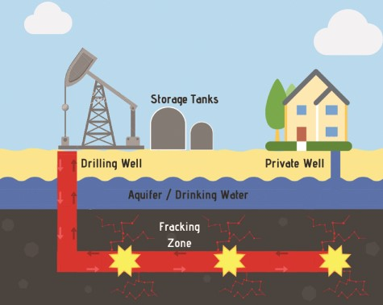
Figure 1 Schematic detailing the hydraulic fracturing process. The well is drilled vertically downward to a certain ...
Notes:
Figure 1 Schematic detailing the hydraulic fracturing process. The well is drilled vertically downward to a certain depth up to 5000 ft (reported as the well drill depth) and then horizontally radiating out by 1–2 miles (not reported by FracFocus). The fracking occurs in the horizontal space after perforating the casing and delivering proppant (sand or silica plus hydraulic fracturing fluid) to keep the fissures open releasing the oil or gas kept in the shale within the earth.
Unless provided in the caption above, the following copyright applies to the content of this slide: © The Author(s) 2020. Published by Oxford University Press.This is an Open Access article distributed under the terms of the Creative Commons Attribution License (http://creativecommons.org/licenses/by/4.0/), which permits unrestricted reuse, distribution, and reproduction in any medium, provided the original work is properly cited.

Slide 2
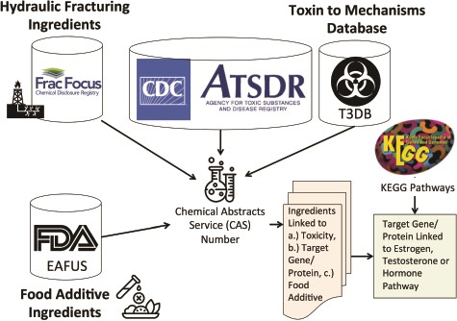
Figure 2 Method for linking hydraulic fracturing ingredients (i.e. chemicals) with information on toxicity (ATSDR), ...
Notes:
Figure 2 Method for linking hydraulic fracturing ingredients (i.e. chemicals) with information on toxicity (ATSDR), gene and protein targets (T3DB) and food additives Everything Added to Food in USA (EAFUS). We linked the hydraulic fracturing ingredients to information on toxicity, gene and protein targets for each chemical and whether or not the chemical was a food additive using their Chemical Abstracts Service (CAS) numbers. We further linked the gene/proteins to estrogen, testosterone or hormone pathways using KEGG pathways.
Unless provided in the caption above, the following copyright applies to the content of this slide: © The Author(s) 2020. Published by Oxford University Press.This is an Open Access article distributed under the terms of the Creative Commons Attribution License (http://creativecommons.org/licenses/by/4.0/), which permits unrestricted reuse, distribution, and reproduction in any medium, provided the original work is properly cited.

Slide 3
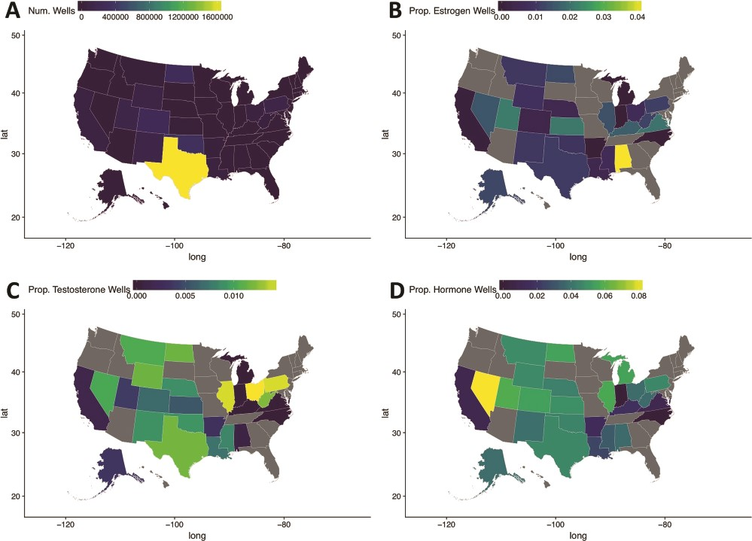
Figure 3 Maps of the United States of America detailing hydraulic fracturing well locations (A), the proportion of ...
Notes:
Figure 3 Maps of the United States of America detailing hydraulic fracturing well locations (A), the proportion of wells with estrogen pathway-targeting Ingredients (B), the proportion of wells with testosterone pathway-targeting Ingredients (C) and the proportion of wells with hormonal pathway-targeting ingredients (D). Notice that states with elevated proportions of certain estrogen, testosterone or hormonal pathway ingredients relative to other hydraulic fracturing wells can be easily identified using these visual maps.
Unless provided in the caption above, the following copyright applies to the content of this slide: © The Author(s) 2020. Published by Oxford University Press.This is an Open Access article distributed under the terms of the Creative Commons Attribution License (http://creativecommons.org/licenses/by/4.0/), which permits unrestricted reuse, distribution, and reproduction in any medium, provided the original work is properly cited.

Slide 4
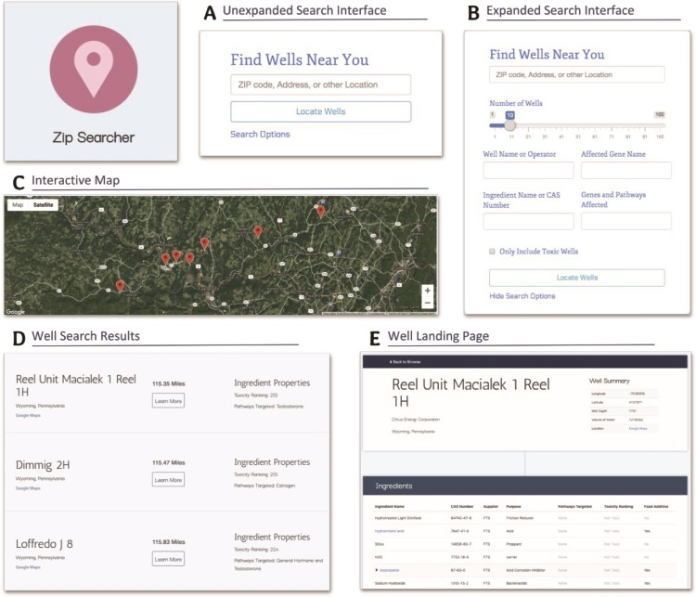
Figure 4 Screenshots from Zip Searcher and well landing pages detailing the different functionalities, fields and ...
Notes:
Figure 4 Screenshots from Zip Searcher and well landing pages detailing the different functionalities, fields and information contained on these pages. (A) The simple, collapsed search interface. (B) The more detailed, expanded search interface. (C) The interactive map displayed at the top of the results list. (D) The well search results containing the well and operator name, a summary of the well’s ingredient properties, the absolute distance from the entered location to the well, and a ‘learn more’ button. (E) The well landing page, displaying more in-depth information about the well as well as a comprehensive list of the well’s ingredients and the properties of these ingredients. We made these pages specifically with interpretability in mind—the search fields are easy to understand, and most of the information displayed is self-explanatory and does not require much background knowledge to interpret.
Unless provided in the caption above, the following copyright applies to the content of this slide: © The Author(s) 2020. Published by Oxford University Press.This is an Open Access article distributed under the terms of the Creative Commons Attribution License (http://creativecommons.org/licenses/by/4.0/), which permits unrestricted reuse, distribution, and reproduction in any medium, provided the original work is properly cited.

Slide 5
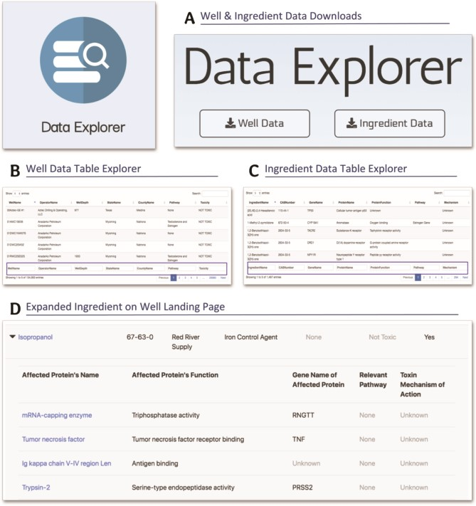
Figure 5 Screenshots from the Data Explorer and well landing pages detailing the download capabilities, data tables ...
Notes:
Figure 5 Screenshots from the Data Explorer and well landing pages detailing the download capabilities, data tables and specific, in-depth information available on these pages. (A) The data download buttons for the well and ingredient data. (B) The well data table explorer with search and sort functionality. (C) The ingredient data table explorer with search and sort functionality. (D) The expanded isopropanol ingredient on the well landing page, displaying the genes, proteins and biological pathways affected by this ingredient. We created the Data Explorer page and the expanded ingredients feature of the well landing page with a more research-purposed and knowledgeable audience in mind.
Unless provided in the caption above, the following copyright applies to the content of this slide: © The Author(s) 2020. Published by Oxford University Press.This is an Open Access article distributed under the terms of the Creative Commons Attribution License (http://creativecommons.org/licenses/by/4.0/), which permits unrestricted reuse, distribution, and reproduction in any medium, provided the original work is properly cited.

Slide 6
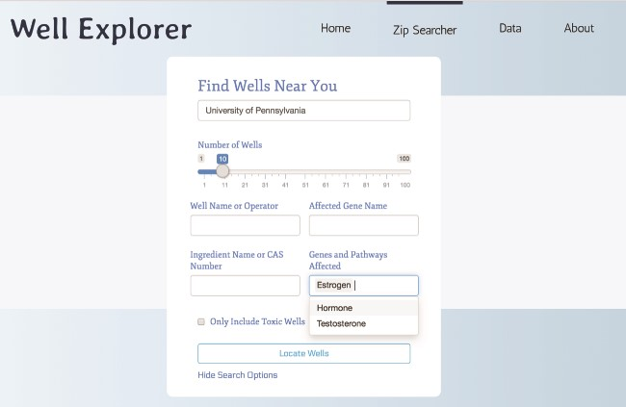
Figure 6 Searching WellExplorer for hydraulic fracturing wells using ingredients that target estrogen pathways. Note ...
Notes:
Figure 6 Searching WellExplorer for hydraulic fracturing wells using ingredients that target estrogen pathways. Note that ‘estrogen’ is selected in the ‘genes and pathways affected’ option. Clicking on ‘locate wells’ will retrieve all wells using ingredients that target estrogen pathways ranked from the closest in distance (in miles).
Unless provided in the caption above, the following copyright applies to the content of this slide: © The Author(s) 2020. Published by Oxford University Press.This is an Open Access article distributed under the terms of the Creative Commons Attribution License (http://creativecommons.org/licenses/by/4.0/), which permits unrestricted reuse, distribution, and reproduction in any medium, provided the original work is properly cited.

